Slide 1
Maths
Addition and Subtraction
Year One
Maths | Year 2 | Addition and Subtraction | Difference | Lesson 2 of 2: The Butterfly House

Slide 3
Aim
I can decide whether to find the difference between 2 numbers or take away.
Success Criteria
I can count between numbers.
I can use efficient jumps.
I can decide when to find the difference and when to take away.

Slide 4
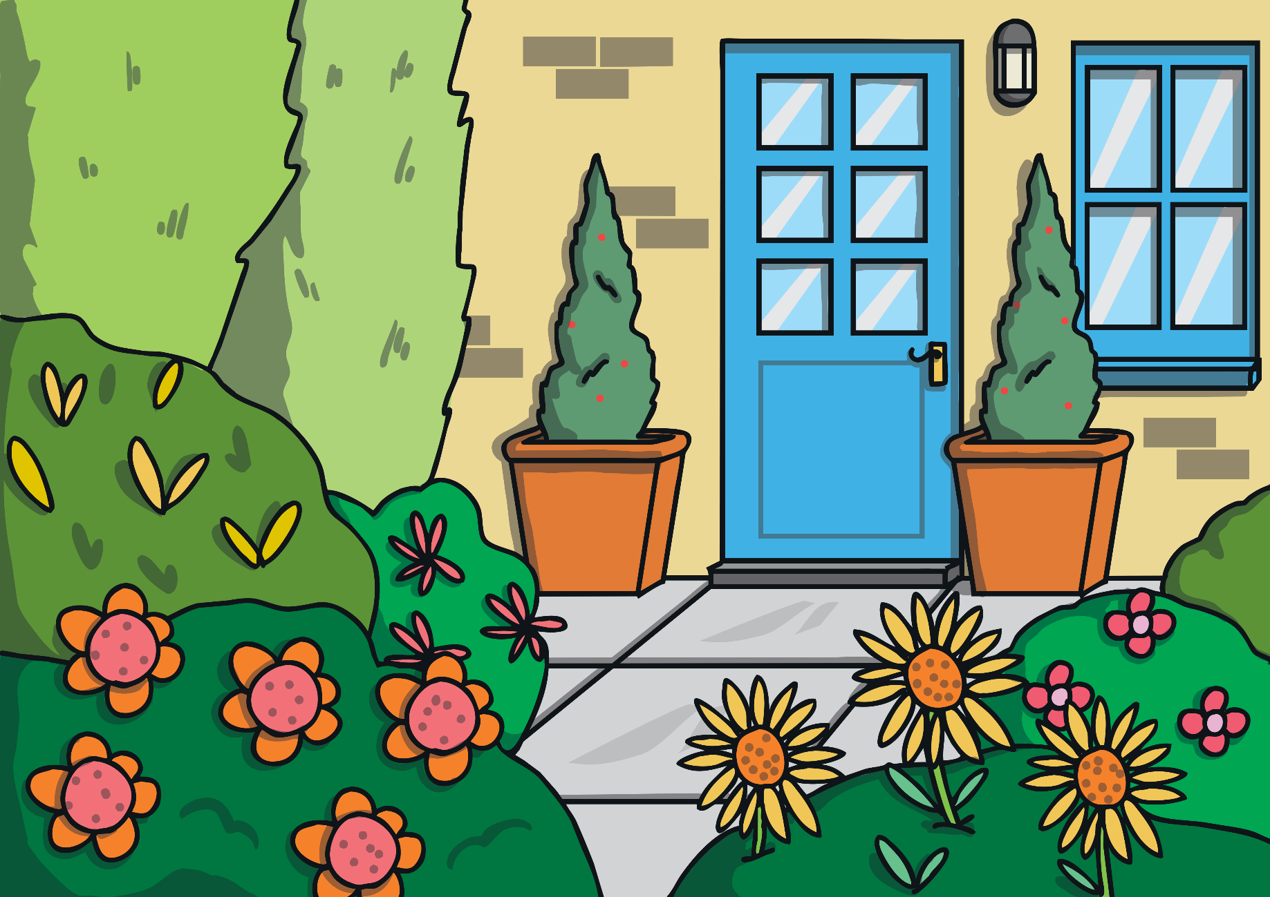
The Butterfly House
Class 2 are at the Butterfly House.
It’s very hot and there are lots of insects to see.

Slide 5
The Butterfly House
Ann counts 41 butterflies. Azim counts 36.
How many more butterflies does Anne see than Azim?
+4
+1
36
37
38
39
40
41
Ann sees 5 more.

Slide 6
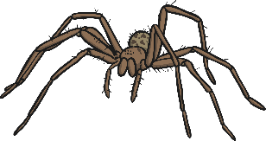
The Butterfly House
Samira counts 17 spiders. Adam counts 3.
How many more spiders does Samira see than Adam?
+7
+7
3
4
5
6
7
8
9
10
11
12
13
14
15
16
17
Is this the best way to work it out?
Can you think of a quicker way to do this?
Samira sees 14 more.

Slide 7
The Butterfly House
17 – 3 = 14
Is difference a type of subtraction?
Can we find the difference by taking away?

Slide 8
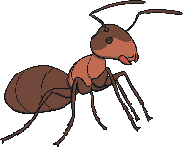
Insects Everywhere
Work with a partner to find out if ‘difference’ is the same as subtraction.
Choose 2 numbers. One of you must find the difference between the 2 numbers and the other must subtract the smallest number from the biggest number.
Do you get the same answer?
Is one method quicker than the other?
43
18
4
38
35

Slide 9
Activity
It was so hot in there. I need an ice cream!
We saw lots of insects.

Slide 10
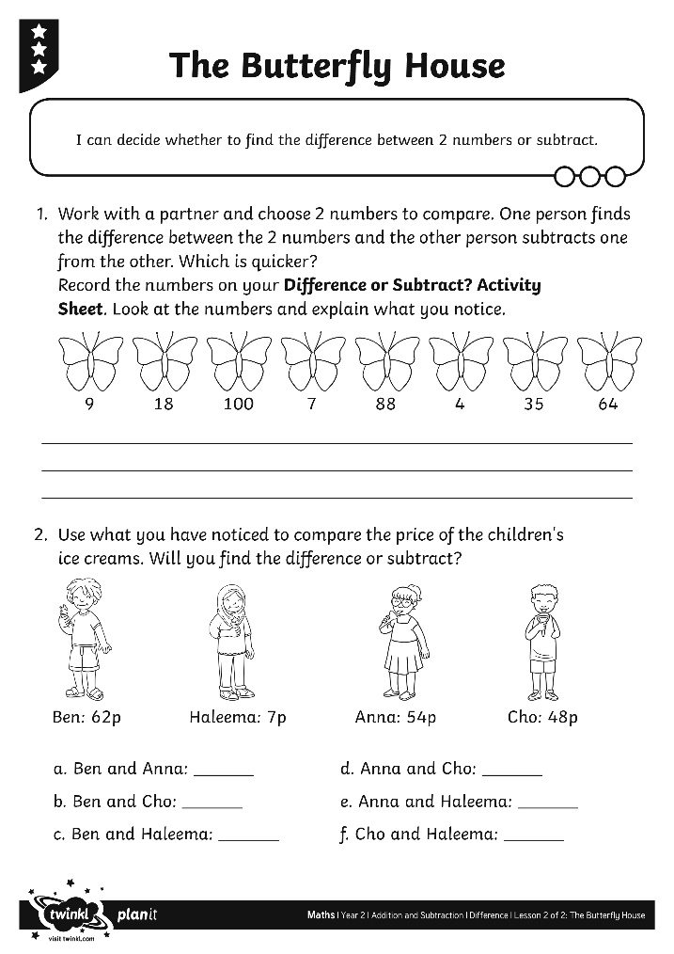
Activity

Slide 11
Thoughts
Is finding the difference a type of subtraction?
Is it sometimes quicker to find the difference than to take away?
Is it sometimes quicker to take away than to find the difference?
Can you explain why?

Slide 12
Aim
I can decide whether to find the difference between 2 numbers or take away.
Success Criteria
I can count between numbers.
I can use efficient jumps.
I can decide when to find the difference and when to take away.

