Slide 2
Diving into Mastery Guidance for Educators
Each activity sheet is split into three sections, diving, deeper and deepest, which are represented by the following icons:
These carefully designed activities take your children through a learning journey, initially ensuring they are fluent with the key concept being taught; then applying this to a range of reasoning and problem-solving activities.
These sheets might not necessarily be used in a linear way. Some children might begin at the ‘Deeper’ section and in fact, others may ‘dive straight in’ to the ‘Deepest’ section if they have already mastered the skill and are applying this to show their depth of understanding.
Diving
Deeper
Deepest

Slide 3
Aim
Read, write and convert time between analogue and digital 12- and 24-hour clocks.

Slide 4
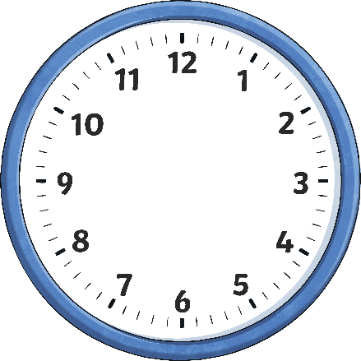
Analogue to Digital - 24-Hour
Diving
Which of the 24-hour digit times matches the time shown on the analogue clocks?
06:45
09:35
05:45
15:48
17:45
21:35
a.m.
p.m.
11:10
11:55
14:55
00:55
23:10
23:55
a.m.
p.m.

Slide 5
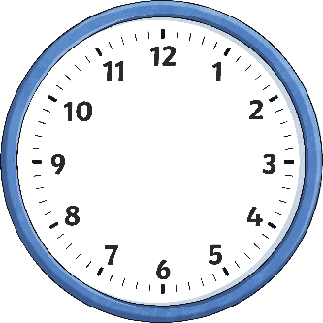
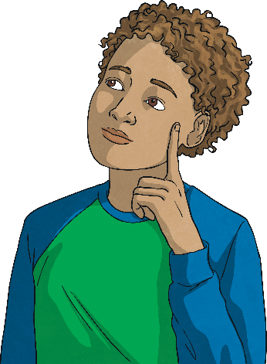
Analogue to Digital - 24-Hour
Deeper
Do you agree that Jack has ordered the times correctly? If not, correct and explain any mistakes he has made.
I have ordered these times from earliest to latest.
p.m.
03:30
15:30
p.m.
00:10
Earliest
Latest
The correct order is:
00:10, 03:30, 14:45, 15:30, 20:00
Jack didn't take into account whether the time was before noon or after noon.

Slide 6
Analogue to Digital - 24-Hour
Deepest
Parts of these clocks have been covered, including the hour and minute hands.
Give three possible 24-hour digital clock times that each analogue clock could be showing.
A
B
Various times are possible.
For example: 11:55, 09:20 or 16:50.
Various times are possible.
For example: 21:05, 04:45 or 17:20.
What is the latest time each clock could show?
= 23:59
(B) = 21:47
What is the earliest time each clock could show?
= 03:15
(B) = 00:00

Slide 7
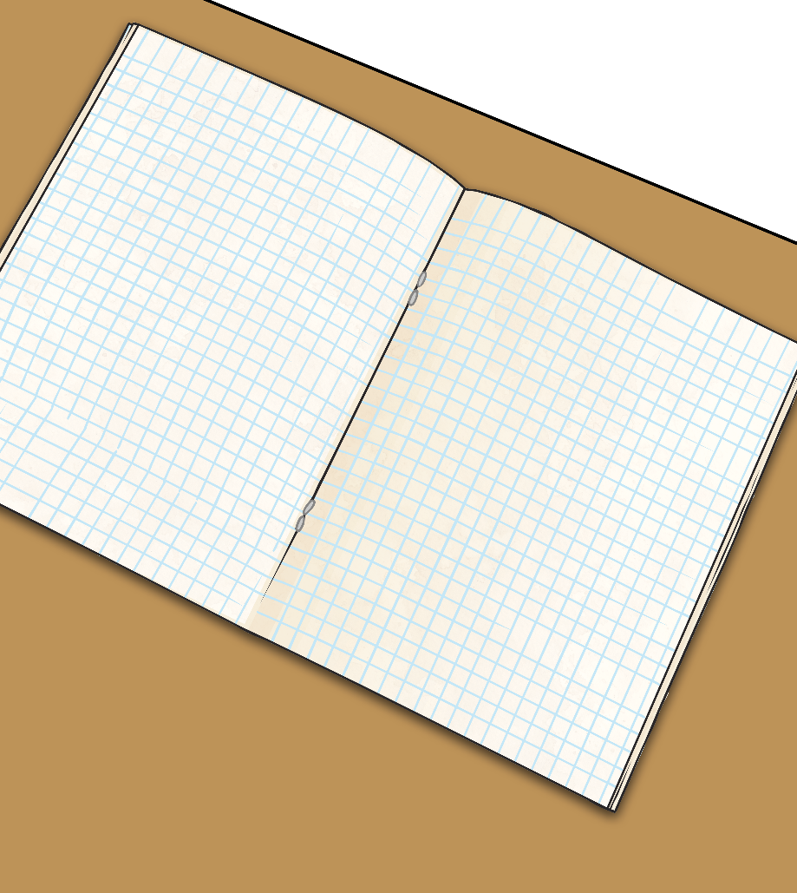
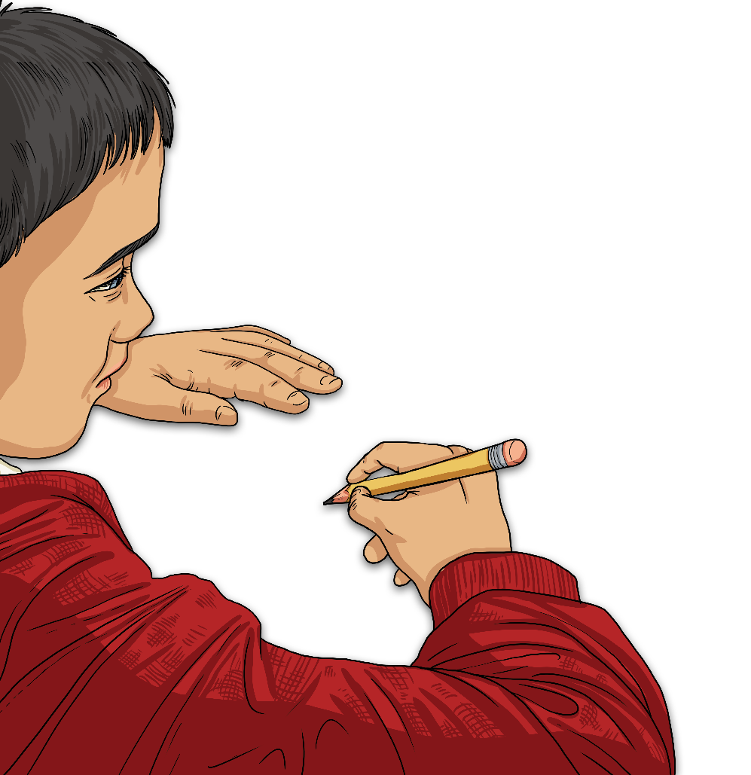
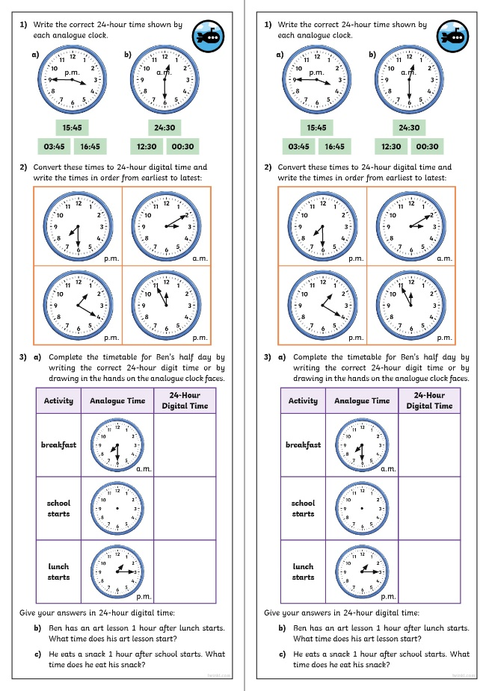
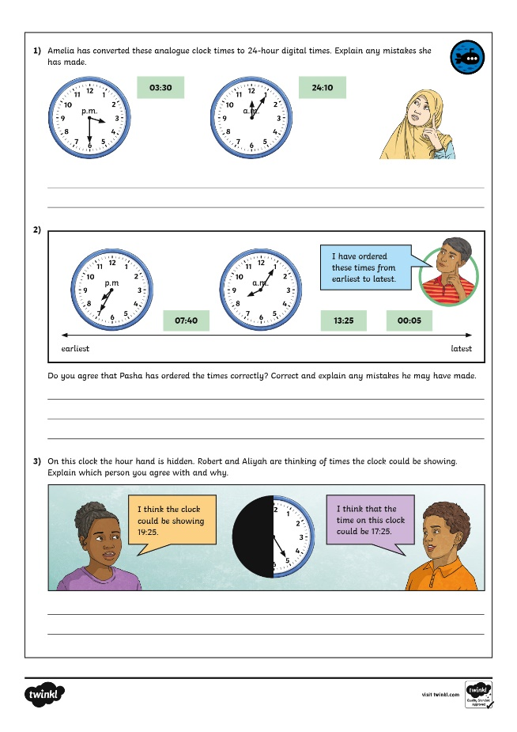
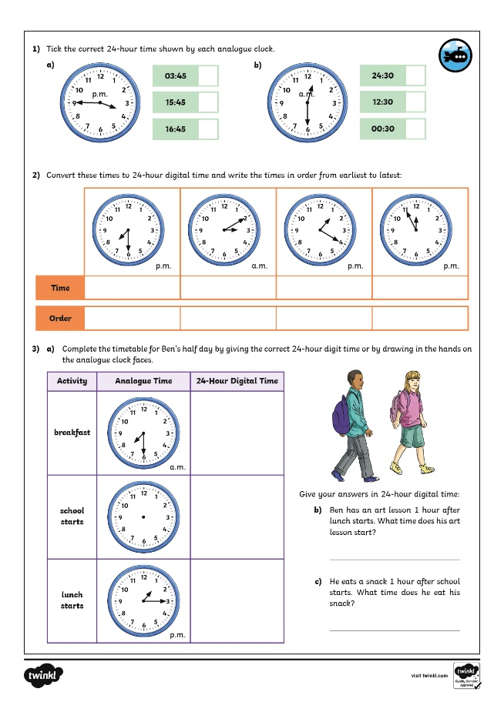
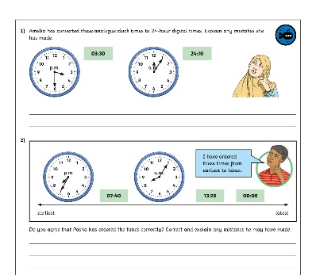
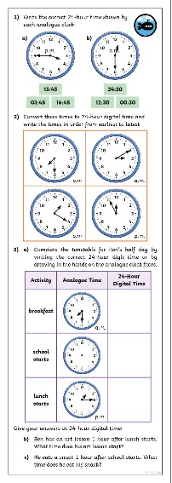
Analogue to Digital - 24-Hour
Dive in by completing your own activity!

Slide 8
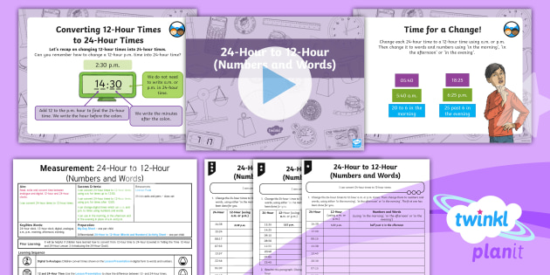
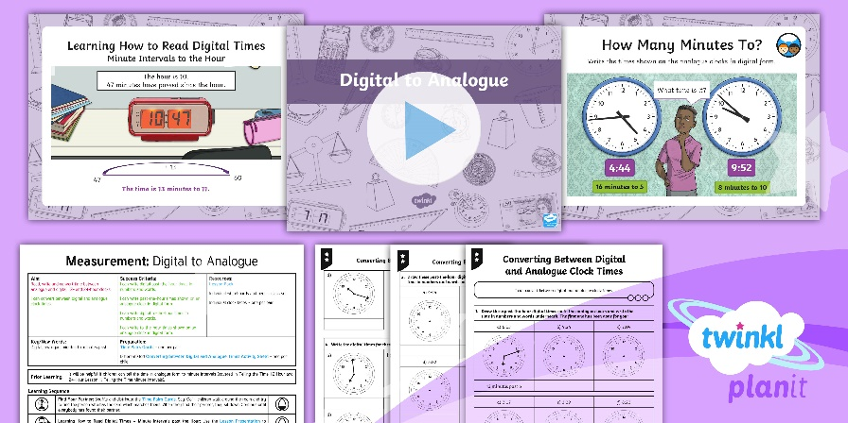
Need Planning to Complement this Resource?
National Curriculum Aim
Read, write and convert time between analogue and digital 12- and 24-hour clocks.
For more planning resources to support this aim, click here.
Twinkl PlanIt is our award-winning scheme of work with over 4000 resources.

