Slide 3
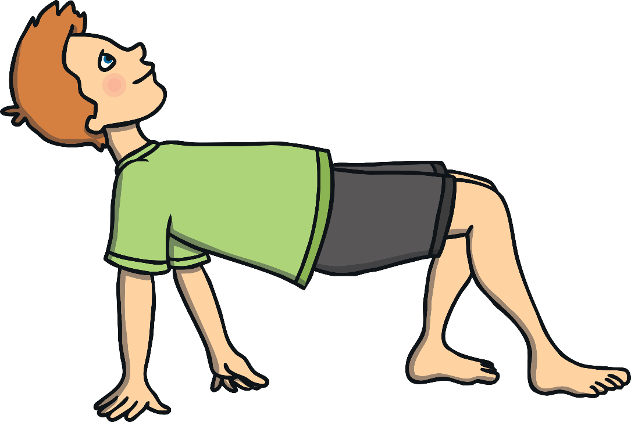
Animal Walks
Move around the space while staying 2m apart.
Listen out for the different animal movements being called out.
Can you demonstrate these animal movements?
a frog jumping
a bunny hopping
a crab walking
a monkey walking
a horse galloping
a fish swimming
an elephant stomping
a cheetah running
a butterfly flying
a duck waddling
Can you think of any of more?

Slide 4
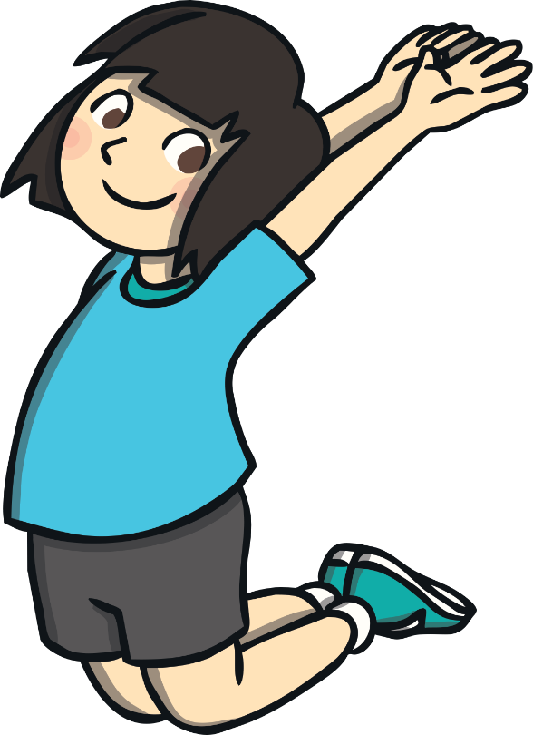
Roll-a-Movement
Stand at least 2m apart.
On the roll of a dice, travel around the space in one of the following ways:
If a one is rolled, jump.
If two is rolled, hop.
If three is rolled, skip.
If four is rolled, gallop.
If five is rolled, sidestep.
If six is rolled, choose your own way of moving.
Keep a distance of 2m apart while travelling.

Slide 5
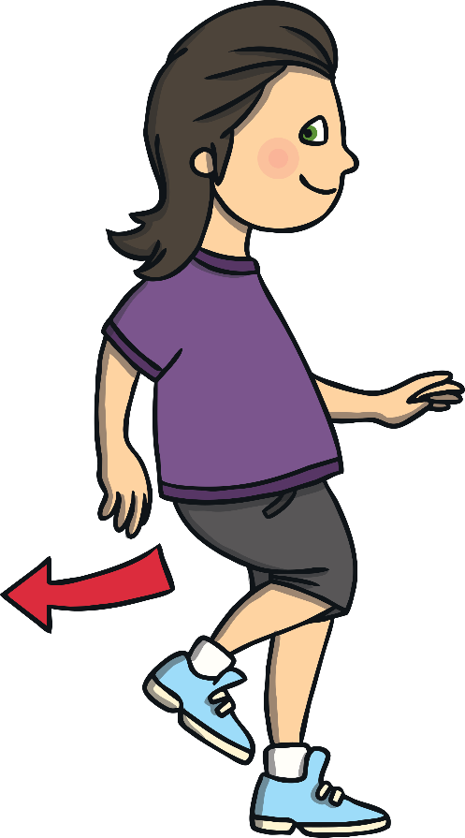
Video Game
Stand at least 2m apart.
Follow the instructions as they are called out while staying 2m apart.
After a short while, take it in turns to call out the instructions.
Video Game Instructions
Play – walk
Fast forward – run
Rewind – move backwards
Pause – freeze
Record – pull a silly face
Slow motion – move slowly

Slide 6
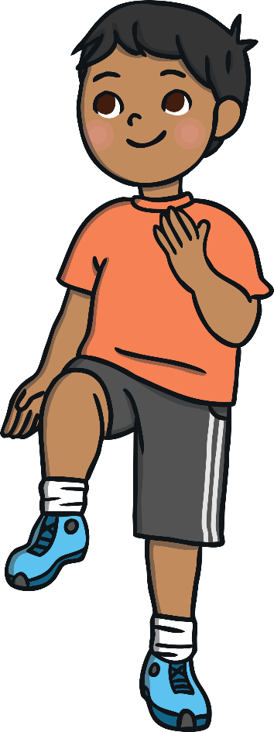
Hoop Moves
Stand in a hoop, at least 2m apart from everyone else.
Listen to the different instructions of what to do while you are inside your hoop.
Hoop Move Instructions
Jump up in the air.
Hop on one leg.
Dance your best moves.
Run on the spot.
Touch your toes.
Balance on one leg.
Do star jumps.
Squat down.
Skip on the spot.
Freeze!
Equipment: hoops

Slide 7
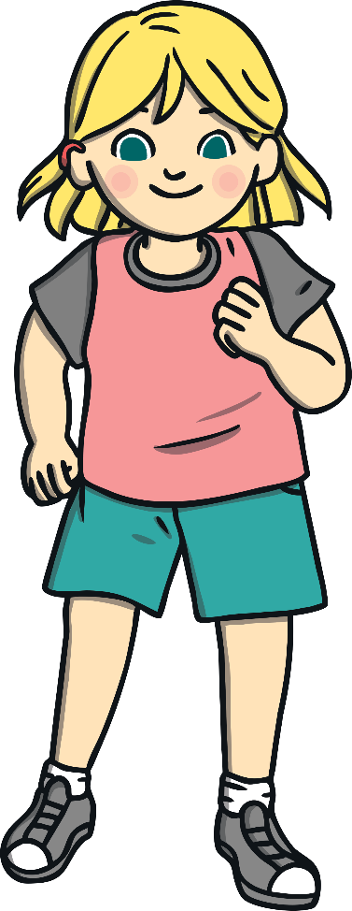
Traffic Lights
Stand at least 2m apart.
Listen out for the traffic light instruction as it is called out and move in that way around the space.
Remember to stay 2m apart.
Traffic Light Instructions
Red – stop
Amber – jog on the spot
Green – go
First gear – walk
Second gear – jog
Third gear – sprint

Slide 8
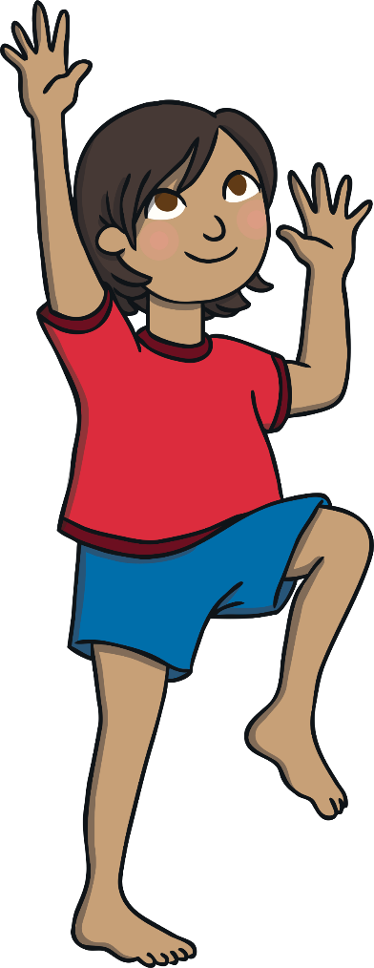
Pirate Ship
Stand at least 2m apart.
Follow the pirate command as it is called out.
Remember to stay 2m apart.
Pirate Commands
Climb the rigging! Move your arms and legs up and down as if you are climbing the rigging.
Captain’s aboard! Stand up straight and salute.
Scrub the decks! Crouch down low and pretend to scrub the floor.
Man overboard! Pretend to swim.
Dig for treasure! Pretend to dig for treasure.
Rats on board! Sit on the floor, hugging your knees into your chest.
Land ahoy! Put one hand above your eyes as if you have spotted land. Point with the other hand to show your fellow pirates.

Slide 9
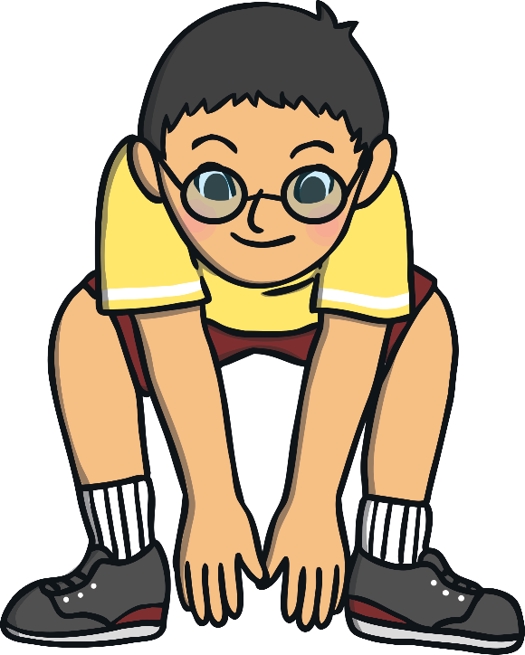
Moving Monsters
Stand at least 2m apart.
Listen for the names of the Moving Monsters and move in the appropriate way, remembering to stay 2m apart.
Can you think up any Moving Monsters of your own?
Slow Monster – Move slowly around the space.
Rush Monster – Move quickly around the space.
Bounce Monster – Jump up and down.
Muddle Monster – Walk backwards around the space (remember to look where you are going).
Small Monster – Crouch down and move low to the ground.
Strong Monster – Stand still and flex your muscles.

Slide 10
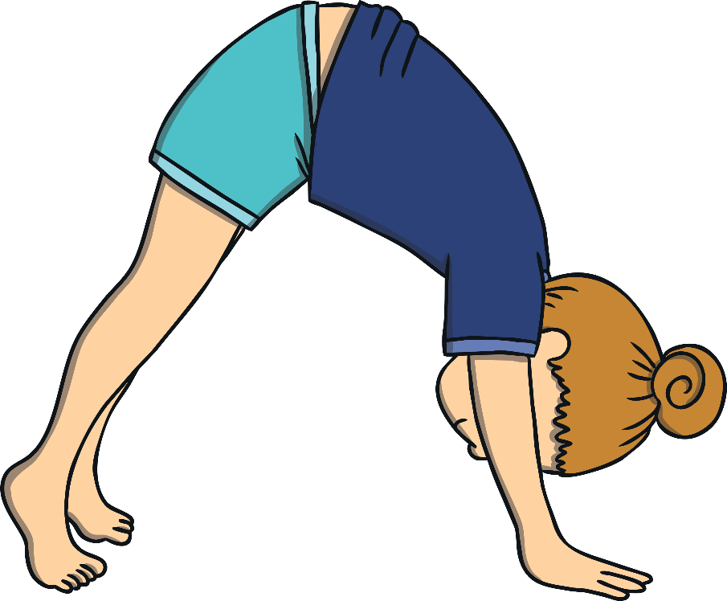
Inside Out
Stand next to a hoop, 2m apart.
Put your hands inside the hoop and keep them in the same position while moving your feet round the outside of the hoop.
Next, put your feet inside the hoop and keep them in the same position while moving your hands round the outside of the hoop.
Finally, put one foot inside the hoop and one outside it. Move the outside foot round the hoop. Try to move in a forwards direction and then backwards.
Equipment: hoops

Slide 11
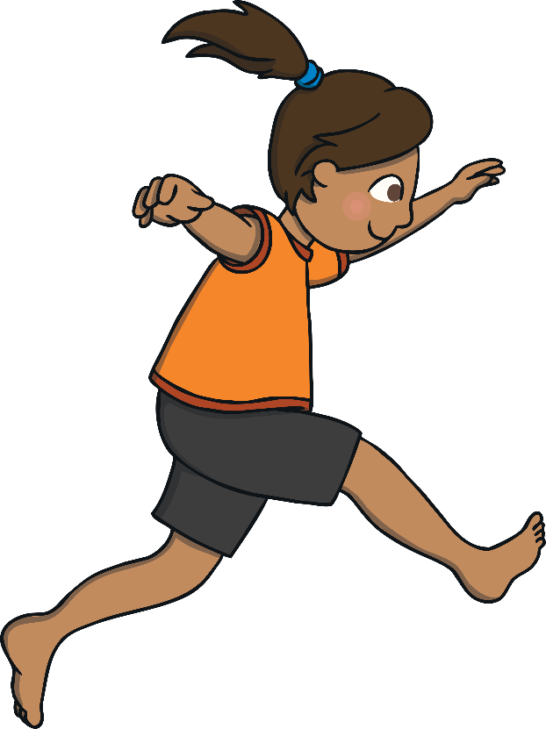
Jumping Jacks
Stand by a cone, at least 2m apart from everybody else.
Carry out the cone command as it is called out.
Cone Commands
Star jump! Jump in the air and make a star shape.
Side to side! Jump side to side over the cone.
Back and forth! Jump forwards and backwards over the cone.
Hop round! Hop round the cone.
Hop over! Hop over the cone!
Hopscotch! Jump and hop next to the cone.
Equipment: cones

Slide 12
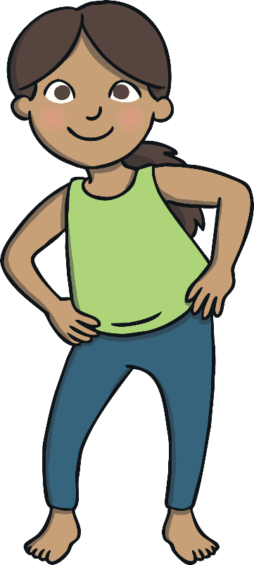
To the Beat of the Drum
Stand at least 2m apart.
Your teacher will use a percussion instrument to tap out a beat, starting fast and getting slower and slower.
Move around the space to the beat of the drum while staying 2m apart.
Alternative Version
Stand on the spot, 2m apart in a space.
Move different body parts or perform different movements to the beat of the drum, such as running on the spot or doing arm circles.
Equipment: a drum

Slide 13
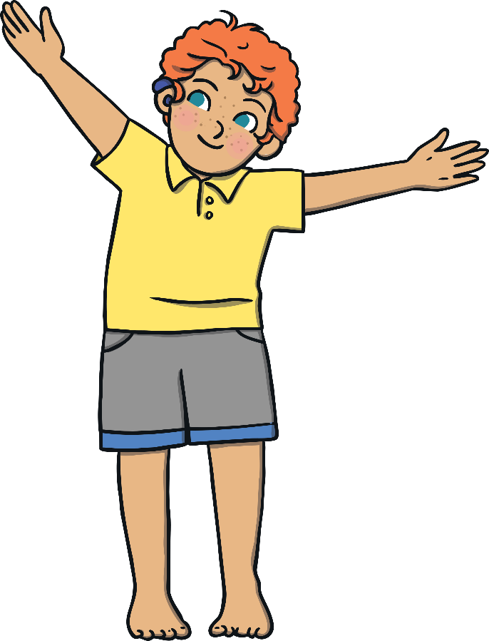
Land the Plane
Stand at least 2m apart.
You are about to go on a flight!
Listen to the aeroplane instructions being called and perform the actions.
Remember to stay 2m apart.
Aeroplane Instructions
Take off! Walk with your arms stretched out to the side.
Cruise! Jog around the space.
Turbulence! Perform little jumps up and down.
Descend! Slow down your movements to a walk.
Land! Sit on the floor, arms still out.
Stop! Place your arms by your side.

Slide 14
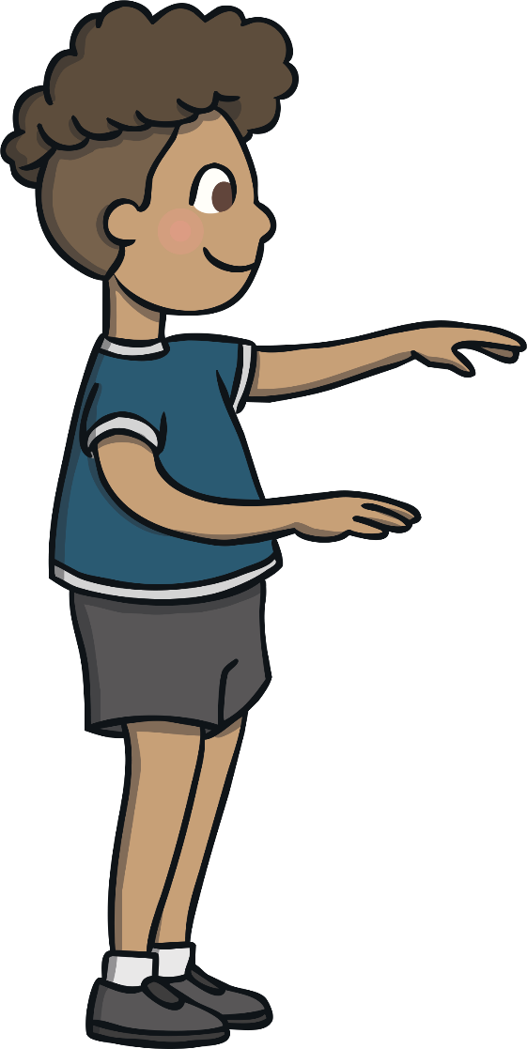
Statues
Move around the space using different movements while remaining 2m apart.
When a spell is cast, you will slowly begin to turn to stone.
Your movements should get slower and heavier until you come to a complete stop and are frozen like a statue.

Slide 15
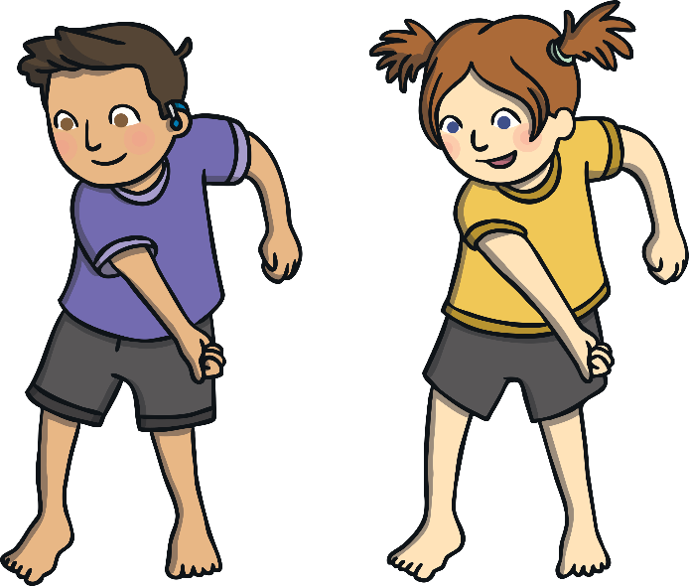
Copycat Dance
This is a paired activity.
Each of you will stand in your own hoop opposite a partner at least 2m apart.
One will start as the dance instructor and will perform a selection of dance moves.
Your partner will copy the dance moves.
The dance instructor should try to use a variety of body parts and movements in their dances.
After a few minutes, you will swap over roles.
Alternative Version
Perform this as a group all together, with one person chosen as the dance instructor and the rest copying.
Equipment: hoops or cones

Slide 16
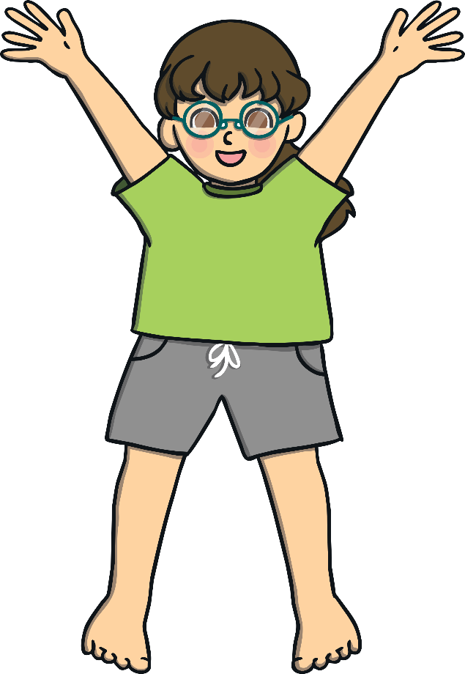
Simon Says
Stand at least 2m apart.
One of you will be chosen to be ‘Simon’.
‘Simon’ will say and perform a movement or action, such as, “Simon says do arm circles,” or “Simon says do star jumps.”
All other players must copy the movement.
You should not copy the action if the leader does not say, “Simon says…” before the action. If you do, you will perform a forfeit (such as five star jumps).
Different people will take on the role of ‘Simon’ throughout the game.

Slide 17
Fitness Circuit
Teacher
Lay out as many cones as the number of children in the group, e.g. 15 cones for 15 children. Make sure they are at least 2m apart and laid out in a easy to follow circuit.
Choose a cone of your own to stand by.
When you hear an exercise from the list being called out, you will spend 15 seconds doing that exercise.
After 15 seconds, walk to the next cone and carry out the next exercise that is called out.
Exercises
Star jumps
Running on the spot
Lunges
Punches
Marching on the spot
Squats
Front Kicks
Running and punching
Mountain climbers
Climb the rope
Frog jumps
Freestyle dancing
Knee lifts
Touch alternate toes
Own choice

Slide 18
Jump It!
Stand at least 2m apart.
Listen out for the different instructions as they are called out. Remember to stay at least 2m apart at all times.
Can you think up any actions of your own?
Instructions
Kick it! Carefully, kick out in front of you.
Twist it! Twist the top half of your body at the waist halfway round and then back again, keeping your feet in the same place on the floor. Then repeat, twisting to the other side.
Spin it! Turn round in a circle.
Pull it! Imagine you are pulling two levers down from above your head.
Jump it! Jump as high as you can in the air.

Slide 19
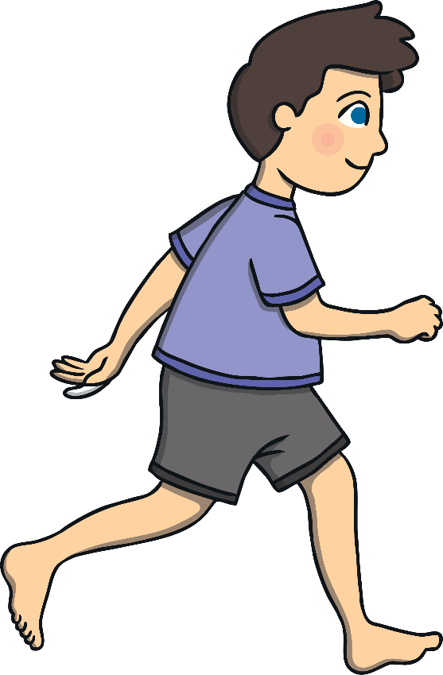
Making Shapes
While staying 2m apart, move slowly around the space and listen out for the names of different shapes.
When you hear a shape, jog around the space, tracing a path of that shape. For example, for a square, jog around an imaginary square-shaped path.
Remember to stay 2m apart while following your own pathway.

Slide 20
Bean Game
Move slowly around the space and listen out for some different ‘bean commands’.
Remain 2m apart at all times.
Bean Commands
Jumping bean – Jump on the spot.
Runner bean – Run on the spot.
Broad bean – Stretch your arms and legs out as wide as you can.
Baked bean – Lay on the floor in a star shape.
Jelly bean – Wobble like a jelly.
Chilli bean – Shiver and shake as if you are cold.
Frozen bean – Stand still.
String bean – Stand on your tiptoes and make yourself as tall and thin as possible.
Kidney bean – Touch your toes.

Slide 21
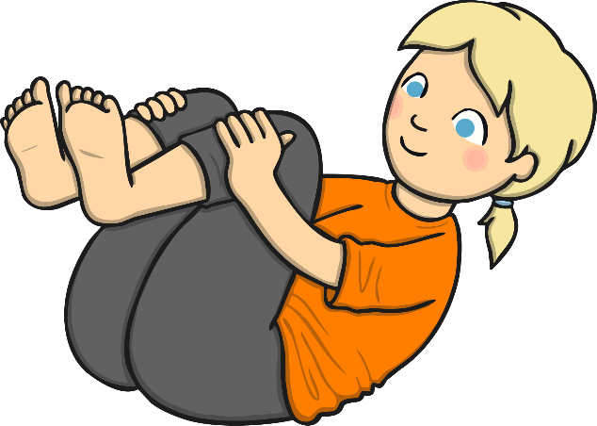
Washing Machine
Stand at least 2m apart.
Begin to move slowly around the space, listening out for the washing machine command.
Remember to stay 2m apart.
Washing Machine Commands
Trousers – Stand up straight and as tall as you can.
Dress – Stand still in a wide stance.
Socks – Curl up in a ball.
Washing machine – Turn round on the spot.
Washing line – Flap about as if drying on the line in the breeze.

Slide 22
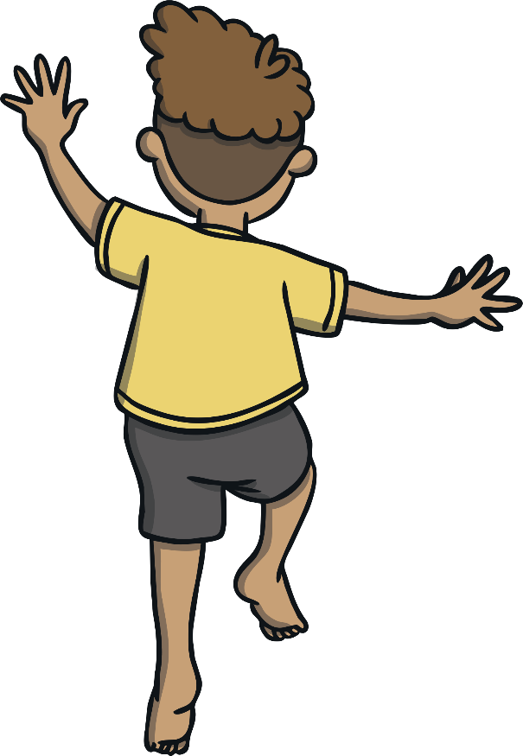
Wacky Walks
Stand at least 2m apart.
When instructed you will walk around the space in a wacky walk!
Listen out for different ways of walking and remember to stay 2m apart.
Wacky Walks
Walk with big strides.
Walk with tiny steps.
Walk backwards – take care!
Walk sideways.
Pretend you are walking through heavy mud.
Imagine you are walking over hot coals.
Walk slowly and wrap your arms round your body to give yourself a hug.
Walk and flap your arms like a chicken!

