Slide 2
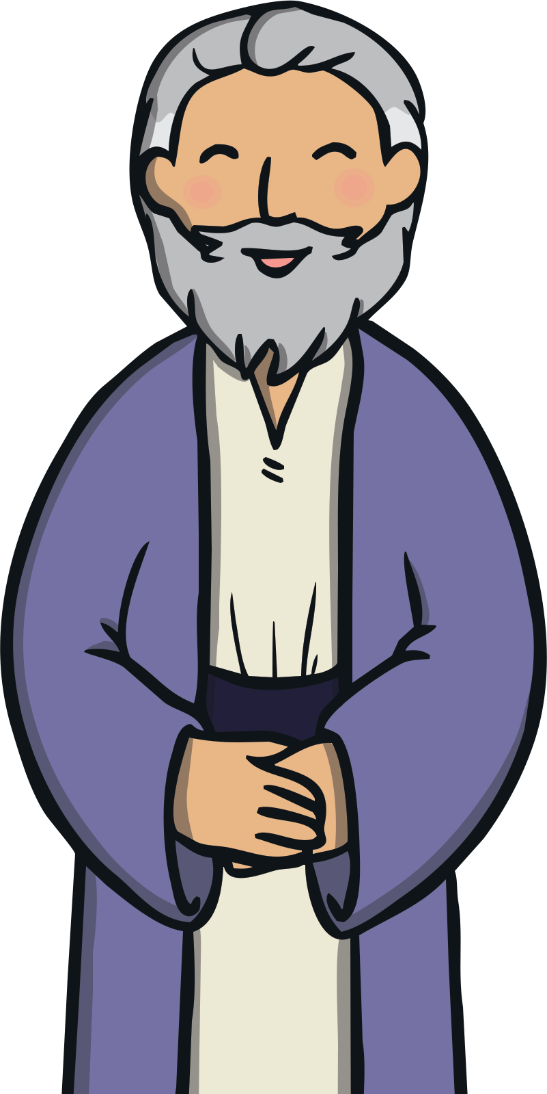
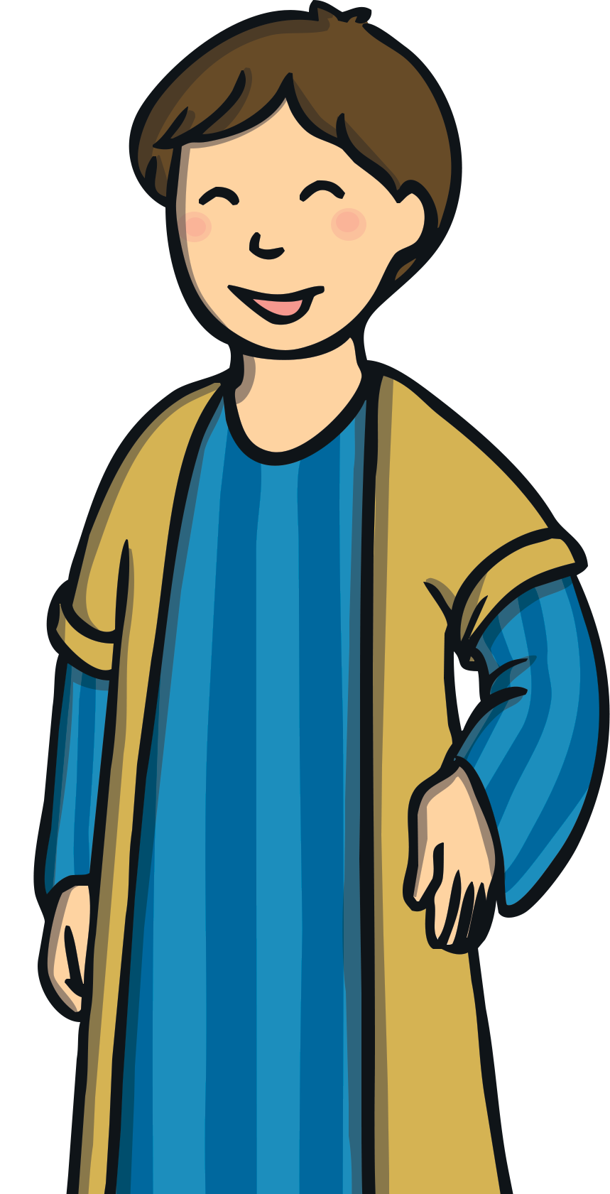
There was once a man who had two sons.

Slide 3
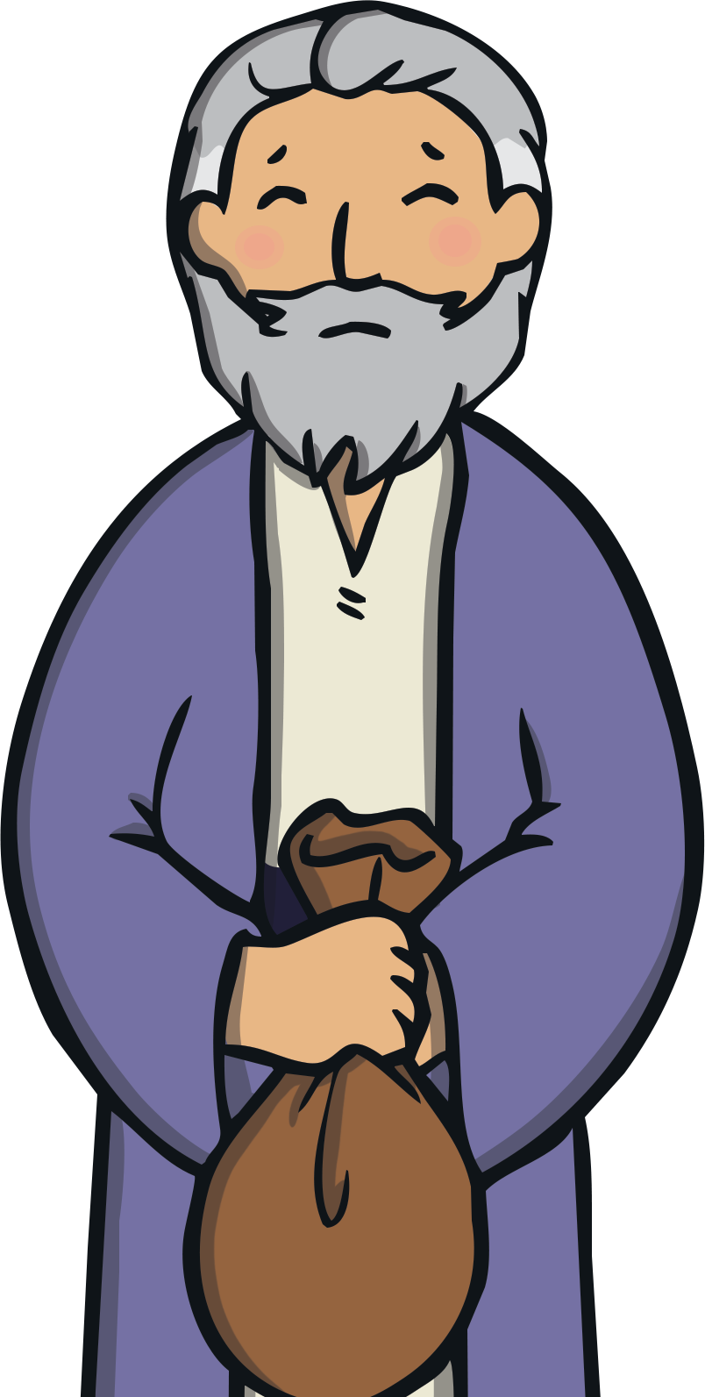
One day, the youngest son asked his father for his inheritance money.

Slide 4
The father thought about it and divided what he owned between them, giving his sons their inheritance.

Slide 5
The youngest son moved far away and very soon spent all of his money.

Slide 6
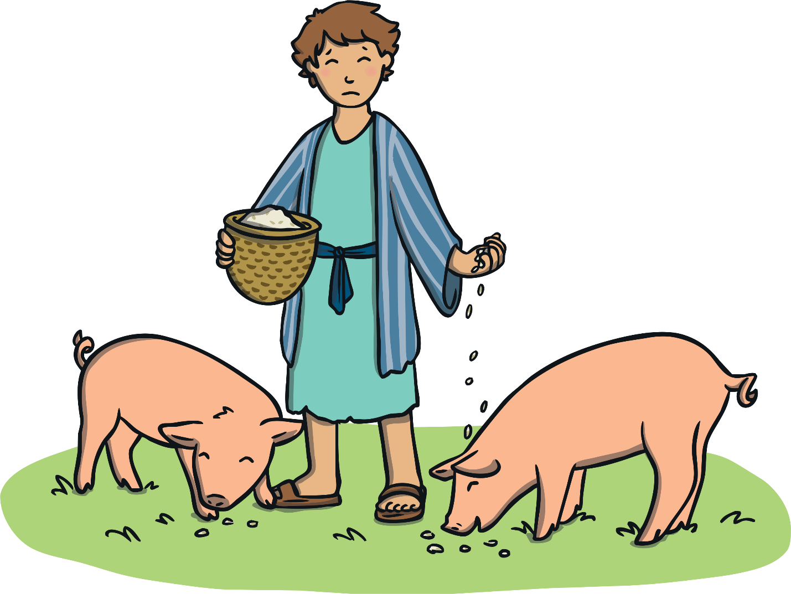
He was very hungry and had no place to live, so he decided to get a job. He was given a job feeding pigs but no-one gave him anything to eat.

Slide 7
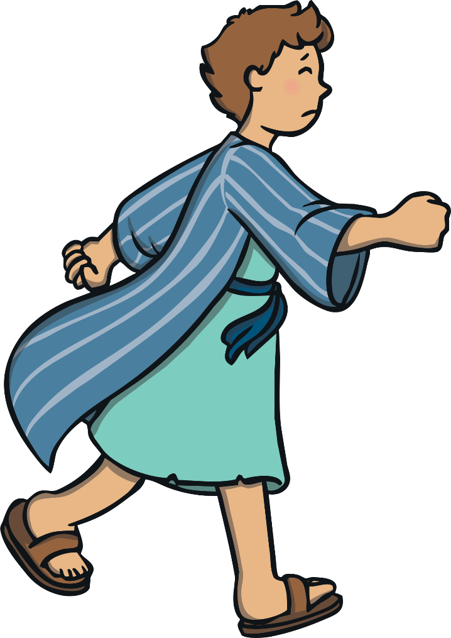
The son was very sad and very sorry for what he had done. Back home, even his father’s hired men were fed well. He decided to go back home, say sorry and ask his father for a job as a servant.

Slide 8
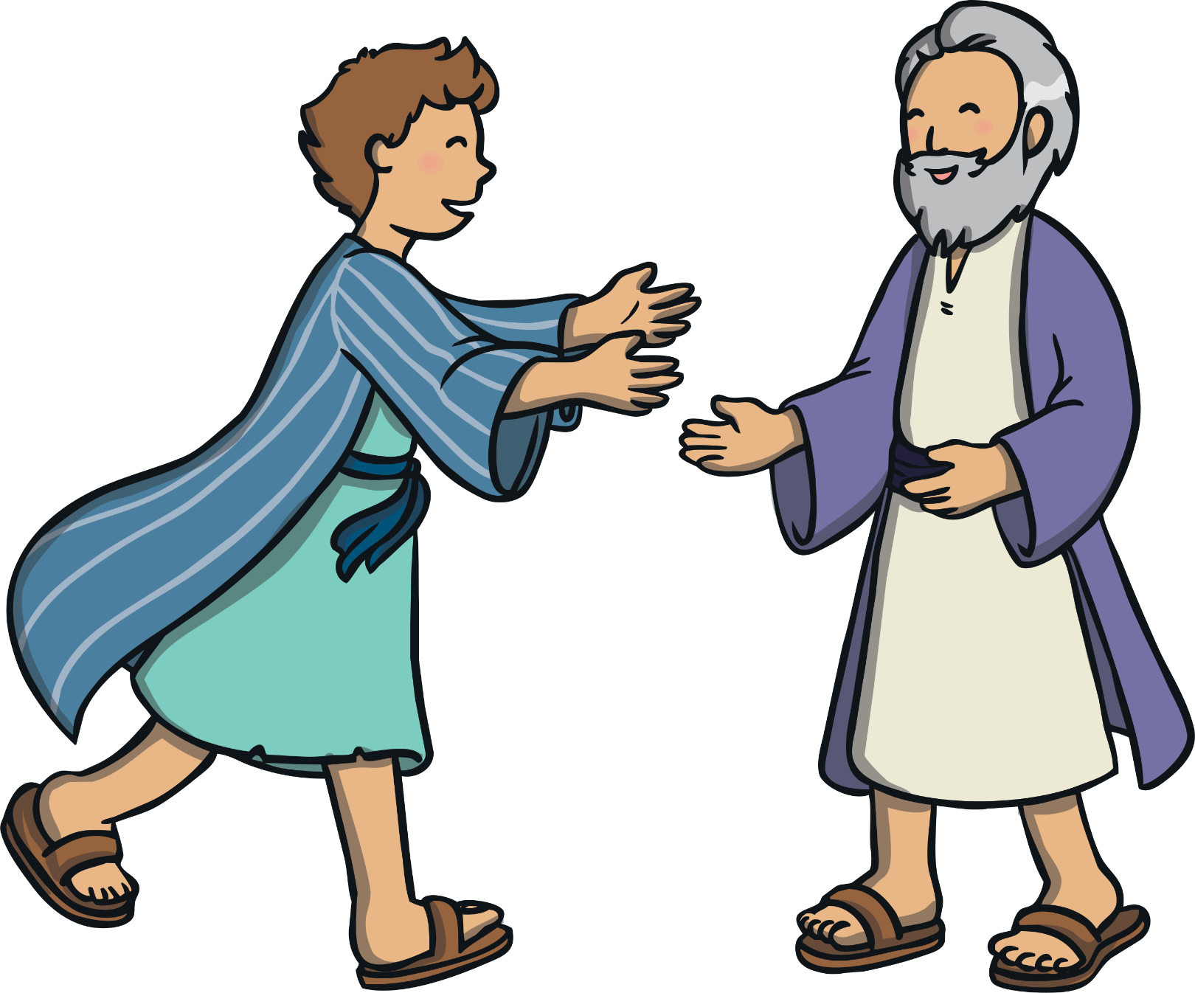
When the father saw his youngest son returning, he was filled with great joy and ran to greet his returning son. He hugged and kissed the boy.

Slide 9
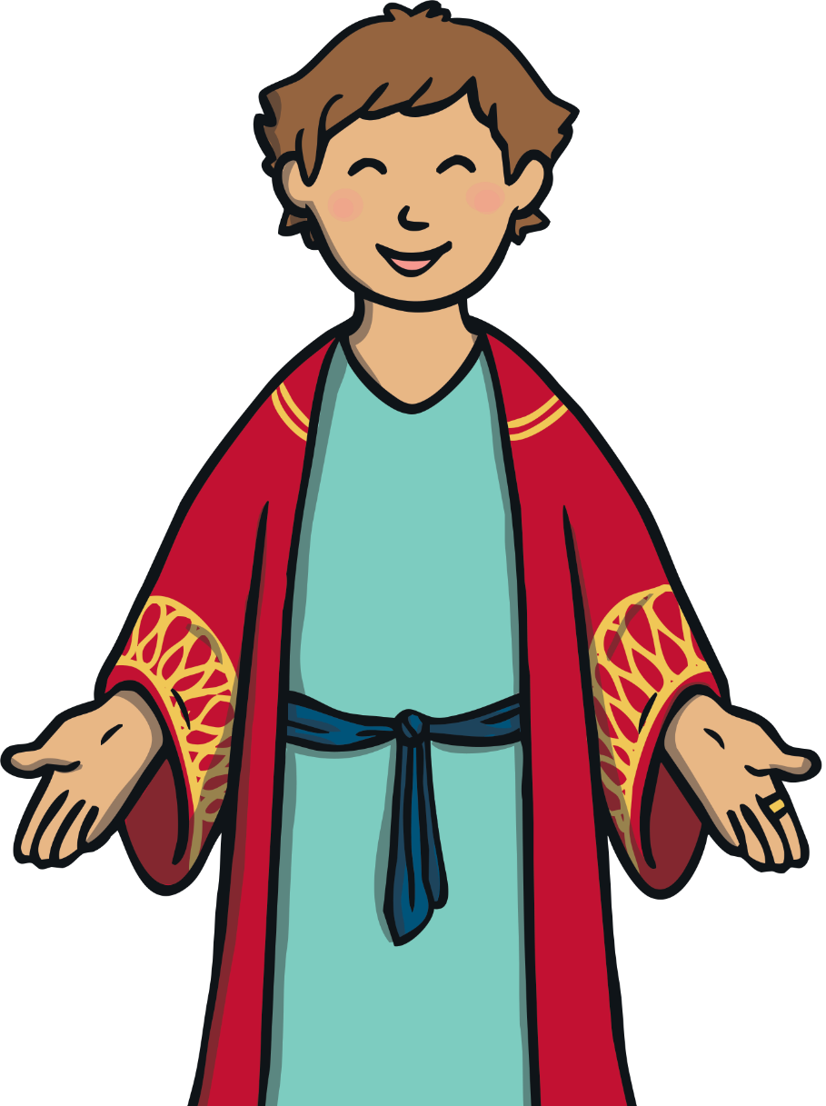
The father dressed him up in the best robe, some new sandals and put a ring on his finger. The father was so happy that his son had returned that he threw a great feast to celebrate!

Slide 10
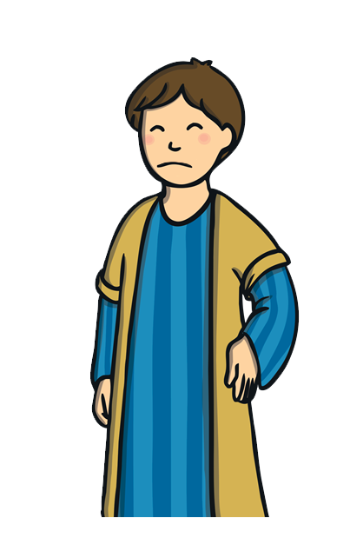
While the younger brother had been away, the older brother had been working hard for his father and saved all of his inheritance. When he heard that his brother had returned with nothing and a great feast was being thrown for him, he felt very angry and jealous.

Slide 11
But the father did not want his son to be jealous and angry. “We must celebrate and rejoice,” he told his older son, “because it is as if this brother of yours was dead and has come to life; he was lost and has been found.”

