Slide 2
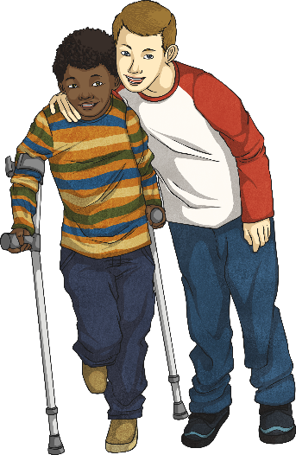
Punctuating Speech
Let’s have a go at correctly punctuating speech.
Josh:
I’m really struggling to walk.
Matthew:
Don’t worry, I’ll help you.
If we were punctuating Josh’s speech, it would say:
Punctuation
Reporting clause
“I’m really struggling to walk,” explained Josh.
Inverted commas
Inverted commas
Punctuation
Click on each box to find out more about it.
Next

Slide 3
Inverted Commas
There are two places where inverted commas are needed when writing direct speech:
“I’m really struggling to walk,” explained Josh.
Inverted commas
Inverted commas
You need to open your inverted commas with a “ (66) before the first word which is being spoken.
You need to close your inverted commas with a ” (99) after the last word which is being spoken.
Imagine that inverted commas are like hands;
they hold within them only the words which are being spoken.
“I’m really struggling to walk,” explained Josh.
Back

Slide 4
Punctuation
There are two places where other forms of punctuation are needed when writing direct speech:
“I’m really struggling to walk,” explained Josh.
You need to end the speaking with either:
A comma
A question mark, if it is a question
An exclamation mark, if it is an exclamation
You need to finish your sentence with a full stop after the reporting clause.
“How exciting!” exclaimed Sarah.
“Is your favourite drink lemonade?” enquired Chad.
“I don’t know what to do,” said Sayeed.
Back

Slide 5
Reporting Clauses
Accompanying the speech is a reporting clause, which gives a little bit of information about who is speaking and how it was said.
“I’m really struggling to walk,” explained Josh.
Reporting clause:
In this case, Josh is speaking.
If Josh said it in a different way, you could change ‘explained’ to...
“I’m really struggling to walk,” claimed Josh.
“I’m really struggling to walk,” disclosed Josh.
“I’m really struggling to walk,” whispered Josh.
“I’m really struggling to walk,” cried Josh.
Back

Slide 6
Punctuating Speech
Sometimes, the reporting clause can appear before the speech. The same punctuation rules apply.
Josh:
I’m really struggling to walk.
Matthew:
Don’t worry, I’ll help you.
If the reporting clause came before the speech, Matthew's reply could read:
Punctuation
Inverted commas
Matthew replied, “Don’t worry, I’ll help you.”
Reporting clause
Inverted commas
Punctuation
Click on each box to find out more about it.

Slide 7
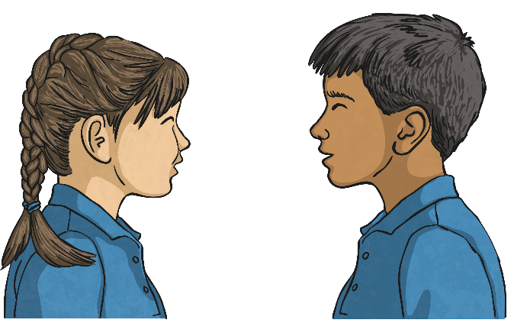
Examples of Correctly Punctuated Speech
Below are all examples of correctly punctuated speech. Tell your partner why they are correct.
The conductor bellowed, “Sit down!”
“Can I have ketchup with my chips?” asked Gina.
The referee blew the whistle and shouted, “Time’s up!”
“Please stop annoying me!” pleaded Waldek.
“It’s all the money I have left,” explained Mary.
Benjamin yelled, “Over here!”

Slide 8
It’s Your Turn...
Choose a mystery box. If the number is even, write this sentence with the reporting clause after the speech. If the number is odd, the reporting clause must come before the speech. Don’t forget the correct punctuation.
Gretchen:
Hooray! It’s the summer holidays.
4
6
?
?
?
5
1
?
3
2
?
?

Slide 9
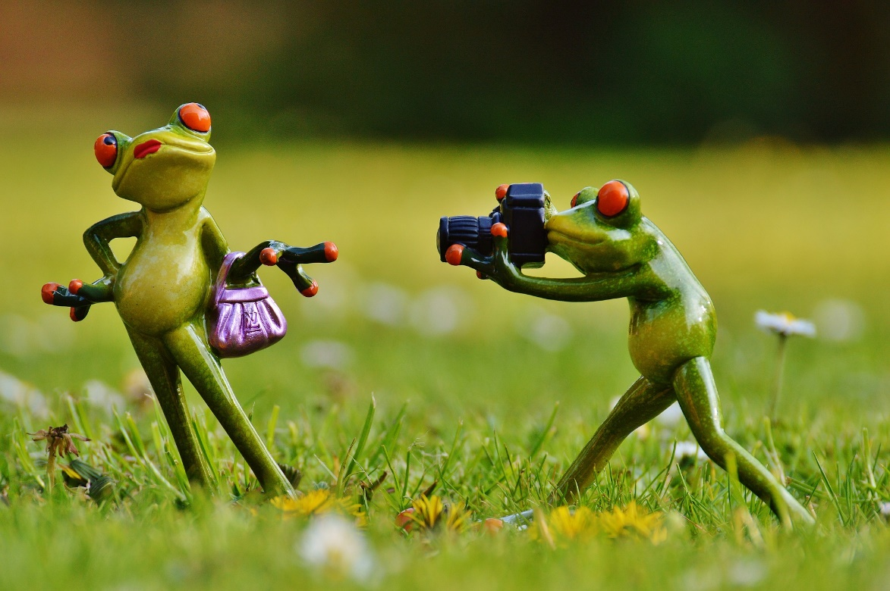
Froggy Freeze Frame
You have two minutes to write two pieces of speech which could be happening in this picture. One sentence must have the reporting clause before the speech, the other must have it after.

Slide 10
Mix and Match
Choose one piece of direct speech, one reporting clause and one extra detail. How many different sentences can you write? Make sure that you punctuate them correctly.
Direct Speech | Reporting Clause | Extra Detail
I want to go home. | said Maureen | angrily
That’s disgusting! | asked Frank | at midnight
How much is it? | the little girl asked | whilst holding a key
No. | she exclaimed | jokingly
Let me have a look. | he roared | urgently
Can I see the doctor? | Hattie replied | at 4 p.m.

Slide 11
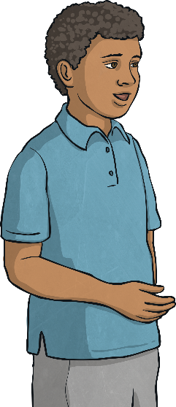
Direct Speech Quick Quiz
Take a quiz to see if you are an expert!
Is this speech punctuated correctly?
James asked “What if we go to Southport instead?”
Yes
No
There is a piece of punctuation missing. Where should it be?

Slide 12
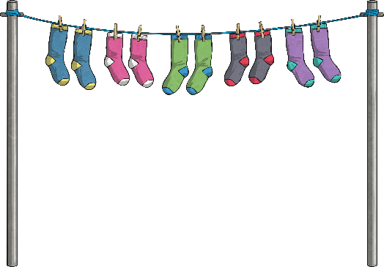
Direct Speech Quick Quiz
Take a quiz to see if you are an expert!
Is this speech punctuated correctly?
“Please will you peg the washing out?” requested Lynne.
Yes
No
How did you know that it was correct?

Slide 13
Direct Speech Quick Quiz
Take a quiz to see if you are an expert!
Is this speech punctuated correctly?
Jessie replied “Of course you can.
Yes
No
Which two pieces of punctuation are missing and where should they be?

Slide 14
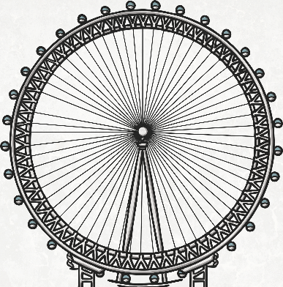
Direct Speech Quick Quiz
Take a quiz to see if you are an expert!
Is this speech punctuated correctly?
“I’ve never been to London but I’d like to go” stated Samuel.
Yes
No
Which sneaky piece of punctuation is missing from this direct speech?

Slide 15
Direct Speech Quick Quiz
Take a quiz to see if you are an expert!
Is this speech punctuated correctly?
“Where have you left your bag?” asked Mum angrily.
Yes
No
They’ve even included an adverb. Way to go!

Slide 16
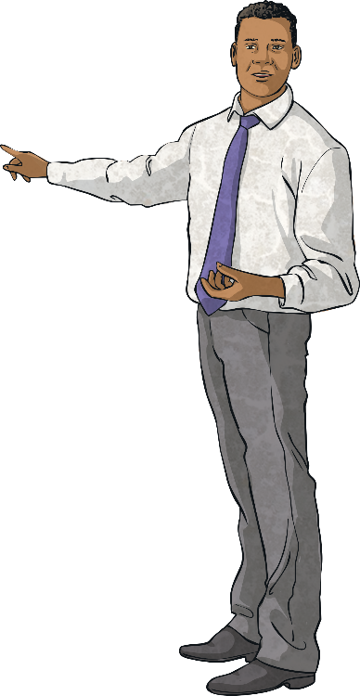
Direct Speech Quick Quiz
Take a quiz to see if you are an expert!
Is this speech punctuated correctly?
The teacher bragged, “I am an expert at punctuating speech.”
Yes
No
The teacher is an expert. Now you are too!

