Slide 1
Wednesday 18th November
WALT: To recognise the function and symbols of electrical components.
What we’ll be doing:
Recapping electrical components and their symbols/functions
Creating a table to match them all
Playing component snap!

Slide 2
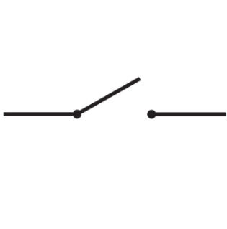
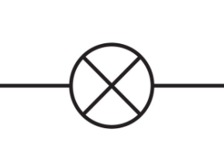
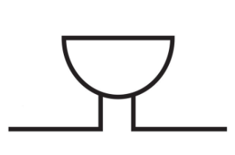
To start with, do you remember any of these symbols?
Try to say them out loud!

Slide 3
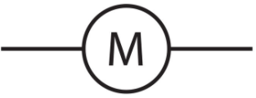
Here’s what they actually were, along with their definitions:
Bulb - A component that lights up when electric current passes through it in a circuit. It converts electrical energy into light.
Buzzer - A component that makes a sound when electric current passes through it in a circuit. It converts electrical energy into sound.
Motor - A component that spins when electric current passes through it in a circuit. It converts electrical energy into movement.

Slide 4
There’s a few more…
Cell - a power source that provides electrical energy to activate a circuit.
Wire - used to connect different components in a circuit.
It is made from plastic-covered metal. The metal centre conducts electric current around the circuit and the outer plastic coating insulates it.
Switch - A component used to break the flow of the circuit.
It can be easily opened and closed.
When OPEN, the circuit is incomplete and the other components do not work. When CLOSED, the circuit is complete, and the components will work.

Slide 5
Your Job!
Create a table matching the 6 components, symbols and functions!
Use the slides before to help you or this factfile:
https://www.discoveryeducation.co.uk/login/eha/?service=espresso
Click espresso → key stage 2 → science → electricity (upper) → factfiles → circuit components

Slide 6
Do one component at a time so you have enough space to write the functions down.
Here an example:

Slide 7
Here’s a game to test your knowledge!
https://www.discoveryeducation.co.uk/login/eha/?service=espresso
Click espresso → Key Stage 2 → Science → Electricity (upper) → activities → electrical component snap

