Slide 1
Maths
Position and Direction
Year One
Maths | Year 2 | Position and Direction | Position, Direction and Movement | Lesson 1 of 3: Mend the Quilt

Slide 3
Aim
To follow instructions for position, direction and movement.
Success Criteria
I can use words to describe position, direction and movement.
I can follow instructions to complete a pattern.
I can make half and quarter turns.
I can move in clockwise and anticlockwise directions.

Slide 4
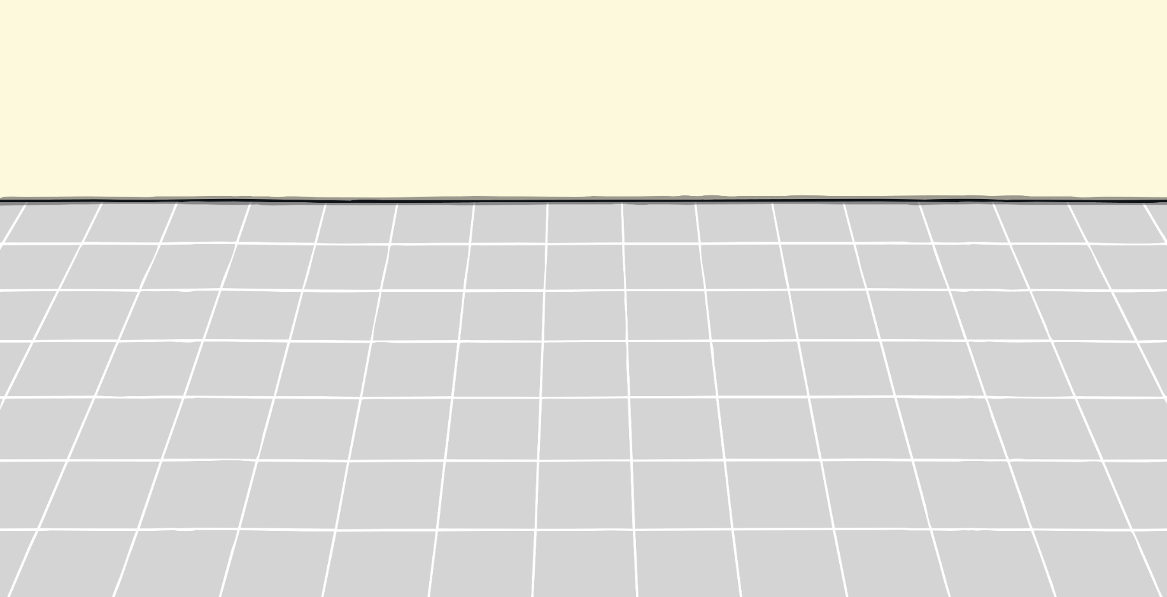
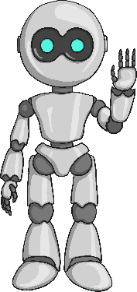
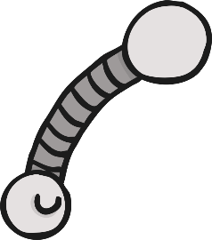
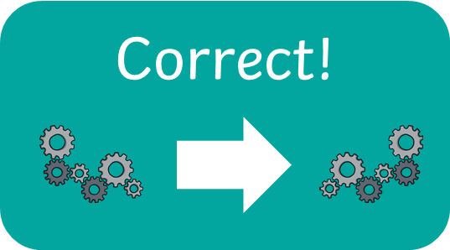
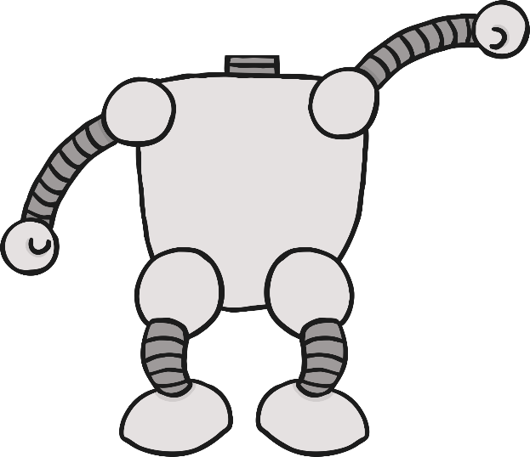
Robot Shop
Which robot’s parts spin or turn around?
Incorrect

Slide 5
Robot Shop
Which robot’s parts move forwards and backwards?
Incorrect

Slide 6
Robot Shop
Which robot’s parts move up and down?
Incorrect

Slide 7
Robot Shop
Which robot’s parts move left or right?
Incorrect

Slide 8
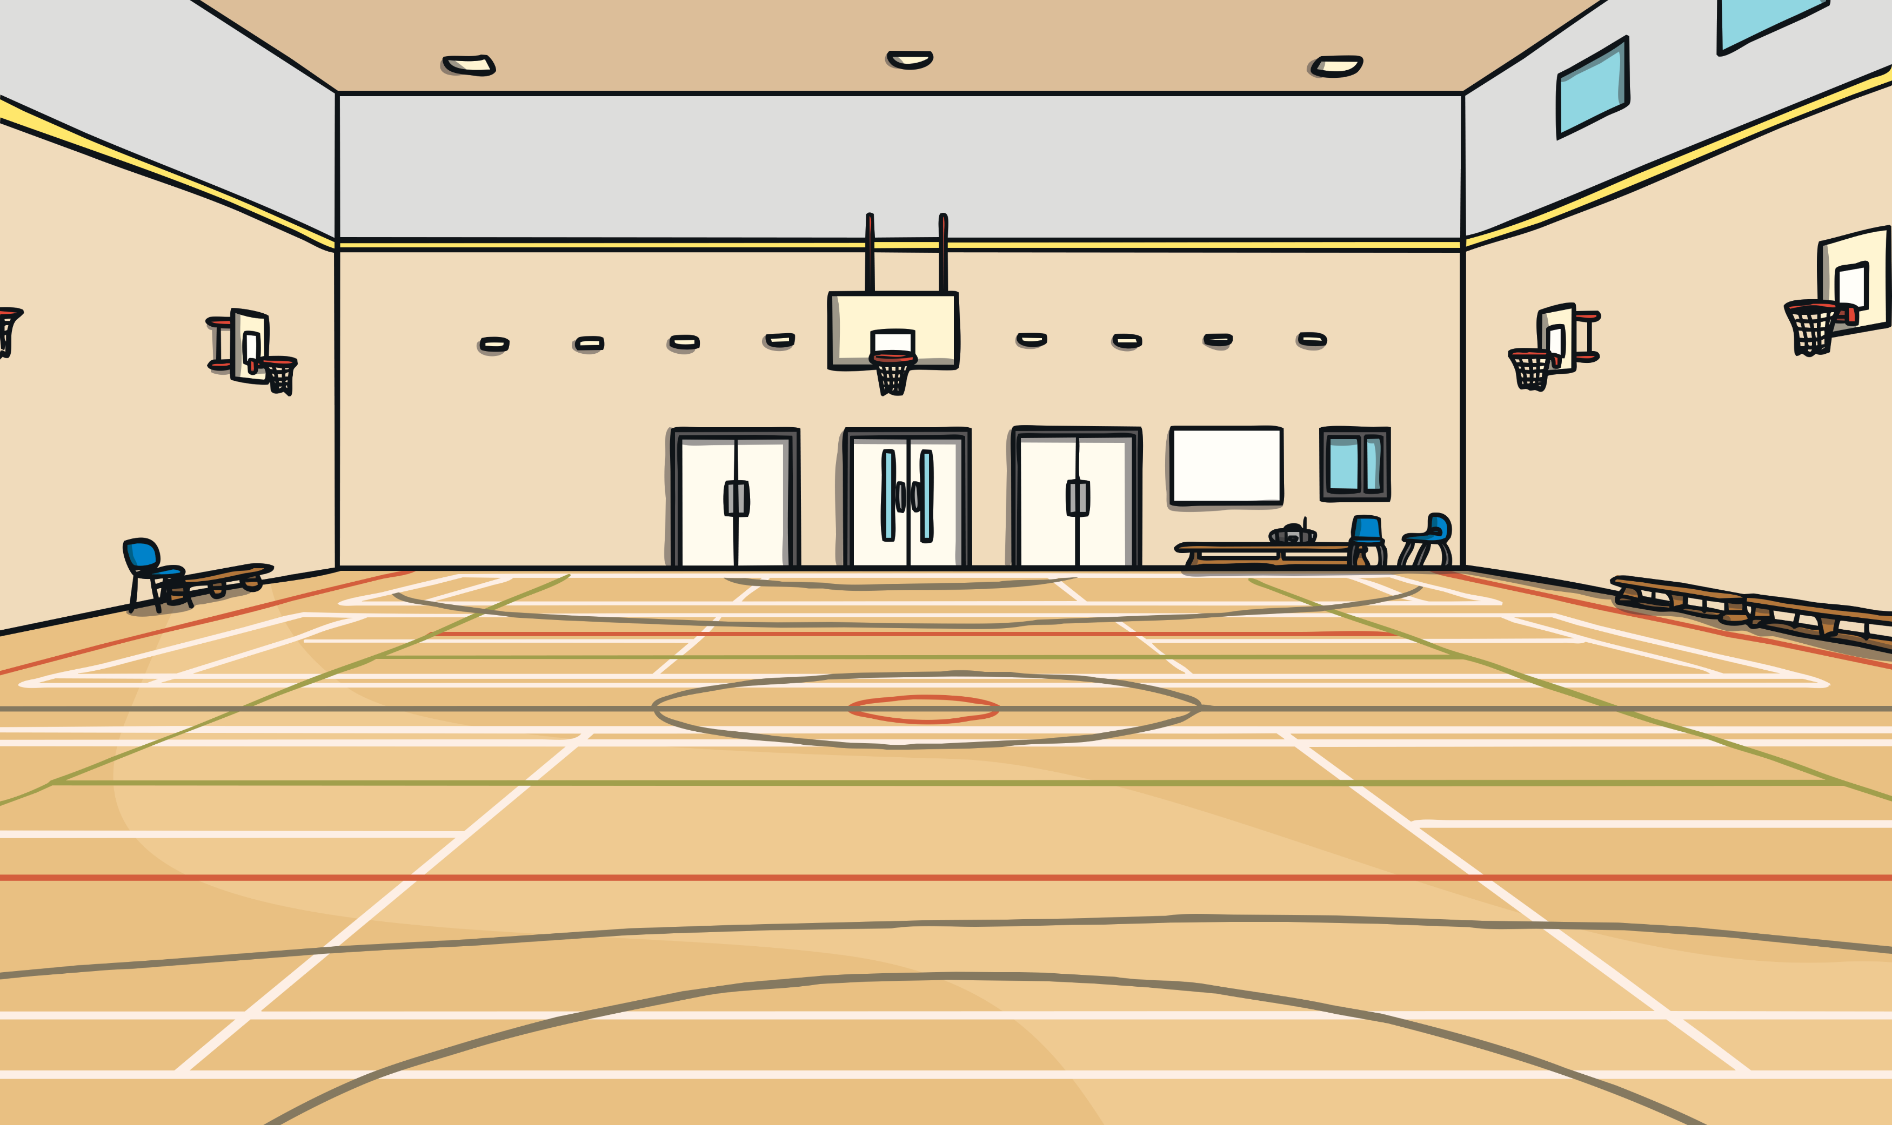
Dance Moves
Which way did the dancer turn?
How far did the dancer turn?
Which way did the dancer turn?
How far did the dancer turn?
Which way did the dancer turn?
How far did the dancer turn?
anticlockwise
a quarter turn
a half turn
a three-quarter turn
clockwise
clockwise

Slide 9
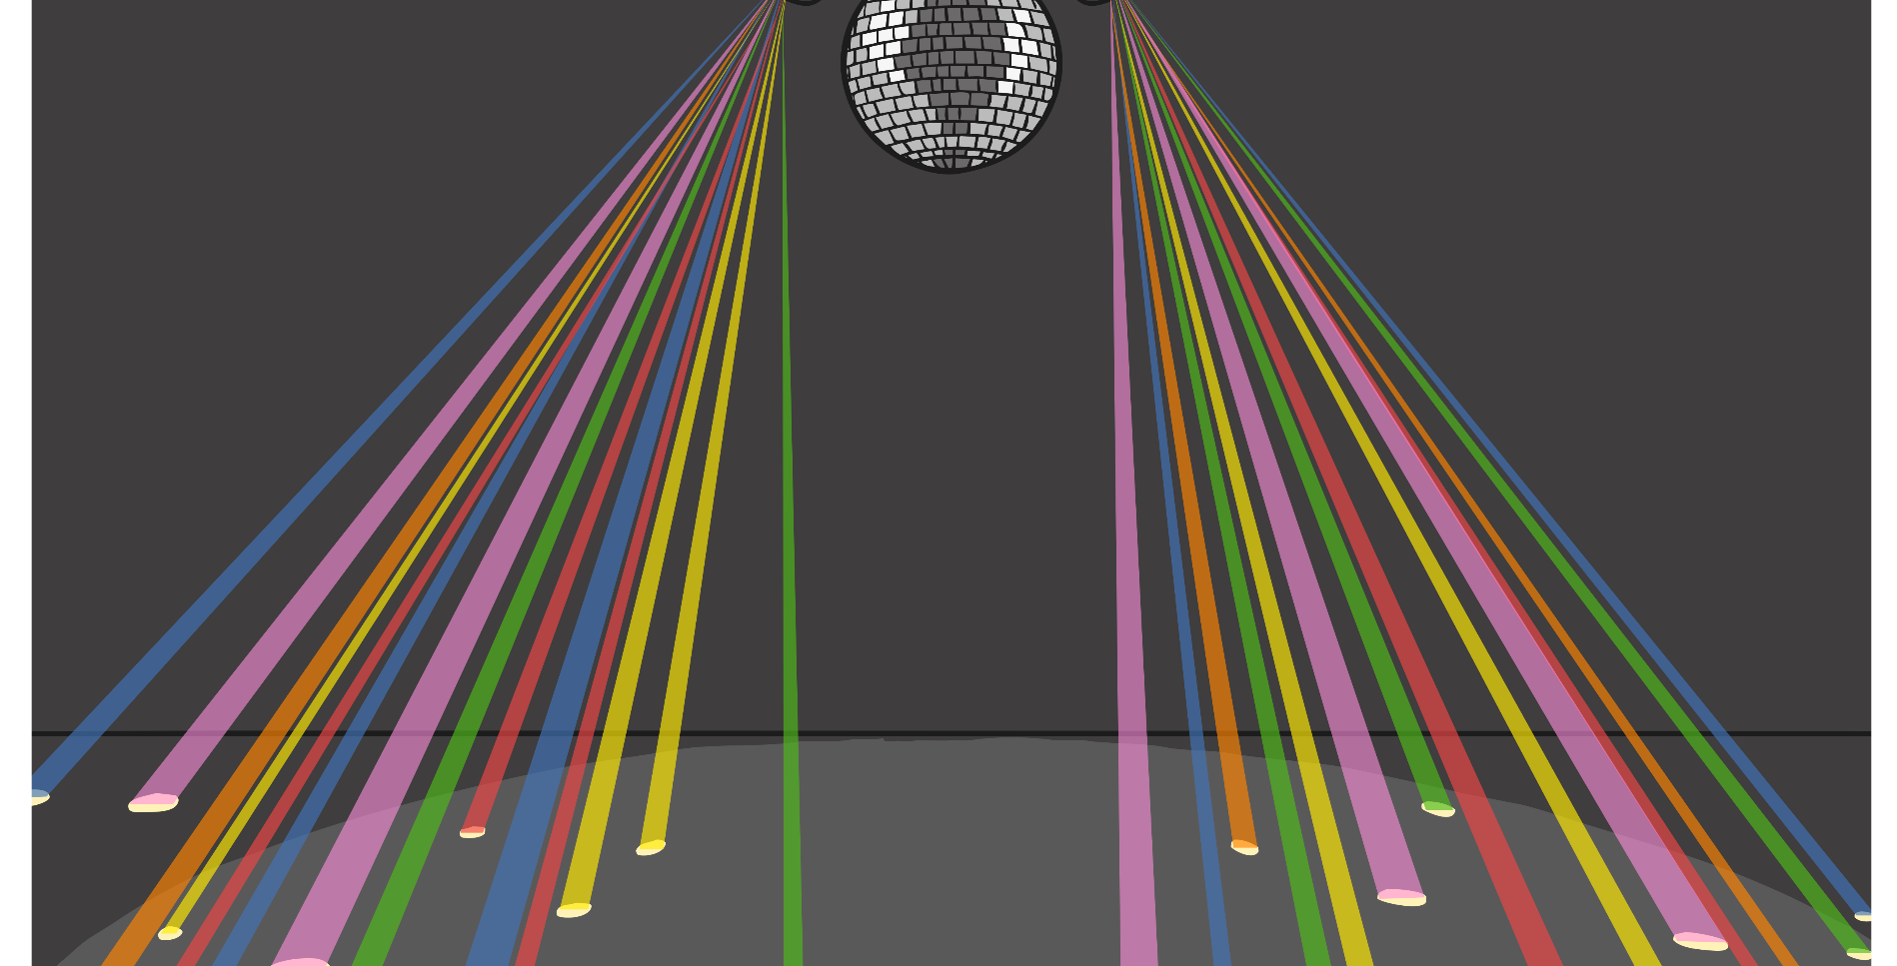
Position, Direction and
Movement Dance-Off
Make a quarter turn clockwise.
Face the window and make a whole turn anticlockwise.
Spin three full turns.
Slide to the left and slide to the right.
Make a three-quarter turn anticlockwise.
Face the front and make a full turn clockwise.
Turn half a turn anticlockwise.
Turn in a full circle.
Jump backwards and jump forwards.

Slide 10
Mend the Quilt
Mend the quilt by following the instructions to move. Begin at the start square and follow the arrows.
Start
Make half a turn clockwise from the start square.
Make half a turn anticlockwise from the square before.
Reveal answers

Slide 11
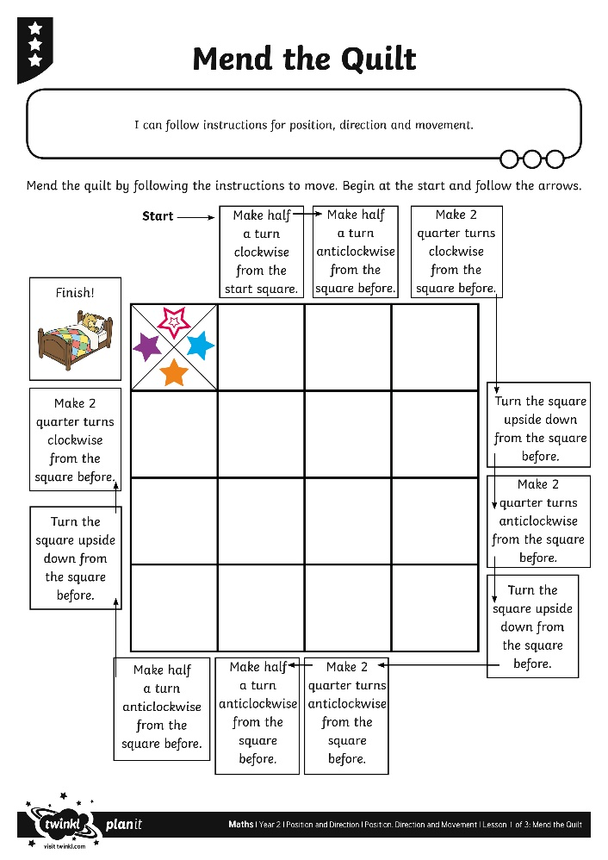
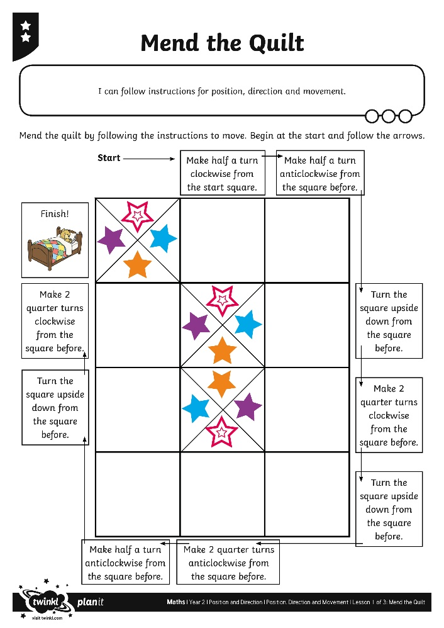
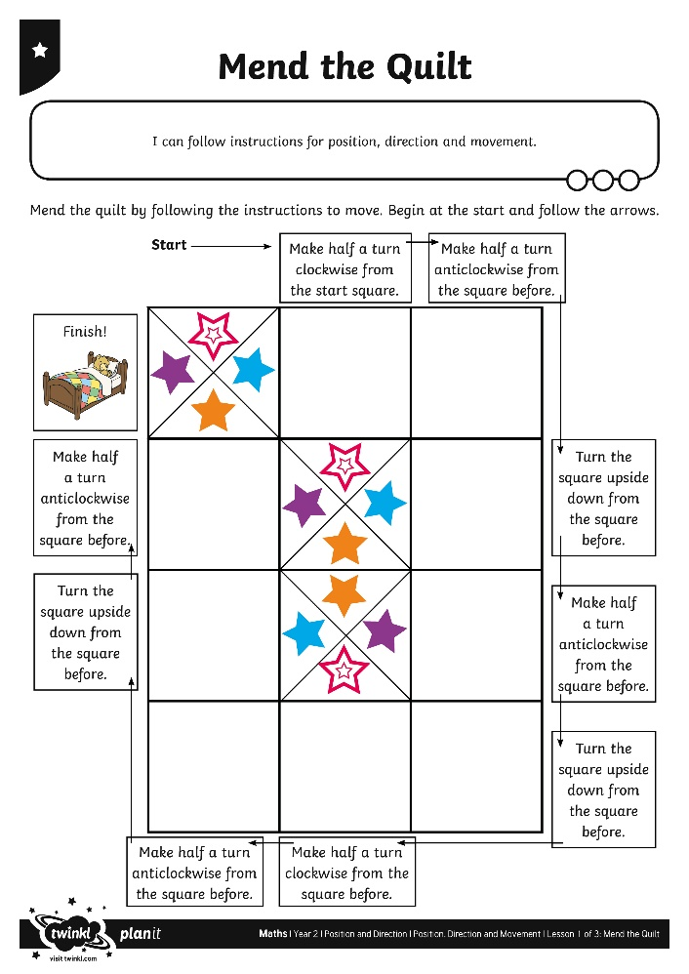
Mend the Quilt

Slide 12
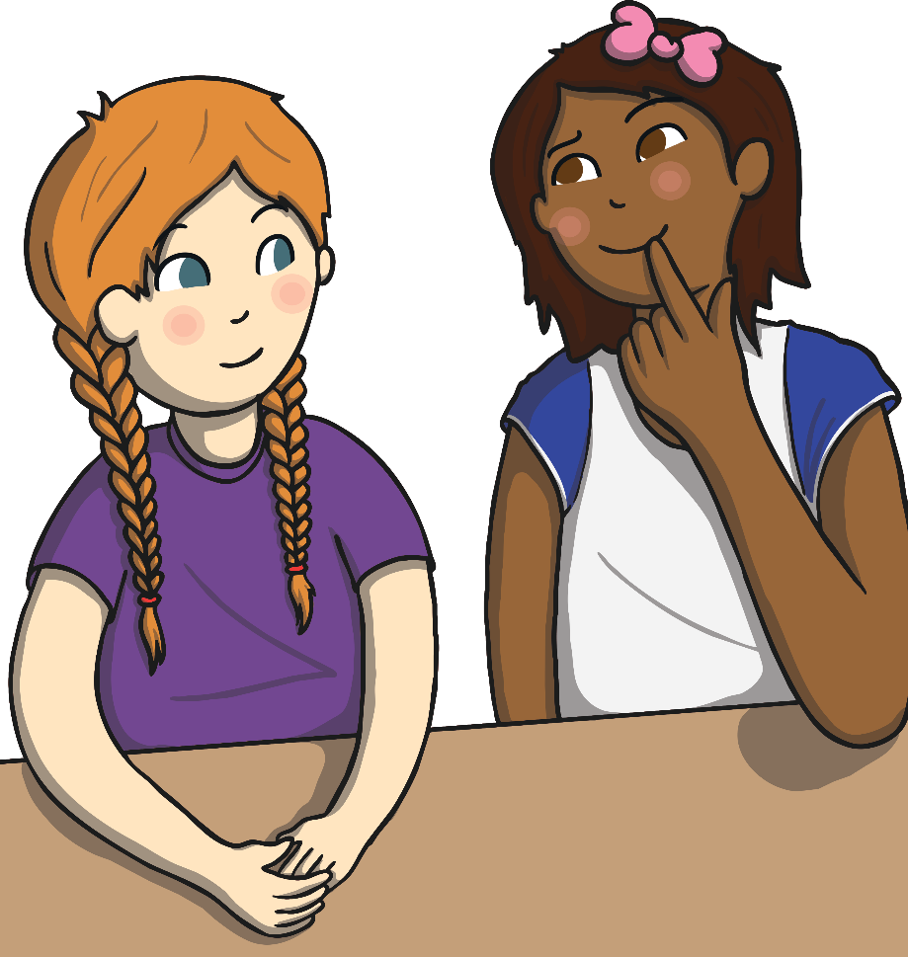
Diving into Mastery
Dive in by completing your own activity!

Slide 13
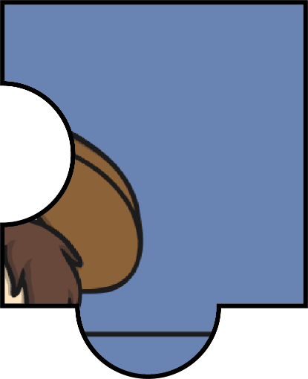
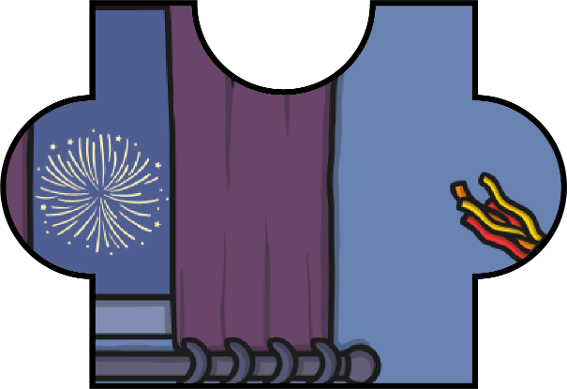
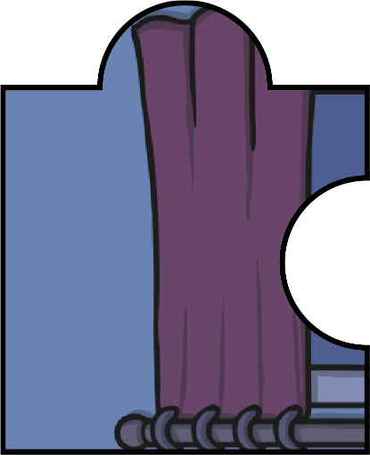
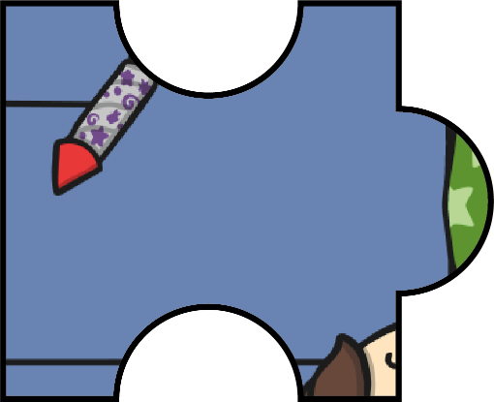
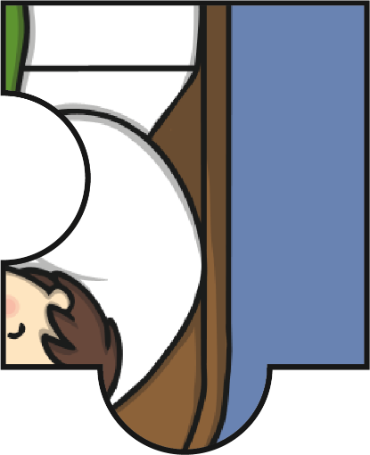
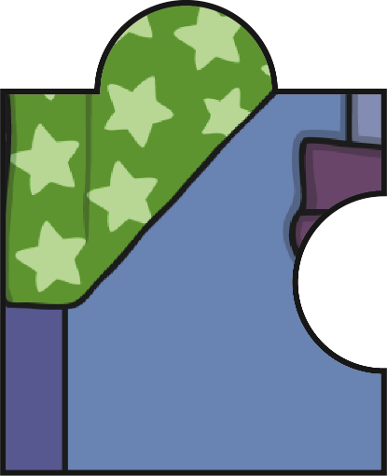
Design and Mend the Quilt
Draw your own quilt or bedtime scene. Cut out the jigsaw pieces and arrange the pieces to make the picture again. Describe how each piece of the jigsaw moves using the language of position, direction and movement.

Slide 14
Aim
To follow instructions for position, direction and movement.
Success Criteria
I can use words to describe position, direction and movement.
I can follow instructions to complete a pattern.
I can make half and quarter turns.
I can move in clockwise and anticlockwise directions.

