Slide 1
Maths
Position and Direction
Year One
Maths | Year 2 | Position and Direction | Turns, Rotations and Right Angles | Lesson 2 of 3: Right-Angled Roads

Slide 3
Aim
I can explore turns of a right angle in clockwise and anticlockwise directions.
Success Criteria
I can follow a route, moving in clockwise and anticlockwise turns.
I can identify a right angle turn.
I can label clockwise and anticlockwise right angle turns.

Slide 4
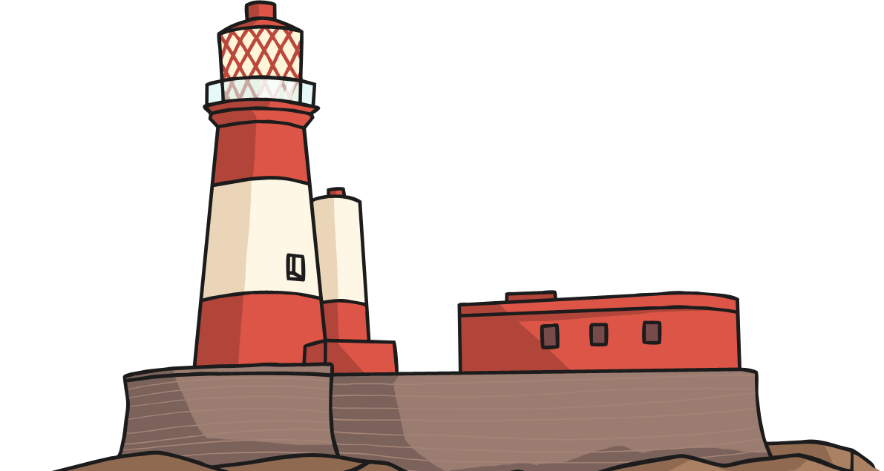
Lighthouse Turns
Watch the lighthouse and describe the turns made by the beam.
Click here to start

Slide 5
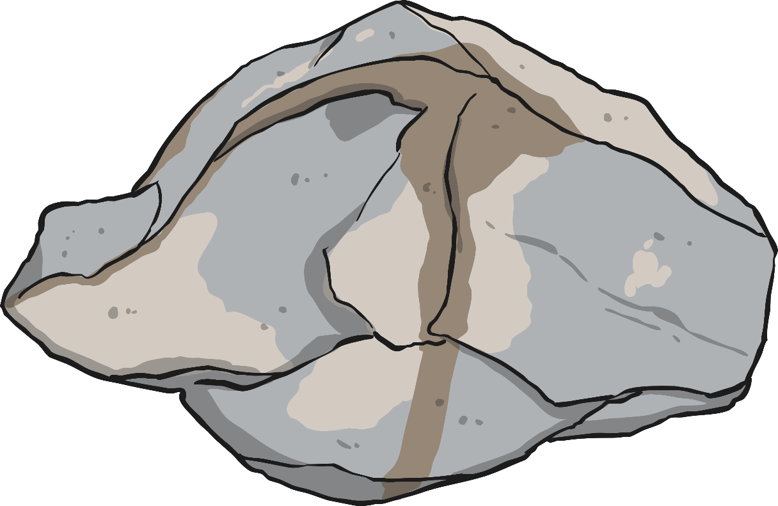
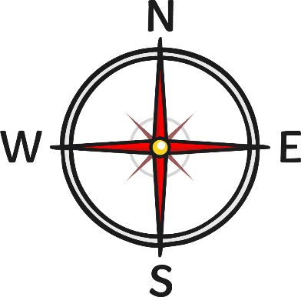
Has the beam moved a whole, half, quarter or three-quarter turn and through how many right angles?
Does the beam move in a clockwise or anticlockwise direction?

Slide 6
Has the beam moved a whole, half, quarter or three-quarter turn and through how many right angles?
Does the beam move in a clockwise or anticlockwise direction?

Slide 7
Has the beam moved a whole, half, quarter or three-quarter turn and through how many right angles?
Does the beam move in a clockwise or anticlockwise direction?

Slide 8
Has the beam moved a whole, half, quarter or three-quarter turn and through how many right angles?
Does the beam move in a clockwise or anticlockwise direction?

Slide 9
Has the beam moved a whole, half, quarter or three-quarter turn and through how many right angles?
Does the beam move in a clockwise or anticlockwise direction?

Slide 10
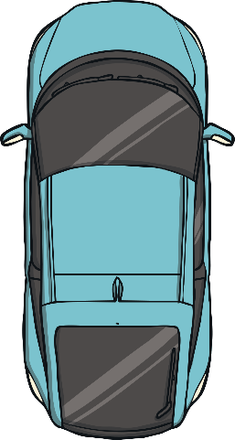
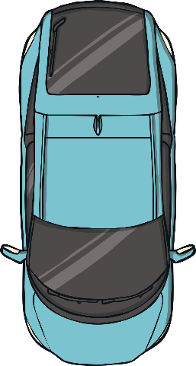
Road Rotations
Can you direct the car back to its starting position by clicking on the correct directions?
starting position
half a turn clockwise
left
a whole turn anticlockwise
a three-quarter turn clockwise
a quarter turn clockwise

Slide 11
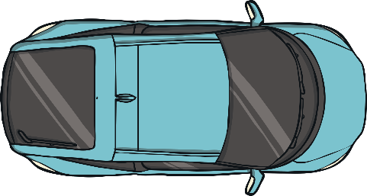
Road Rotations
Can you direct the car back to its starting position by clicking on the correct directions?
half a turn clockwise
left
a whole turn anticlockwise
a three-quarter turn clockwise
a quarter turn clockwise

Slide 12
Road Rotations
Can you direct the car back to its starting position by clicking on the correct directions?
half a turn clockwise
left
a whole turn anticlockwise
a three-quarter turn clockwise
a quarter turn clockwise

Slide 13
Road Rotations
Can you direct the car back to its starting position by clicking on the correct directions?
half a turn clockwise
left
a whole turn anticlockwise
a three-quarter turn clockwise
a quarter turn clockwise

Slide 14
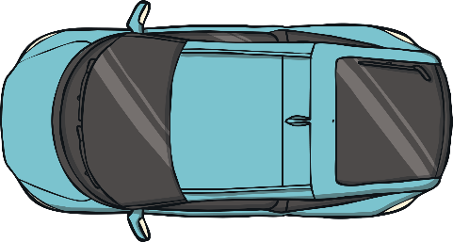
Road Rotations
Can you direct the car back to its starting position by clicking on the correct directions?
half a turn clockwise
left
a whole turn anticlockwise
a three-quarter turn clockwise
a quarter turn clockwise

Slide 15
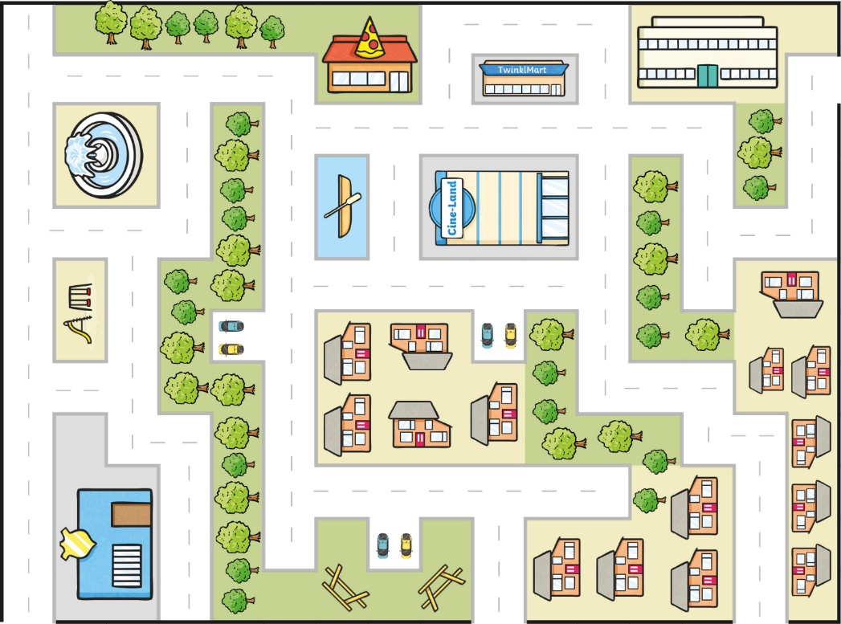
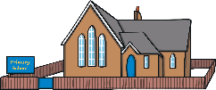
Right-Angled Roads
Drive the red car to the school. Are the turns clockwise right angle turns, or anticlockwise right angle turns? Click on the car to find out.
clockwise
anticlockwise

Slide 16
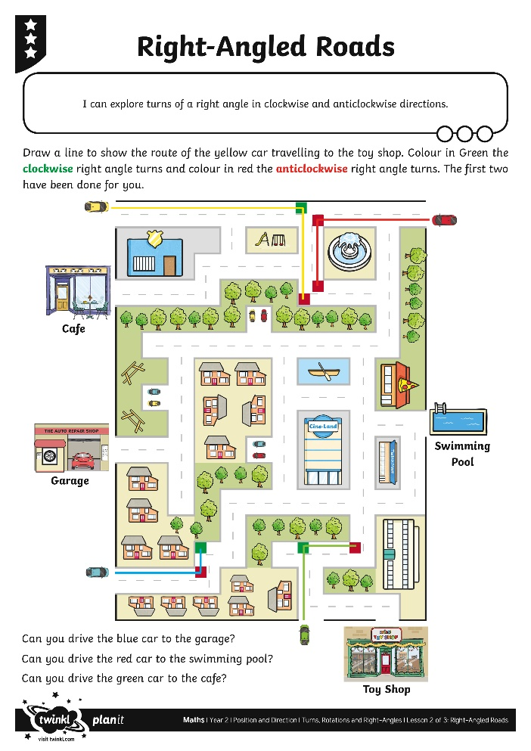
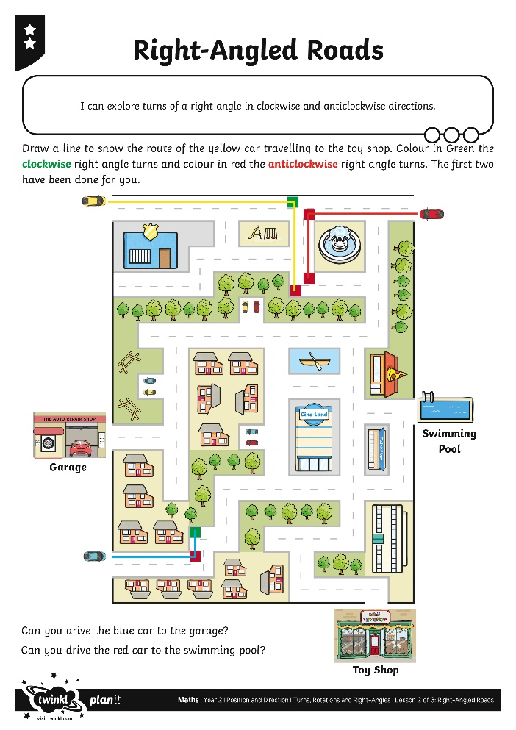
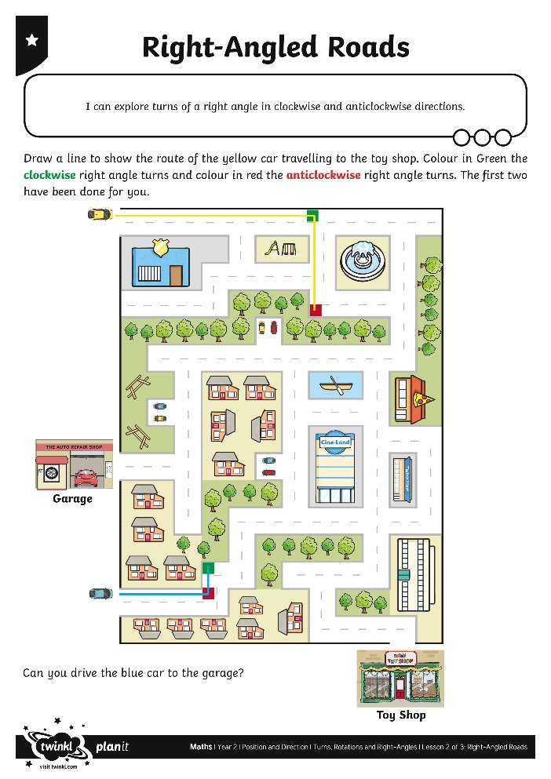
Right-Angled Roads Activity

Slide 17
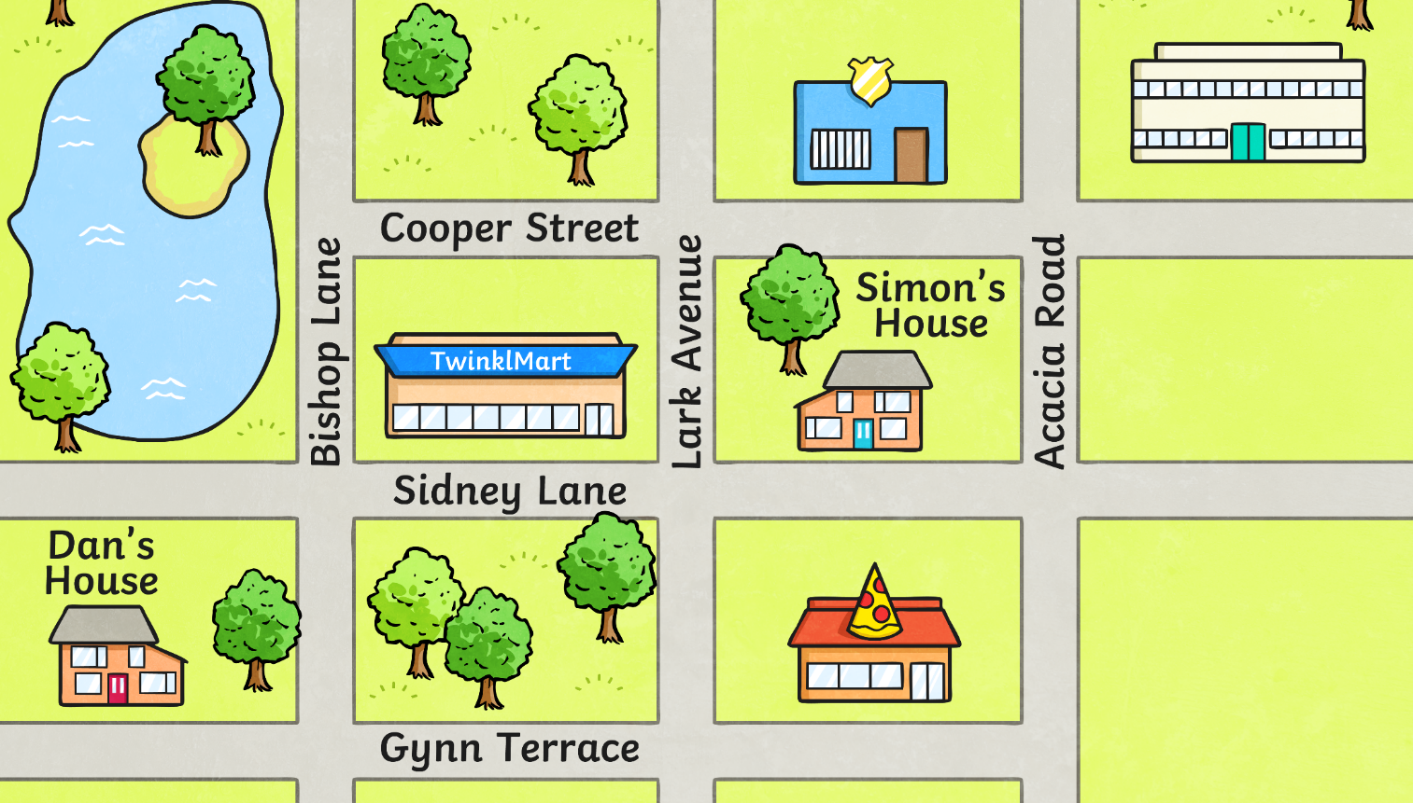
The Right Road
Design your own town with right-angled road junctions like the one below.
Direct your partner from one place to another, describing the turns you make.

Slide 18
Aim
I can explore turns of a right angle in clockwise and anticlockwise directions.
Success Criteria
I can follow a route, moving in clockwise and anticlockwise turns.
I can identify a right angle turn.
I can label clockwise and anticlockwise right angle turns.

