Slide 2
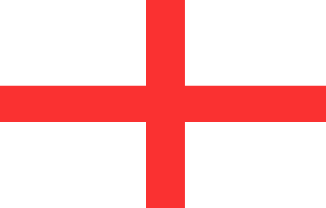
Geography
The United Kingdom of Great Britain and Northern Ireland (also referred to as the UK) is made up of four countries:
Scotland
Northern Ireland
England
Wales

Slide 3
Geography
The flag of the UK combines the crosses of three patron saints:
St Andrew: Scotland
St Patrick: Northern Ireland
St George: England
United Kingdom

Slide 4
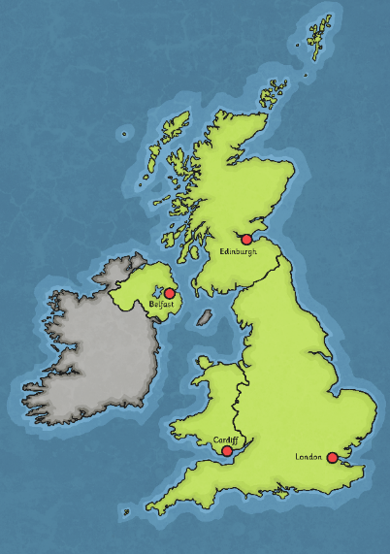
Geography
The capital city of the United Kingdom is London. In addition, Scotland, Wales and Northern Ireland each have their own capitals (the capital city of England is also London).
The capital city of Scotland is Edinburgh.
The capital city of Northern Ireland is Belfast.
The capital city of Wales is Cardiff.
The capital city of England is London.

