Slide 2
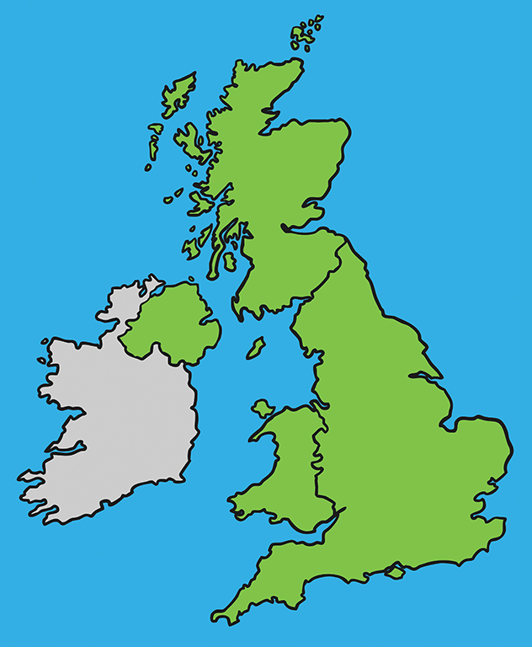
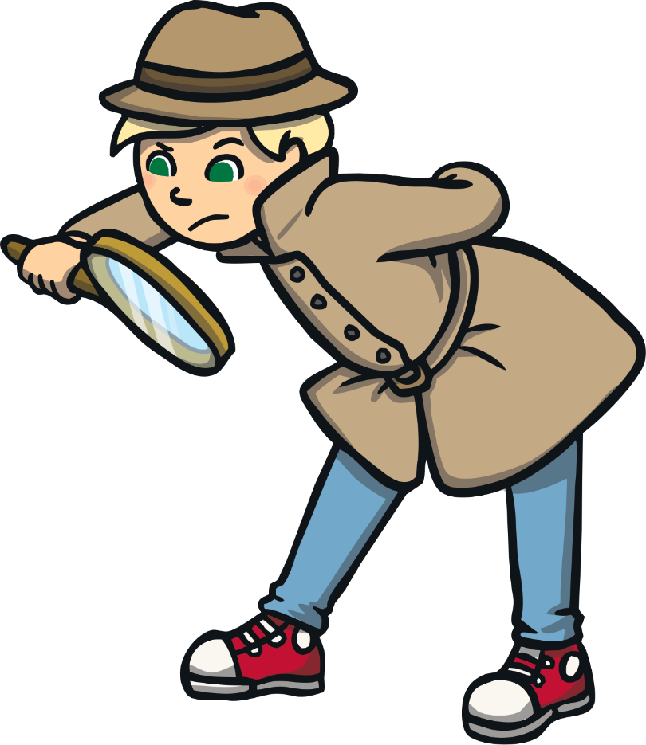
United Kingdom
The official name of the UK is ‘The United Kingdom of Great Britain and Northern Ireland’.
Scotland
Northern
Ireland
England
Wales

Slide 3
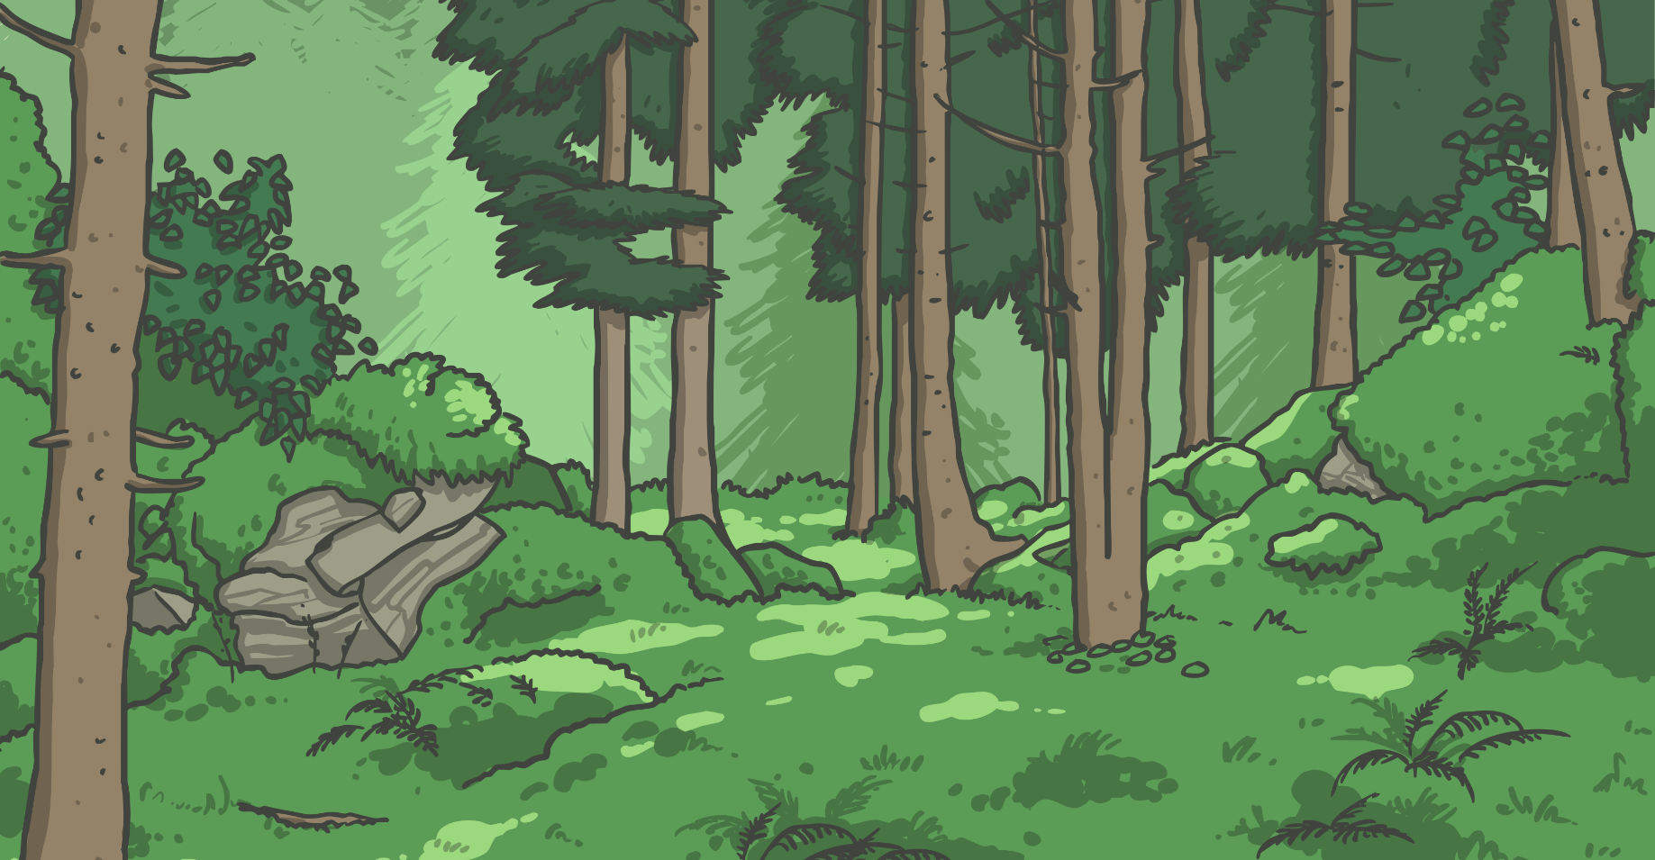
History
Did you know … ?
5,000 years ago the UK was covered in thick forest!

Slide 4
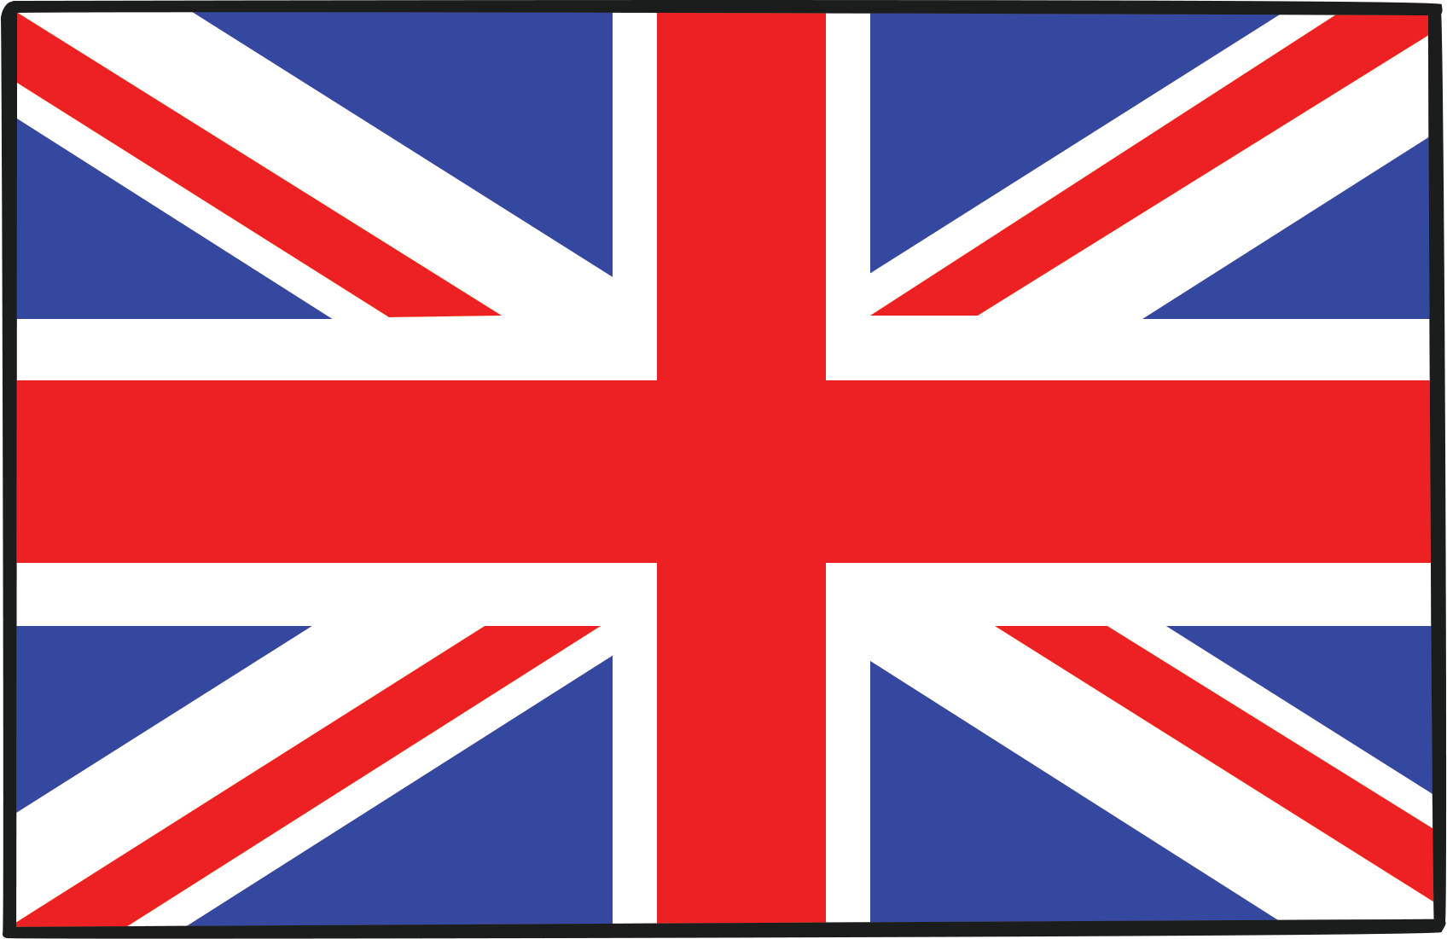
Union Jack
The official flag is the Union Flag, nicknamed the Union Jack.
It was designed to include the English, Scottish,
Welsh and Northern Irish flags.

Slide 5
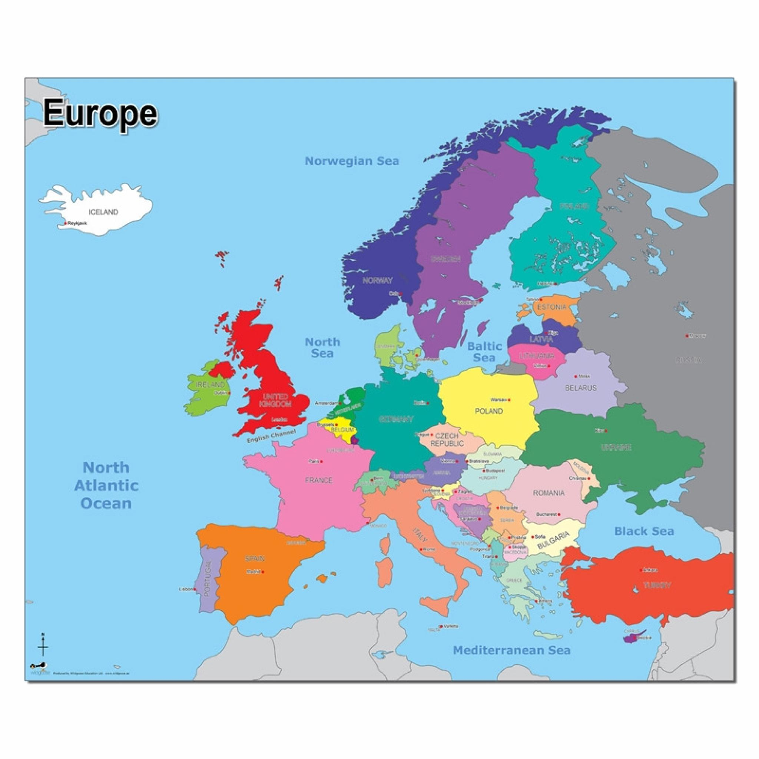
Our Continent - Europe
A continent
is a group of
countries.
Can you spot
the United
Kingdom?

Slide 6
Population
Population is the number of people living in a place.
England has the
largest population
in the UK.
The population of the whole UK is around
67 million!

Slide 7
Languages of the UK
The main language spoken in the Kingdom is English.
Did you know… ?
There are 2 official
Languages in
Wales – Welsh
As well as
English!
Scotland
Northern
Ireland
England
Wales

Slide 8
Islands of the United Kingdom
Many small islands belong to the UK, such as the Isle of Wight.
Isle of
Wight

Slide 9
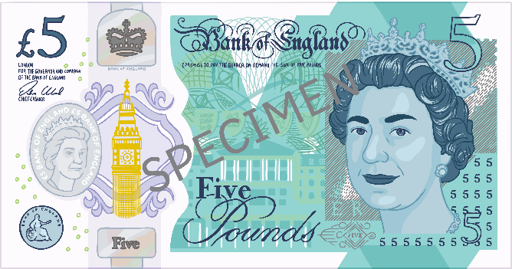
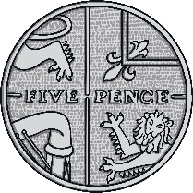
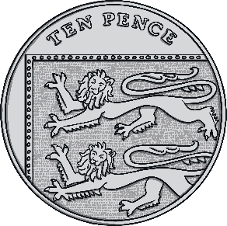
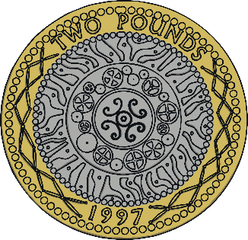
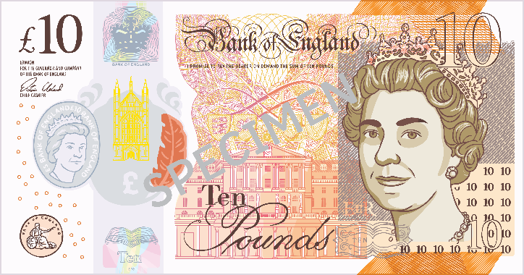
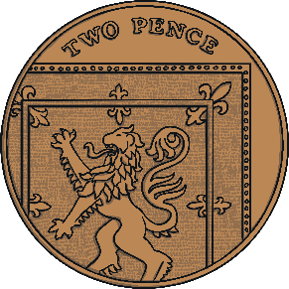
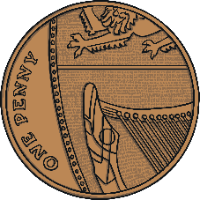
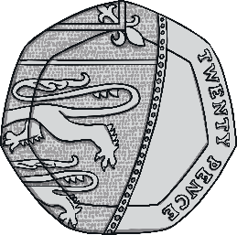
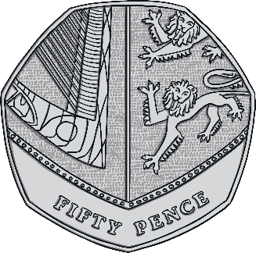
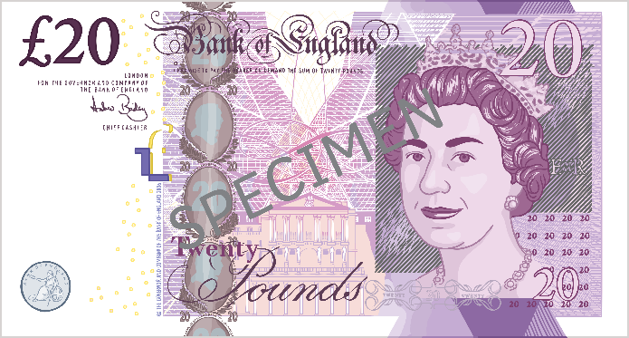
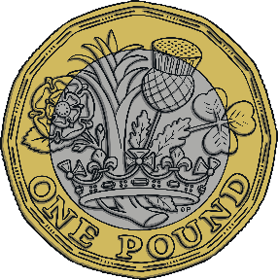
Currency
Currency means the
official money of a
country.
The currency in the
UK is the pound
(sterling).

Slide 10
Capital Cities
England
London
Scotland
Edinburgh
Edinburgh
Belfast
Wales
Cardiff
Northern Ireland
Cardiff
London
Belfast

Slide 11
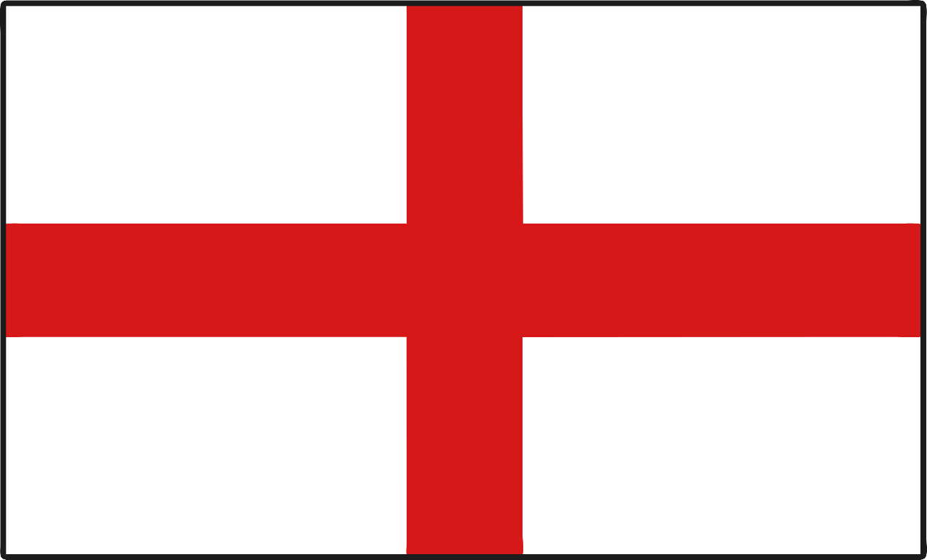
London
The capital city of England is London.

Slide 12
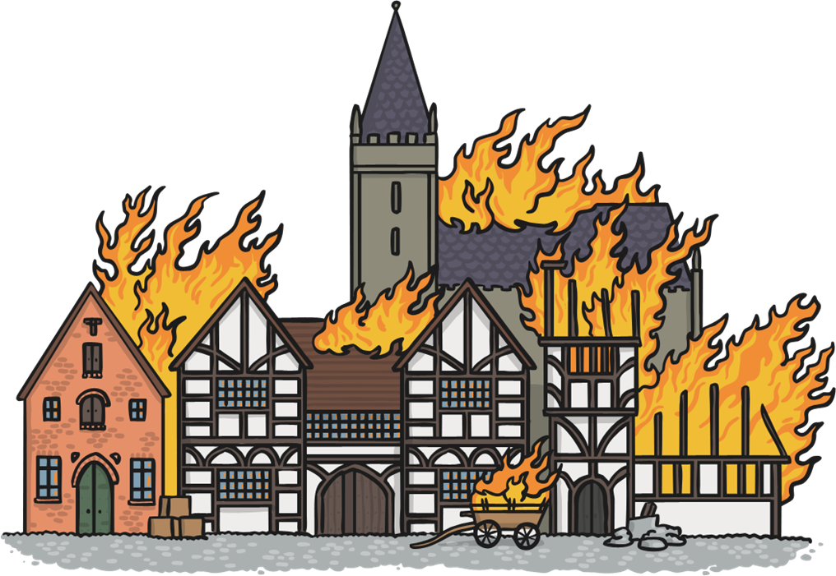
The Great fire of London
In 1666 the Great Fire of London swept through central parts of London. Much of the city had to be rebuilt.

Slide 13
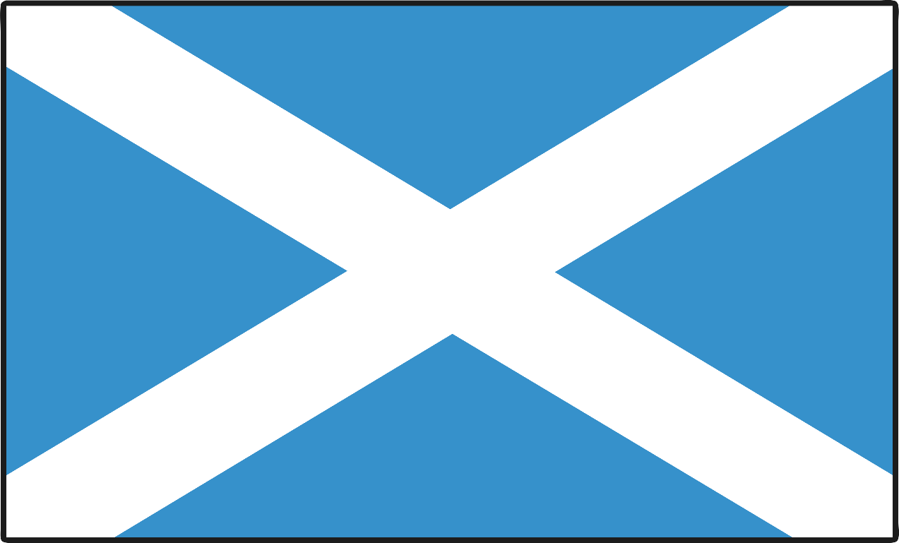
Edinburgh
The capital city of Scotland is Edinburgh.

Slide 14
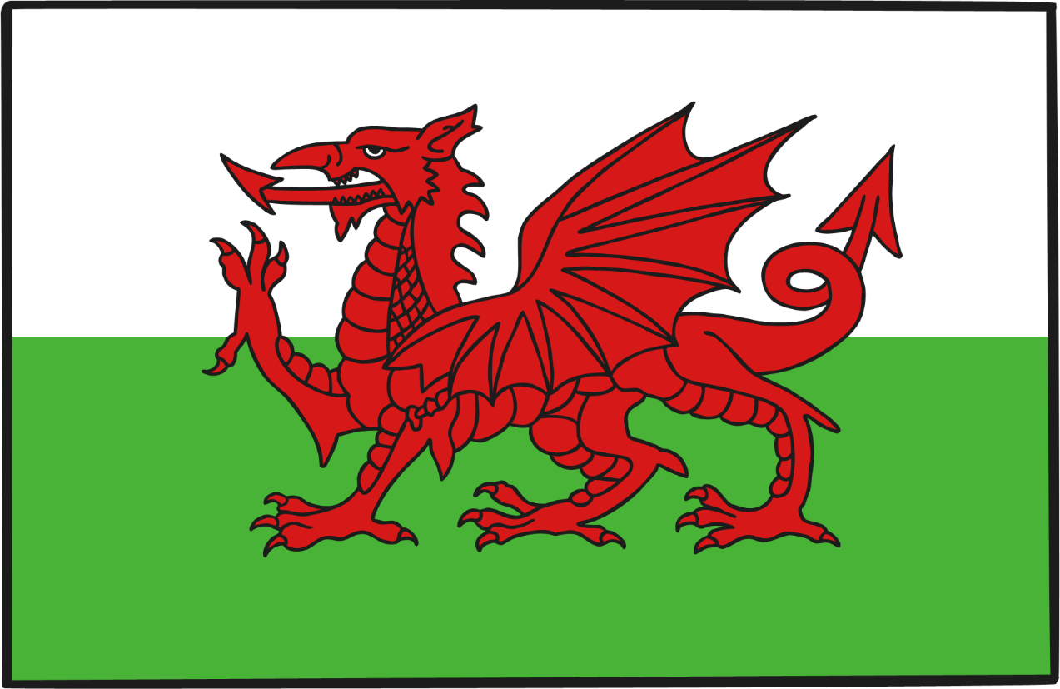
Cardiff
The capital city of Wales is Cardiff.

Slide 15
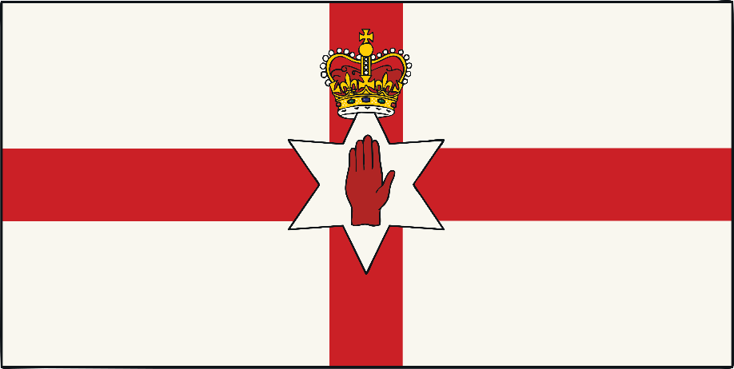
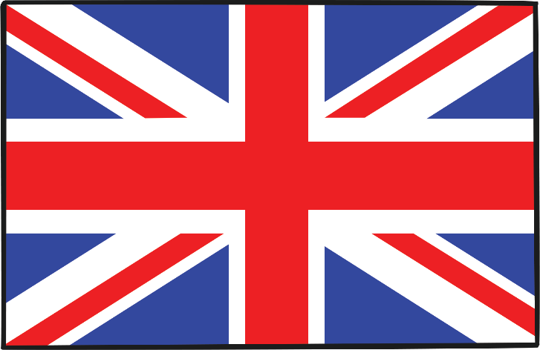
Belfast
The capital city of Northern Ireland is Belfast.

