Slide 2
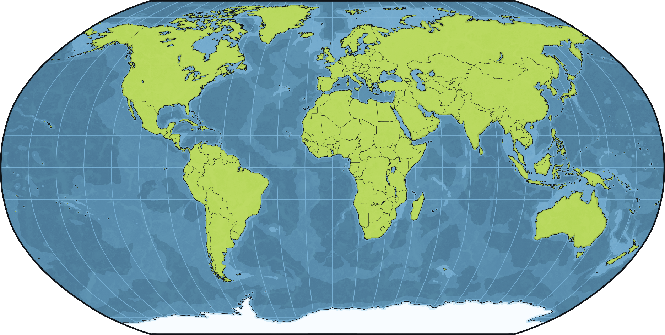
Egypt is here
North America
Europe
Asia
Africa
South America
Oceania

Slide 3
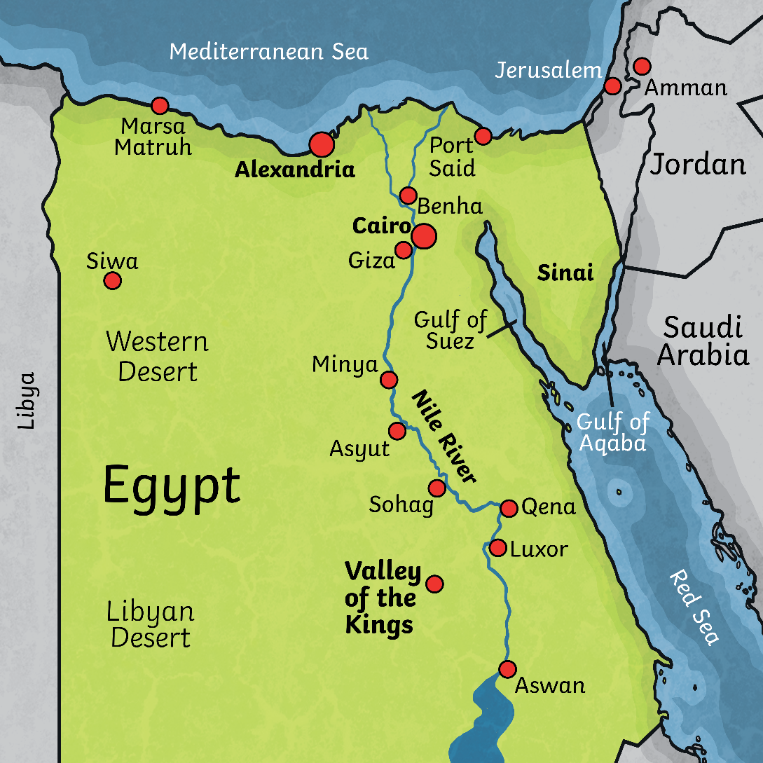
The River Nile
The River Nile runs through Egypt. Most people live along and around the River Nile.
This is because it is green and crops can be grown in the areas around the Nile whilst the rest of Egypt is desert.
The people of ancient Egypt depended on the Nile to survive.

Slide 4
Floods
The River Nile would flood every year and leave behind a rich, black silt that fertilised the soil.
This was essential for growing food for everyone.
A system of canals that led from the Nile were also used to water fields in other areas. This is called irrigation.

Slide 5
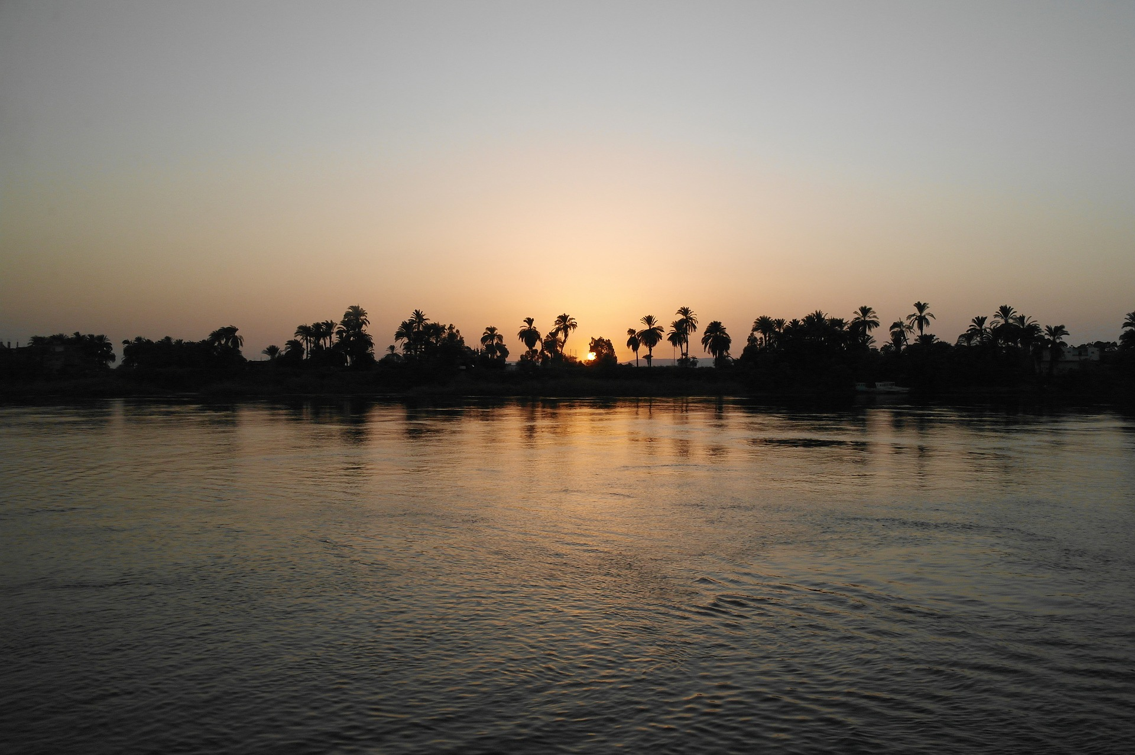

Slide 6
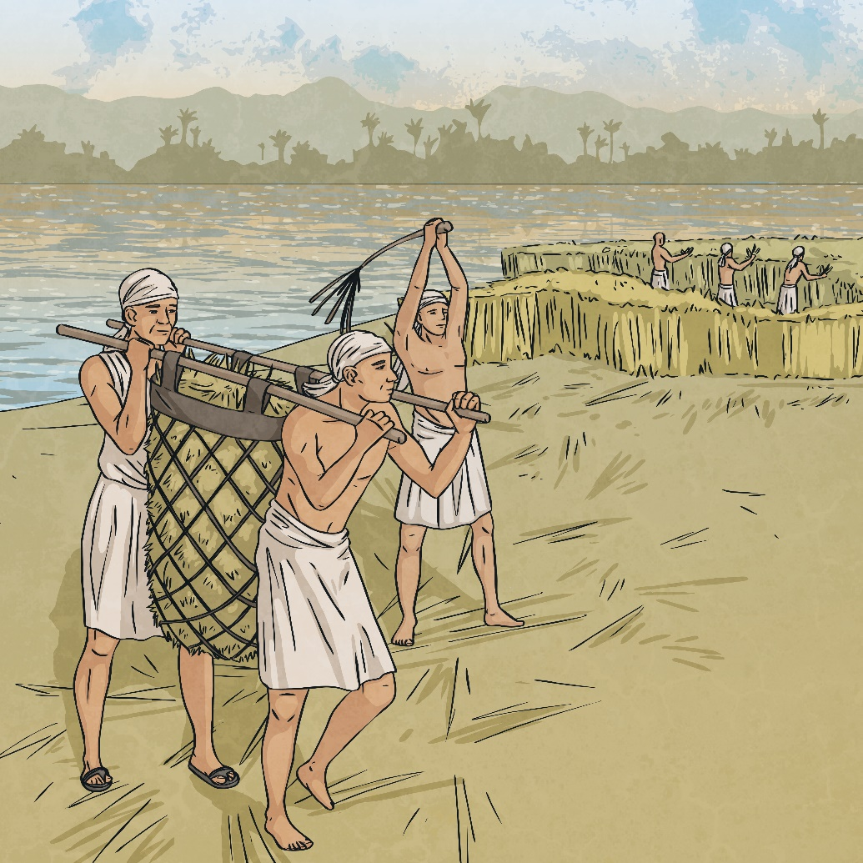
Crops and Food
The Egyptians grew wheat and barley as well as fruits
and vegetables like melons, figs, peas, garlic, lettuce and cucumbers.
Flax was grown for making linen to make clothes.
The Nile was also important for fishing. This was done in boats with nets.

Slide 7
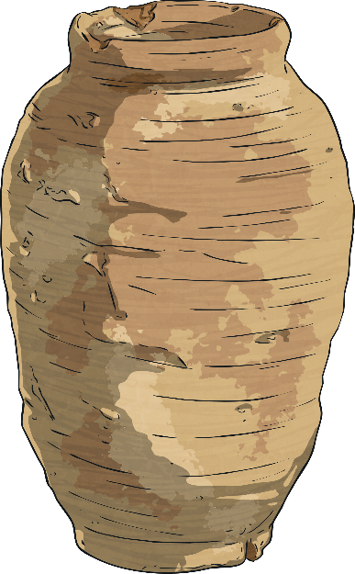
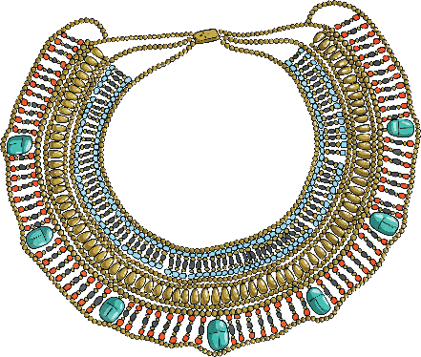
Transport and Trade
There was no such thing as money in ancient Egypt so people would trade by swapping things like pottery, food, jewellery and art etc.
Boats were use to travel up and down the Nile to trade throughout the country.

Slide 8
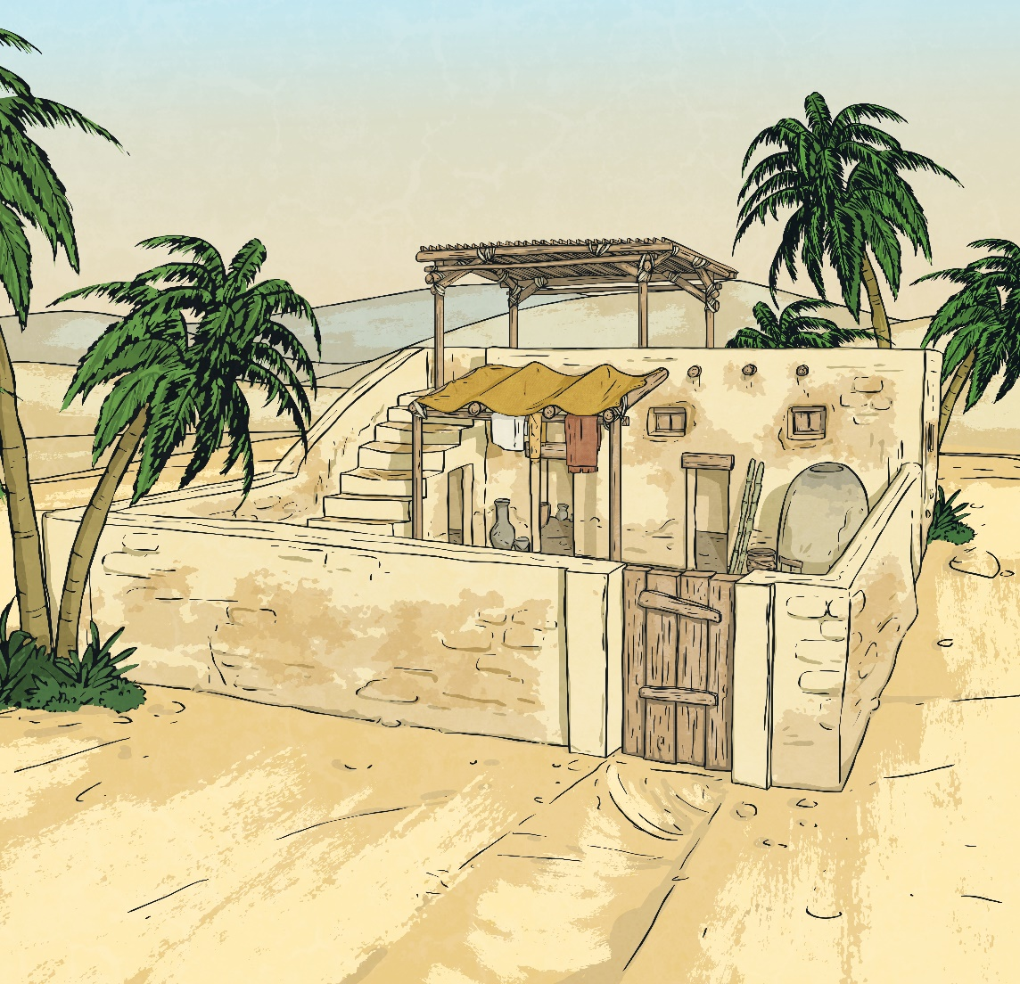
Building and Papyrus
Mud from around the River Nile would be used to make bricks for building.
The papyrus plants around the river were used to make papyrus which was the paper of the ancient Egyptians.

Slide 9
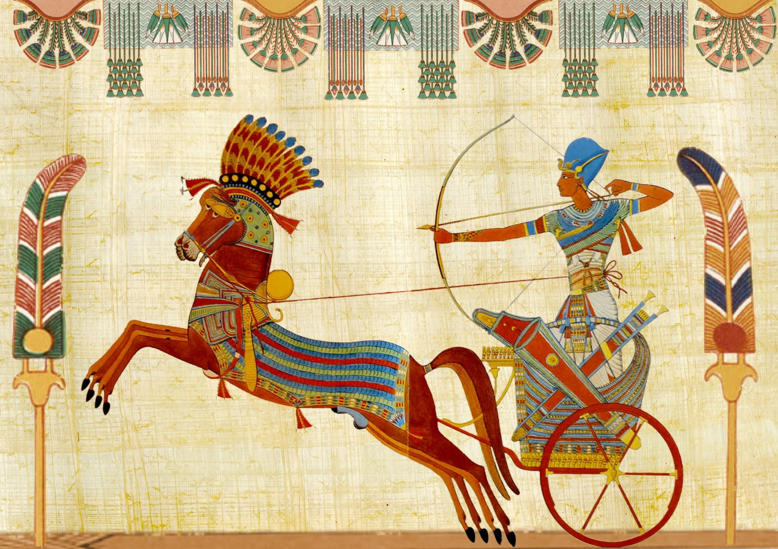

Slide 10
The Egyptian Calendar
The Egyptian year was based on the happenings of the River Nile. It had 3 seasons, each one lasting 4 months:
AHKET - July – October, this was flooding season
PERET – November – February, the fields were planted in this season
SHEMU – March – June, the crops were harvested.

Slide 11
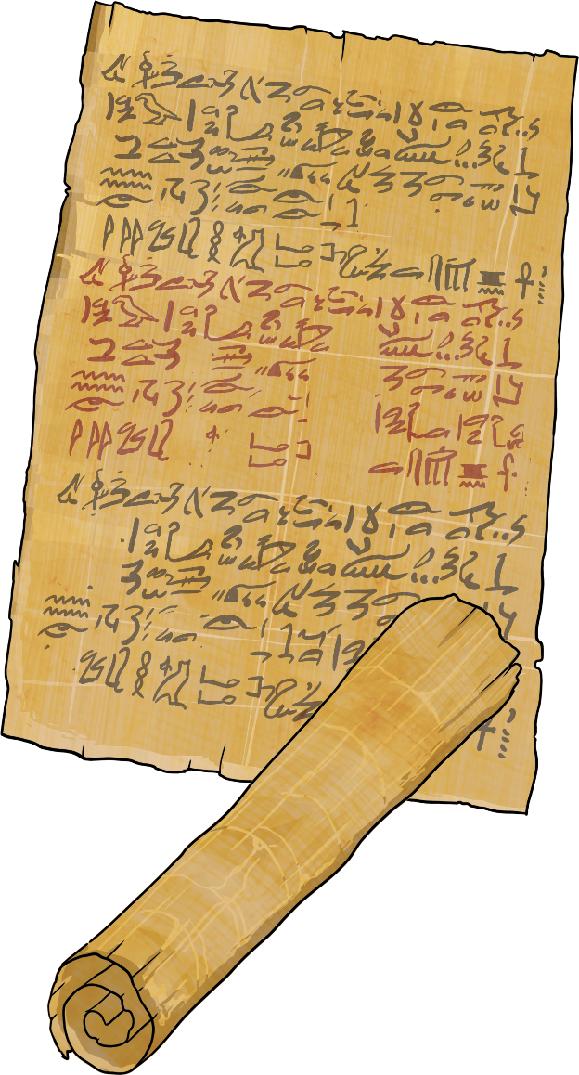
Task
Now use your worksheets to write down what you remember about why the River Nile was so important to the ancient Egyptians.

