Slide 2
What Is Father’s Day?
Father’s Day is a day of celebration, recognising dads, grandads and other father figures in our lives.
On this day, children and adults say thank you to the father figures or special people in their lives.
Usually, people buy their fathers a gift and a card, as well as spending time with them.

Slide 3
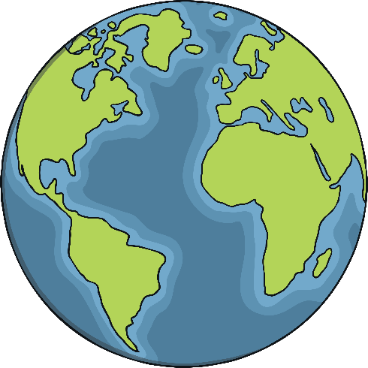
When Is Father’s Day?
Father’s Day is celebrated worldwide. In the majority of countries, it is celebrated on the third Sunday in June.
The date varies every year, but it is always on the third Sunday of the month.
In Catholic Europe, Father’s Day has been celebrated on March 19th for hundreds of years. Countries such as Portugal and Spain celebrate on this day.

Slide 4
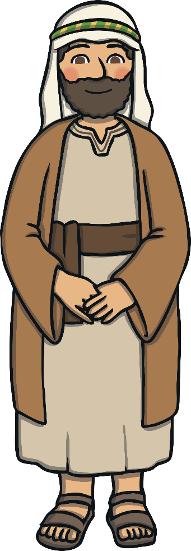
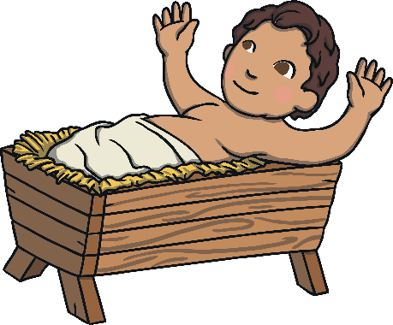
When Did Father’s Day Begin?
The celebration of fatherhood in Catholic Europe is thought to date back to the middle ages. People celebrated on 19th March, which is also St Joseph’s Day, recognising the importance of Joseph in Jesus’ life.
This day is now known as Father’s Day in some European countries as well as in Latin America.

Slide 5
When Did Father’s Day Begin in the USA and UK?
In America, the tradition of Father’s Day first began in 1910 (only just over 100 years ago). Sonora Smart Dodd lived with her dad and siblings, as sadly her mum had died. She felt that fathers should be recognised in the same way in which mothers were on Mother’s Day.

Slide 6
When Did Father’s Day Begin in the USA and UK?
Although, at first, the popularity of the celebration faded, it soon became very well celebrated. In 1972, the president of America declared a national celebration of Father’s Day on the third Sunday of June, every year.

Slide 7
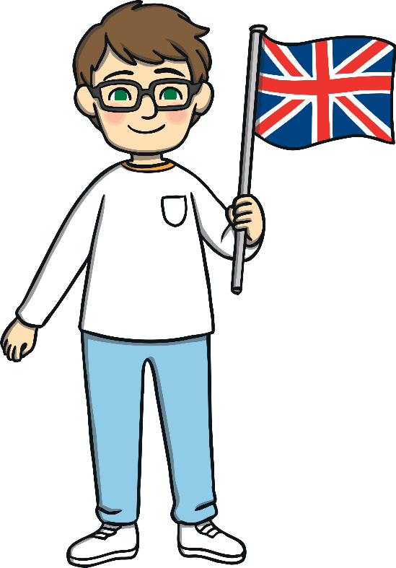
When Did Father’s Day Begin in the USA and UK?
Although the United Kingdom shares the same Father’s Day as America, it is not known exactly when it was first celebrated here. It is thought it was after the Second World War.

Slide 8
How Is Father’s Day Celebrated Today?
It is the day to make your dad feel special. Let him relax, make him a drink or some breakfast. Remember to ask an adult for help.

Slide 9
How Is Father’s Day Celebrated Today?
Many people choose to buy a gift for their dad. Think about what your dad would like. Would he like a tie or maybe some chocolate?

Slide 10
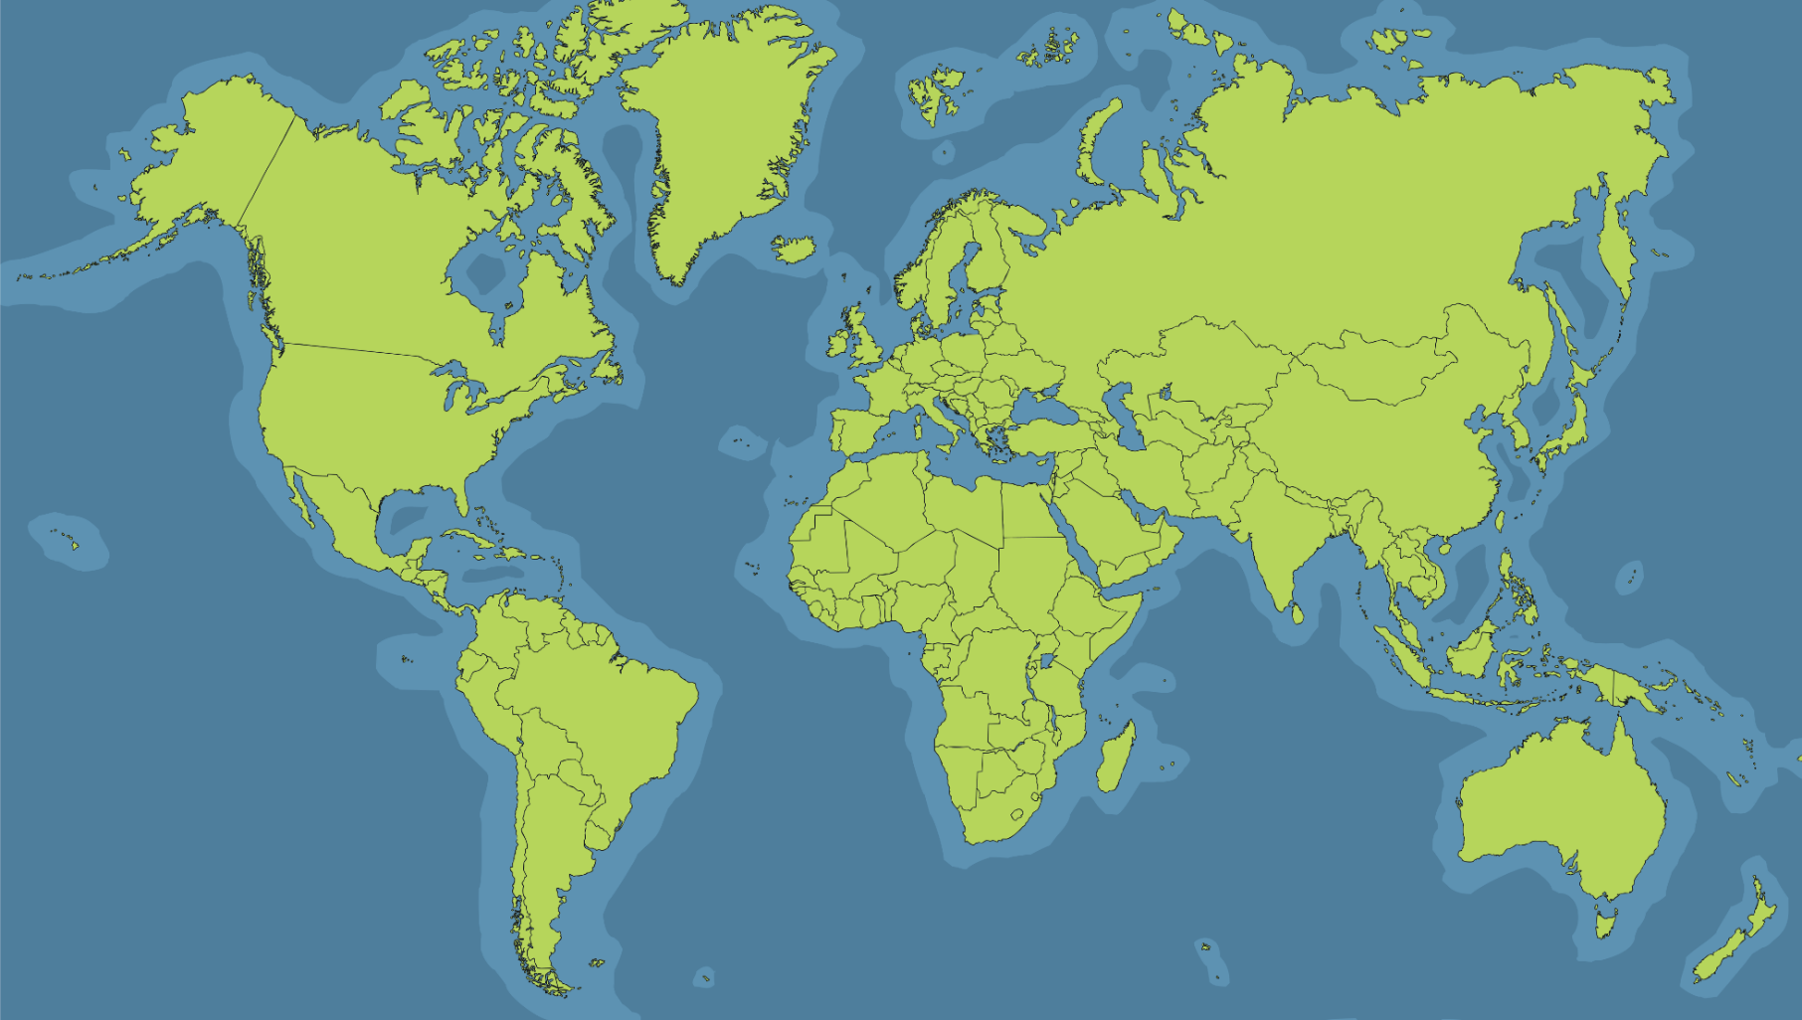
How Is Father’s Day Celebrated Around the World?
Father’s Day is celebrated on Ascension Day in Germany. Traditionally, groups of men gathered together to pull a wooden cart around town and celebrate.
Germany

Slide 11
How Is Father’s Day Celebrated Around the World?
In Russia, Father’s Day is also known as ‘Men’s Day’. The celebration includes parades around town. Interestingly, all women give gifts to important men in their lives, not just father figures.
Russia

Slide 12
How Is Father’s Day Celebrated Around the World?
Father’s Day is a fairly new celebration in India. Children give cards and flowers to show their affection. People often go out for meals and picnics too.
India

Slide 13
How Is Father’s Day Celebrated Around the World?
In Thailand, Father’s Day is celebrated on the birthday of a past king. Thai people celebrate by giving their fathers and grandfathers canna lilies.
Thailand

Slide 14
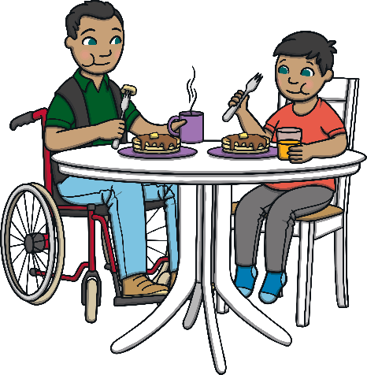
How Will You Celebrate Father’s Day?
There are many different ways in which you can celebrate Father’s Day. It is important to remember to tell your dad or special person how important they are to you and thank them for all the things they do for you. Give them a cuddle and make them feel very special.

