Slide 1
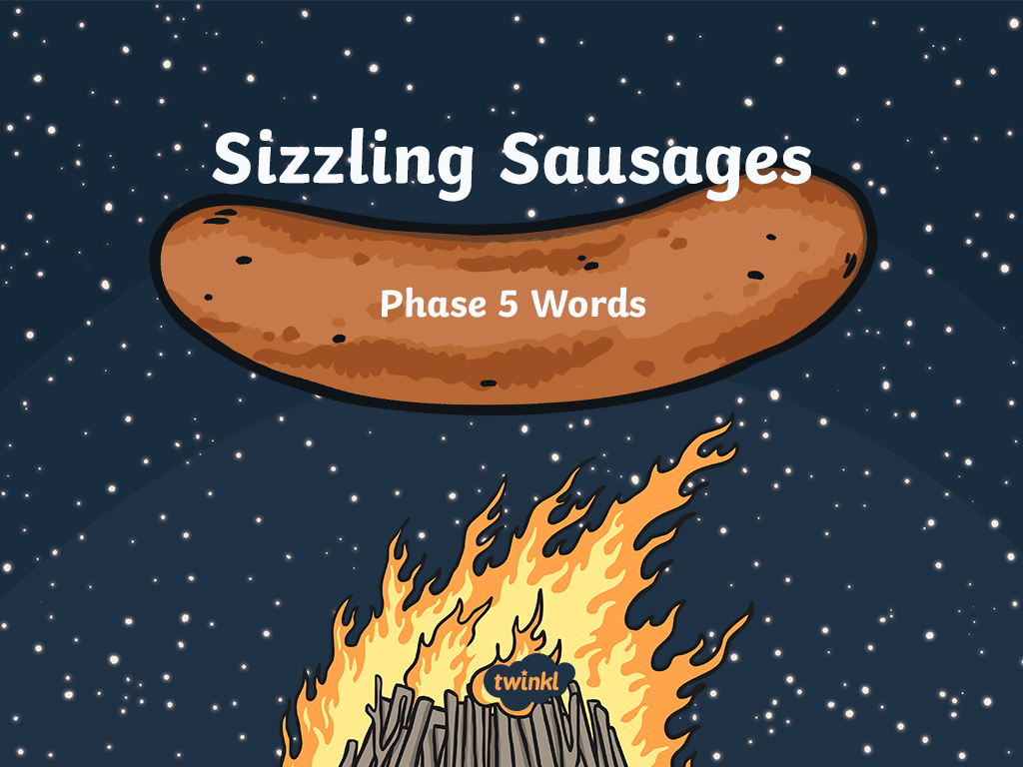

Slide 2
Guess the hidden word on the sausage!
Round 1
Click the sausage to reveal a hidden letter or letters – can you guess what the word might be? Write down as many suggestions as you can.
Round 2
Click again to reveal another letter or letters. Write down your suggestions. How many words can you get now?
Check
Click the sausage again to reveal the hidden word. Score a point for each incorrect but possible word and 3 points for guessing the correct answer!

Slide 3



c
l
ay

Slide 4
l
ou
d

Slide 5
F
r
ie
d

Slide 6
b
ea
d

Slide 7
r
oy
a
l

Slide 8
g
ir
l

Slide 9
g
l
ue

Slide 10
r
e
s
c
ue

Slide 11
d
aw
n

Slide 12
wh
a
ck

Slide 13
a
l
ph
a
b
e
t

Slide 14
s
c
r
ew

Slide 15
n
ew
t

Slide 16
g
e
ck
oe
s

Slide 17
a
s
t
r
o
n
au
t

Slide 18
d
o
n
k
ey

Slide 19
f
m
l
a e

Slide 20
v
n
e e

Slide 21
s
n
h
i e

Slide 22
b
o
n
e

Slide 23
f
t
l
u e

Slide 24
c
u e
b

Slide 25


