Slide 1
Maths
Measurement
Year One
Maths | Year 2 | Measurement | Standard Units | Lesson 2 of 5: Messy Mixtures

Slide 3
Aim
To estimate and measure mass in grams and kilograms.
Success Criteria
I can use language related to mass.
I can estimate the weight of objects by handling them.
I can use scales to measure in grams and kilograms.

Slide 4
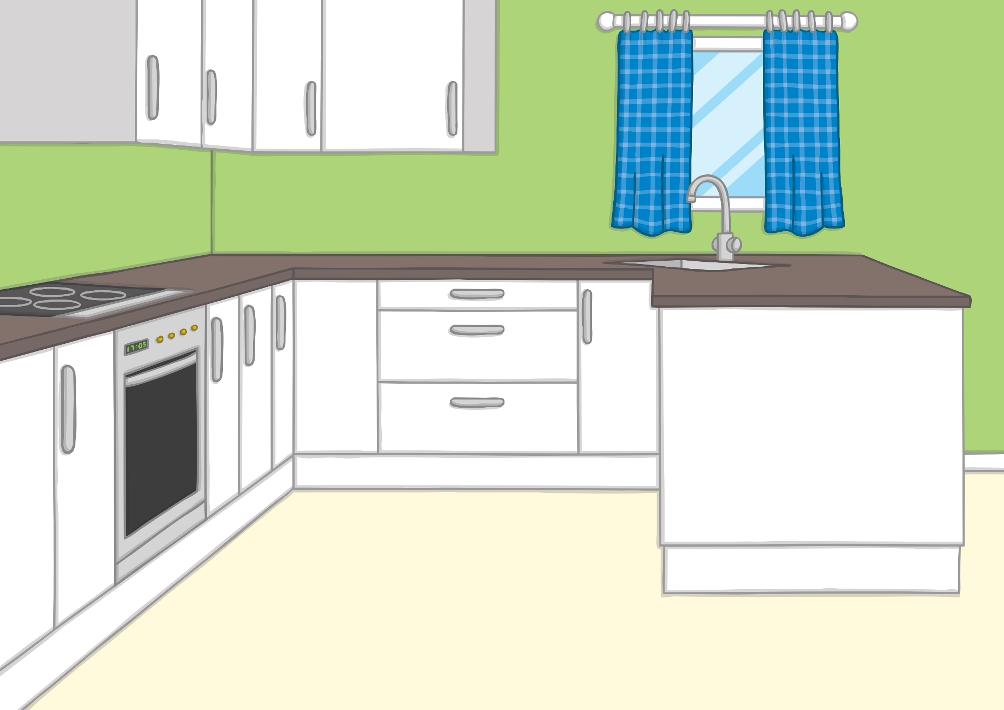
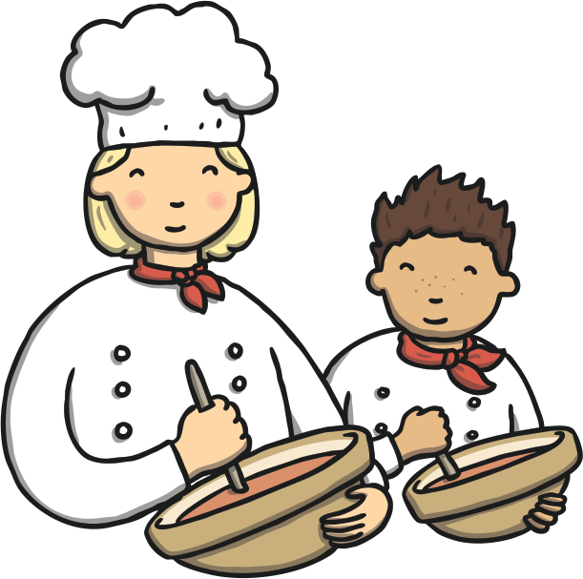
Standard Unit Snap
?
Can you match the units of measurement?
Click on a red card and blue card to turn them over. Shout ‘Snap!’ when you find a pair.
Click here to play the game!

Slide 5
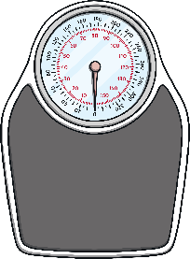
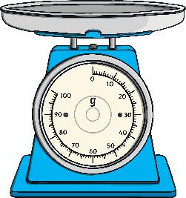
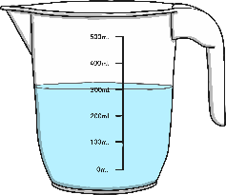
centimetre
kilogram
kg
m
?
?
?
?
metre
gram
l
ml
?
?
?
?
millilitre
litre
g
cm
?
?
?
?
No Match
Found a match? Tick the matching box.
Exit Game

Slide 6
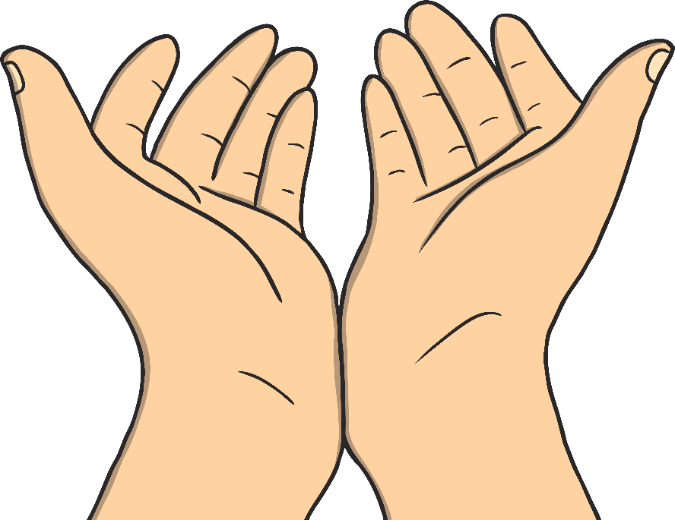
Heavier and Lighter
Than a Kilogram
There are 1000 grams in 1 kilogram.
We can write g for gram.
We can write kg for kilogram.
Work in a group to find objects in the classroom which are heavier and lighter than a kilogram. Hold the weight in one hand and the object in the other to help you compare them.
?
Did you find any objects which were roughly equal to a kilogram?

Slide 7
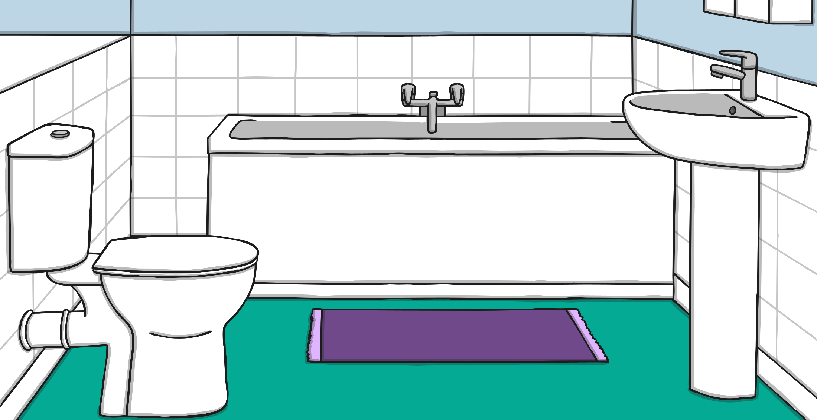
Reading Scales
Here are some bathroom scales. They measure kilograms.
40kg
Can you count in 10s along the scale?
20
30
10
40
0
50
kg
?
Where is the arrow pointing to on the scale?
How many kilograms are the scales measuring?

Slide 8
Reading Scales
Here are some bathroom scales. They measure kilograms.
10kg
20
30
10
40
0
50
kg
?
Where is the arrow pointing to on the scale?
How many kilograms are the scales measuring?

Slide 9
Reading Scales
Here are some bathroom scales. They measure kilograms.
15kg
The dial is between 10 and 20.
What number is half way between?
20
30
10
40
0
50
kg
?
Where is the arrow pointing to on the scale?
How many kilograms are the scales measuring?

Slide 10
Reading Scales
Here are some bathroom scales. They measure kilograms.
25kg
The dial is between 20 and 30.
What number is half way between?
20
30
10
40
0
50
kg
?
Where is the arrow pointing to on the scale?
How many kilograms are the scales measuring?

Slide 11
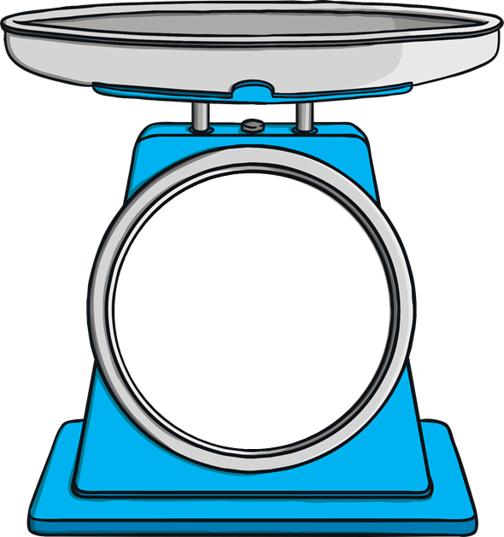
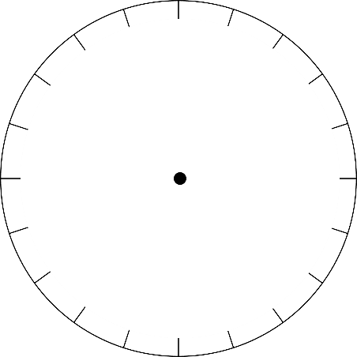
Reading Scales
Here are some kitchen scales. They measure grams.
10g
Can you count in 5s along the scale?
90
100
10
80
20
70
g
30
60
50
40
?
Where is the arrow pointing to on the scale?
How many grams are the scales measuring?

Slide 12
Reading Scales
Here are some kitchen scales. They measure grams.
75g
90
100
10
80
20
70
g
30
60
50
40
?
Where is the arrow pointing to on the scale?
How many grams are the scales measuring?

Slide 13
Reading Scales
Here are some kitchen scales. They measure grams.
50g
What is the maximum weight the scales can measure?
90
100
10
80
20
70
g
30
60
50
40
?
Where is the arrow pointing to on the scale?
How many grams are the scales measuring?

Slide 14
Reading Scales
Here are some kitchen scales. They measure grams.
97g
The arrow has just moved past 95g. Is it closer to 95g or 1000g?
90
100
10
80
20
70
g
30
60
50
40
?
Where is the arrow pointing to on the scale?
How many grams are the scales measuring?

Slide 15
Reading Scales
Here are some kitchen scales. They measure grams.
21g
The dial has just moved past 20g. Is it closer to 20g or 25g?
90
100
10
80
20
70
g
30
60
50
40
?
Where is the arrow pointing to on the scale?
How many grams are the scales measuring?

Slide 16
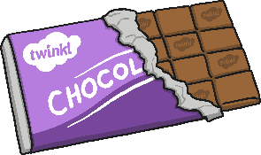
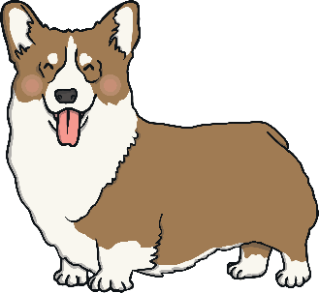
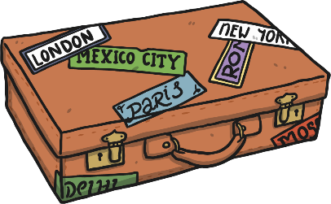
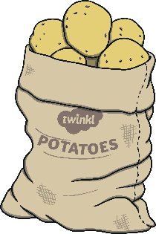
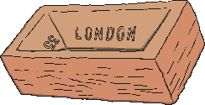
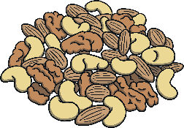
Grams or Kilograms?
Sort these pictures into two groups:
Objects you would measure in grams:
Objects you would measure in kilograms:
Click the pictures to reveal the answers.

Slide 17
Grams or Kilograms?
?
Which of these objects could you sensibly measure in both grams or kilograms?
Objects you would measure in grams:
Objects you would measure in kilograms:

Slide 18
Aim
To estimate and measure mass in grams and kilograms.
Success Criteria
I can use language related to mass.
I can estimate the weight of objects by handling them.
I can use scales to measure in grams and kilograms.

