Slide 1
Maths
Number and Place Value
Year One
Maths | Number and Place Value | Counting in Multiples | Counting in Fours | Lesson 1 of 4

Slide 3
Aim
To count in multiples of four.
Success Criteria
I can count forwards in steps of four.
I can count backwards in steps of four.
I can recognise multiples of four.

Slide 4
Remember It
How far can you count forwards in twos? Can you count to 40? 80? 100?
Can you count backwards in twos from 40? 80? 100?
If you count forwards in twos from 10, what will be the tenth number you say?
If you count forwards in twos from 30, what will be the eighth number you say?
If you count forwards in twos from 40, what will be the sixth number you say?
If you count forwards in twos from 50, what will be the twelfth number you say?

Slide 5
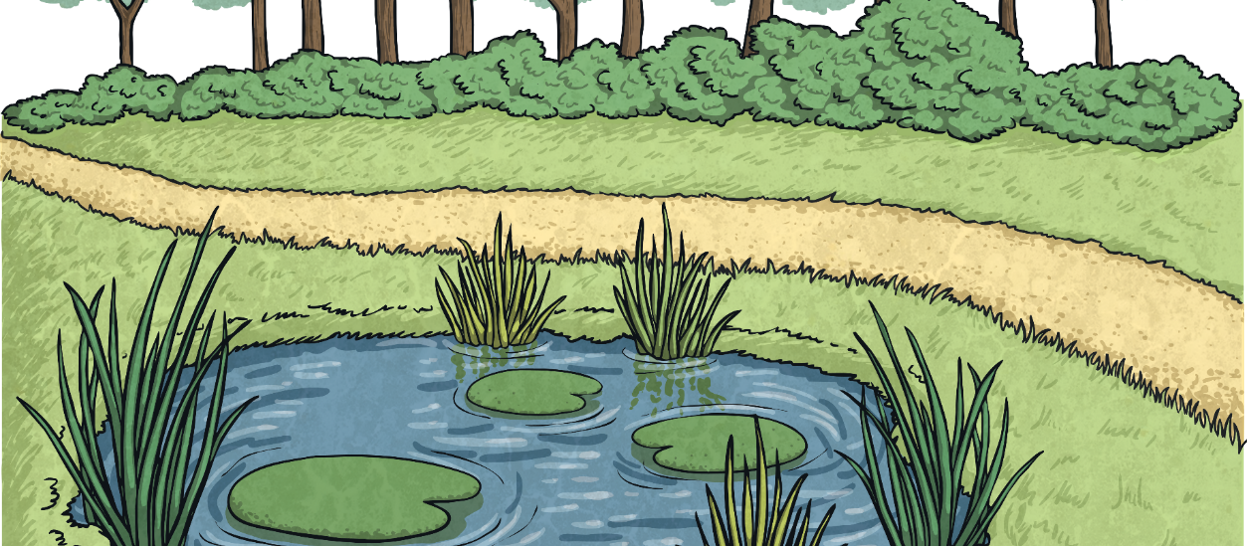
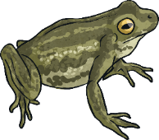
Forward Frog Leaps
Tiddalick loves to count while he is jumping on the lily pads.
Today, he is going to count in multiples of 4.
Multiples of 4 are a counting pattern where we start at 0 and count in steps of 4.
What are multiples of 4?

Slide 6
Forward Frog Leaps
Tiddalick loves to count while he is jumping on the lily pads.
Today, he is going to count in multiples of 4.
I will start at 0 and count along in steps of 4.
How will you count in multiples of 4?
0, 4, 8…

Slide 7
Forward Frog Leaps
Tiddalick wants to count in multiples of 4 from zero.
Let’s help him!
+4
+4
+4
+4
+4
+4
+4
+4
+4
+4
0
4
8
12
16
20
24
28
32
36
40
To count in multiples of 4, Tiddalick adds four on each jump.

Slide 8
Forward Frog Leaps
Let’s have a go again but this time, Tiddalick wants you to predict the next number before he jumps.
+4
+4
+4
+4
+4
+4
+4
+4
+4
+4
0
4
8
12
16
20
24
28
32
36
40

Slide 9
Forward Frog Leaps
Tiddalick wants you to practise counting up in 4s in your quietest voice.
0
4
8
12
16
20
24
28
32
36
40

Slide 10
Forward Frog Leaps
Tiddalick wants you to practise counting up in 4s in your squeakiest voice.
0
4
8
12
16
20
24
28
32
36
40
reveal

Slide 11
Forward Frog Leaps
Tiddalick wants you to practise counting up in 4s in your deepest voice.
0
4
8
12
16
20
24
28
32
36
40
reveal

Slide 12
Forward Frog Leaps
Tiddalick wants you to practise counting up in 4s while jumping like a frog.
0
4
8
12
16
20
24
28
32
36
40
reveal

Slide 13
Forward Frog Leaps
Oh no! Tiddalick has lost some of the numbers.
How could he find out the missing numbers?
0
4
8
12
16
20
24
28
32
36
40

Slide 14
Backward Frog Leaps
Now, Tiddalick will count back in steps of four!
Let’s help him. He is going to start at 40.
-4
-4
-4
-4
-4
-4
-4
-4
-4
-4
0
4
8
12
16
20
24
28
32
36
40
To count in multiples of 4, Tiddalick subtracts 4 on each jump.

Slide 15
Backward Frog Leaps
Tiddalick is still counting backwards.
This time, he starts at 32. Help him to count backwards.
-4
-4
-4
-4
-4
-4
-4
-4
0
4
8
12
16
20
24
28
32

Slide 16
Backward Frog Leaps
This time he is starting at 36.
Help him to count backwards.
-4
-4
-4
-4
-4
-4
-4
-4
-4
0
4
8
12
16
20
24
28
32
36

Slide 17
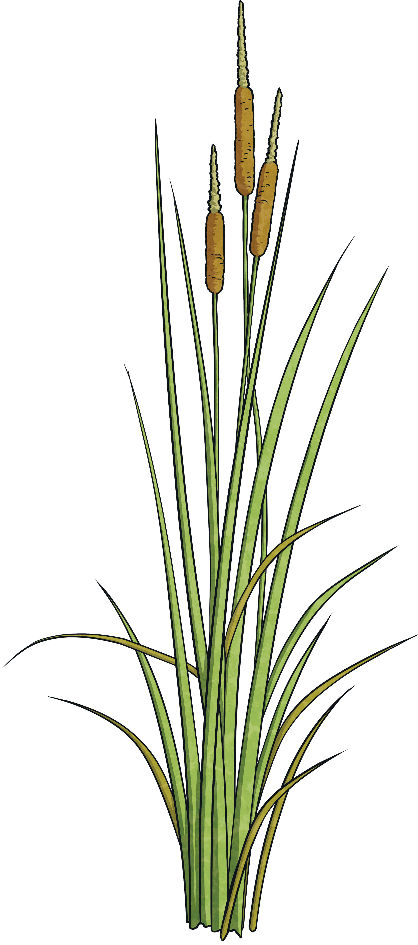
Help Tiddalick
reveal
0, 4, 8, 12, 16, 20, 24
Tiddalick has tried to count forwards or backwards in steps of 4. Can you spot his mistakes?
36, 32, 28, 24, 18, 16, 12, 8, 4, 0
36, 32, 28, 24, 20, 16, 12, 8, 4, 0
28, 24, 20, 16, 12, 8, 4, 0
0, 4, 8, 12, 16, 20, 22, 26
0, 4, 8, 12, 16, 20, 24, 28

Slide 18
Tiddalick’s Thoughts
Tiddalick has been doing lots of jumping across lily pads! He thinks he has found something out.
Do you agree with Tiddalick? Give examples to show why you agree or disagree with Tiddalick.
Multiples of four are also multiples of two.

Slide 19
Aim
To count in multiples of four.
Success Criteria
I can count forwards in steps of four.
I can count backwards in steps of four.
I can recognise multiples of four.

