Slide 2
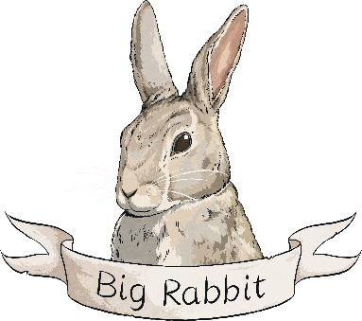
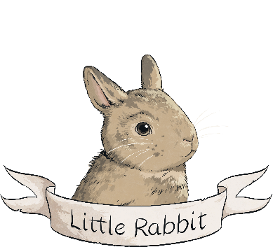
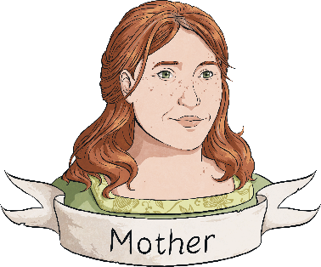
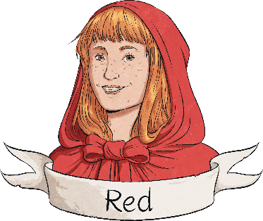
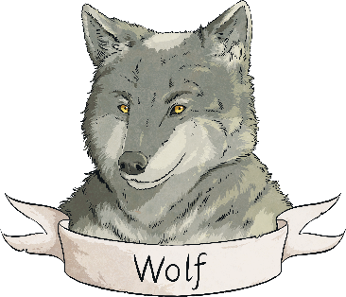
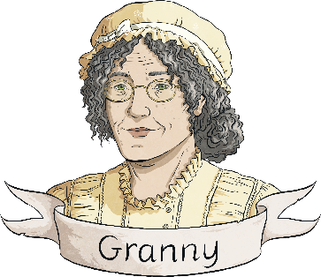
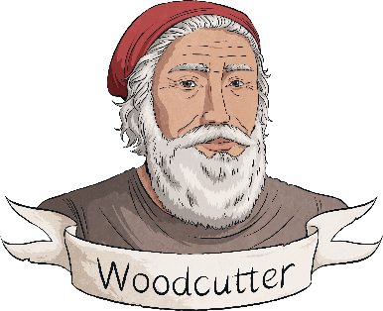
Characters
a younger sibling, eager for a story
usually baking, she wears a floury apron and ^{carries a rolling pin}
an older sibling, and our animal narrator
^{a young girl who wears} ^{a red, hooded cape}
a very fine-looking gentleman with thick hair, bright eyes and very big, white teeth, who turns out to be a trickster
a widow with a frail voice who lives alone in the forest, ^{and who loves to knit and bake}
^{though he’s getting on in} years, he still feels flutters of ^{affection in his heart when} ^{he sees Granny’s face}
Why is it important to summarise each character?

Slide 3
What is meant by 'lights up'?
Why has 'excited' been written in brackets?

Slide 4
What is meant by 'offstage'?
What do we learn about Red and her mother's relationship in this scene?

Slide 5
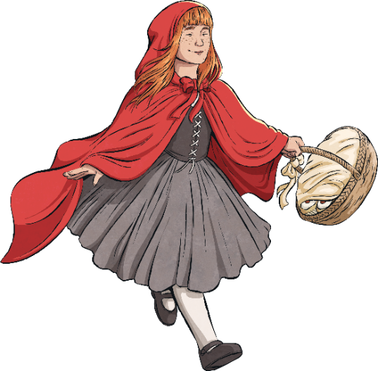
What does Mother mean when she tells Red that there should be no 'dilly-dallying'?
Why has the scene ended with 'lights down'?

Slide 6
How do we know that the setting for this scene is different to the first?
What was the weather like in this scene?

Slide 7
What two things does the wolf say that he likes?
Why does Red sigh 'with relief'?

Slide 8
Where does Granny live?
Do you think that the wolf really knows Granny?

Slide 9
What is meant by the stage direction 'aside'?
What do you predict Wolf will do next?

Slide 10
Find one adjective that Wolf uses to describe Red.
Why did Wolf think that he would get 'double helpings'?

Slide 11
How does Wolf trick Granny into letting him in?
What does the word 'saunters' tell us about how Wolf is feeling?

Slide 12
Why did Big Rabbit describe what Red had been doing before she came back to the stage?
Why did Wolf use a 'frail voice'?

Slide 13
What is the first thing that Red thinks is unusual?
Do you think Red knows who Granny really is at the end of the scene?

Slide 14
What does 'no longer pretending' tell us about Wolf's voice and actions?
What do you predict the woodcutter will do?

Slide 15
Why does Big Rabbit describe the woodcutter's actions?
How did Little Rabbit feel about Red and Granny filling Wolf's belly with rocks?

Slide 16
Why was Wolf going to struggle to eat from now on?
How does Granny feel when she finds out that Red told Wolf where to find her?

Slide 17
Do you think that Red will behave differently in the future?
If you could add one more scene to the end of this play, what would happen next?

