Slide 2
Diving into Mastery Guidance for Educators
Each activity sheet is split into three sections, diving, deeper and deepest, which are represented by the following icons:
These carefully designed activities take your children through a learning journey, initially ensuring they are fluent with the key concept being taught; then applying this to a range of reasoning and problem-solving activities.
These sheets might not necessarily be used in a linear way. Some children might begin at the ‘Deeper’ section and in fact, others may ‘dive straight in’ to the ‘Deepest’ section if they have already mastered the skill and are applying this to show their depth of understanding.
Diving
Deeper
Deepest

Slide 3
Aim
Recall and use multiplication and division facts for the 3, 4 and 8 multiplication tables.

Slide 4
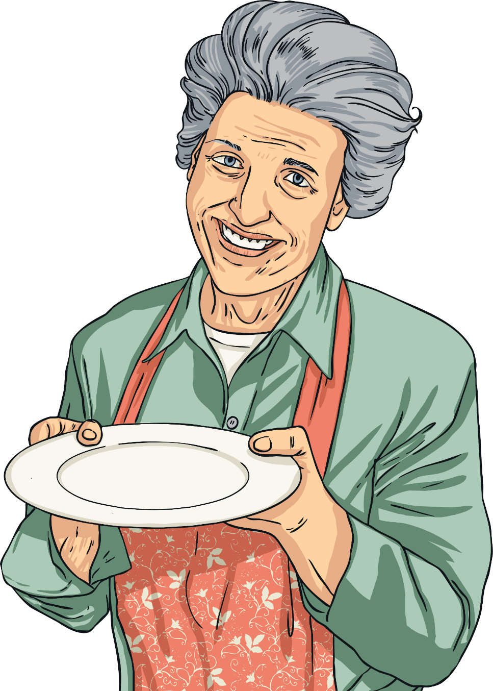
Multiply by 4
Diving
Cupcakes are served in boxes of 4.
How many cakes will be served for each order?
What calculations would you use?
2 boxes
5 boxes
2 × 4 = 8
5 × 4 = 20
4 × 2 = 8
7 boxes
4 × 5 = 20
7 × 4 = 28
4 × 7 = 28

Slide 5
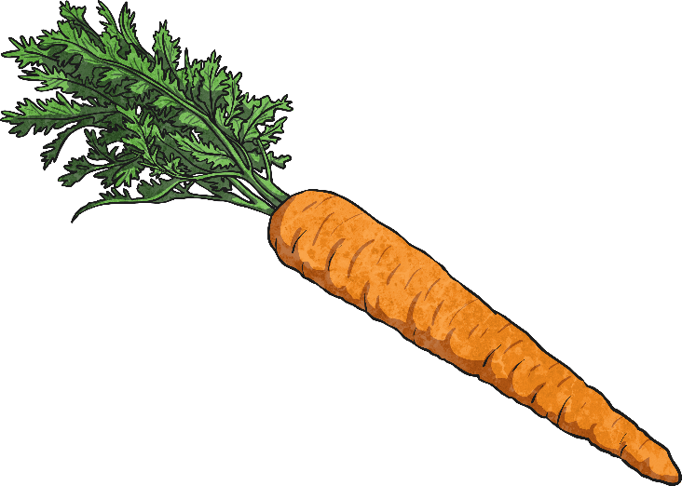
Multiply by 4
Diving
How many carrots is Farmer Twinklson growing? Complete the statement and write the calculation.
There are groups of plants.
3
4
× =
3
4
12

Slide 6
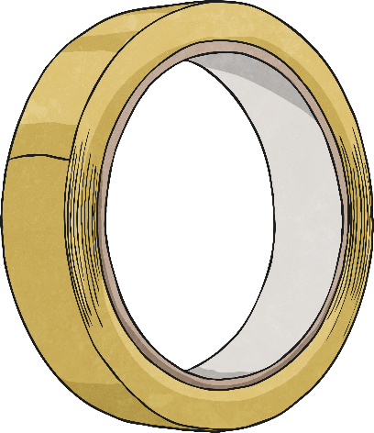
Multiply by 4
Diving
Sticky tape is sold in packs of 4 rolls. Mr Best buys 6 packs. How many rolls of tape is that?
Complete the bar model to show your answer.
24
?
4 | 4 | 4 | 4 | 4 | 4

Slide 7
Multiply by 4
Deeper
Jim and Mayim have collected some bottles for a project.
Which statements match the arrangement?
Jim | Mayim
There are four lots of four bottles. | There are five lots of four bottles.
Melissa | Simon
5 + 5 + 5 + 5 | The total number of bottles is:
Mayim is correct as there are 5 groups, each containing 4 bottles.
Simon is correct as his calculation is equivalent to 5 lots of 4.
3 × 4
+
2 × 4

Slide 8
Multiply by 4
Deepest
Stuart is investigating patterns in the multiples of four.
He shades every fourth number on a 100 square.
Which of the following numbers will be shaded?
1
2
3
4
5
6
7
8
9
10
11
12
13
14
15
16
17
18
19
20
21
2
23
24
25
26
27
28
29
30
31
32
33
34
35
36
37
38
39
40
41
42
43
44
45
46
47
48
49
50
51
52
53
54
55
56
57
58
59
60
61
62
63
64
65
66
67
68
69
70
66 | 88
52 | 74
71
72
73
74
75
76
77
78
79
80
88
81
82
83
84
85
86
87
88
89
90
52
91
92
93
94
95
96
97
98
99
100

Slide 9
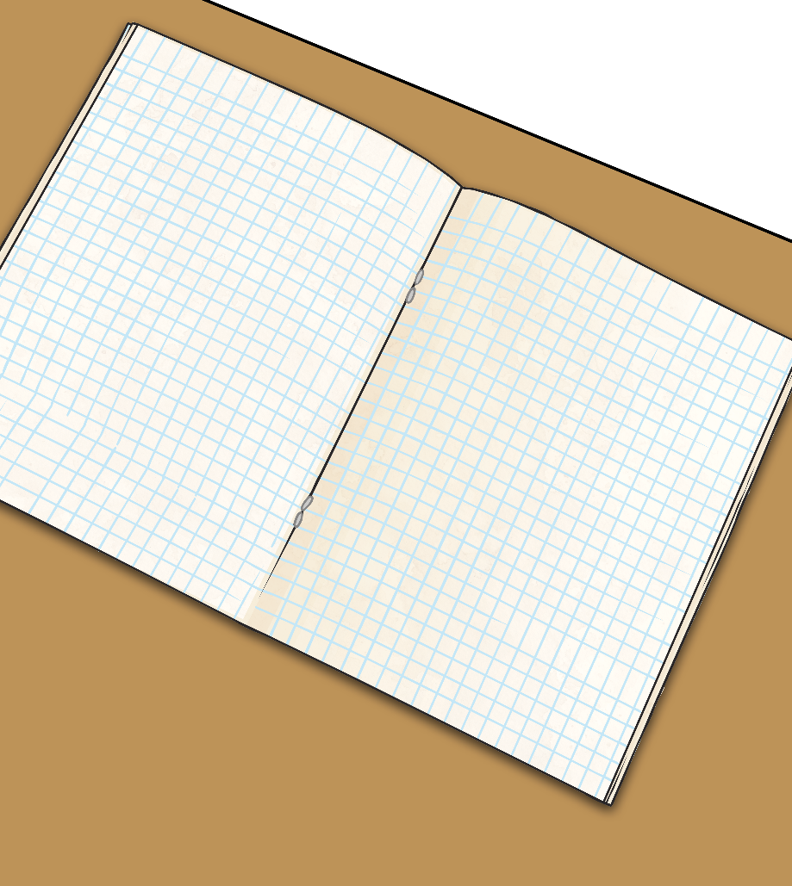
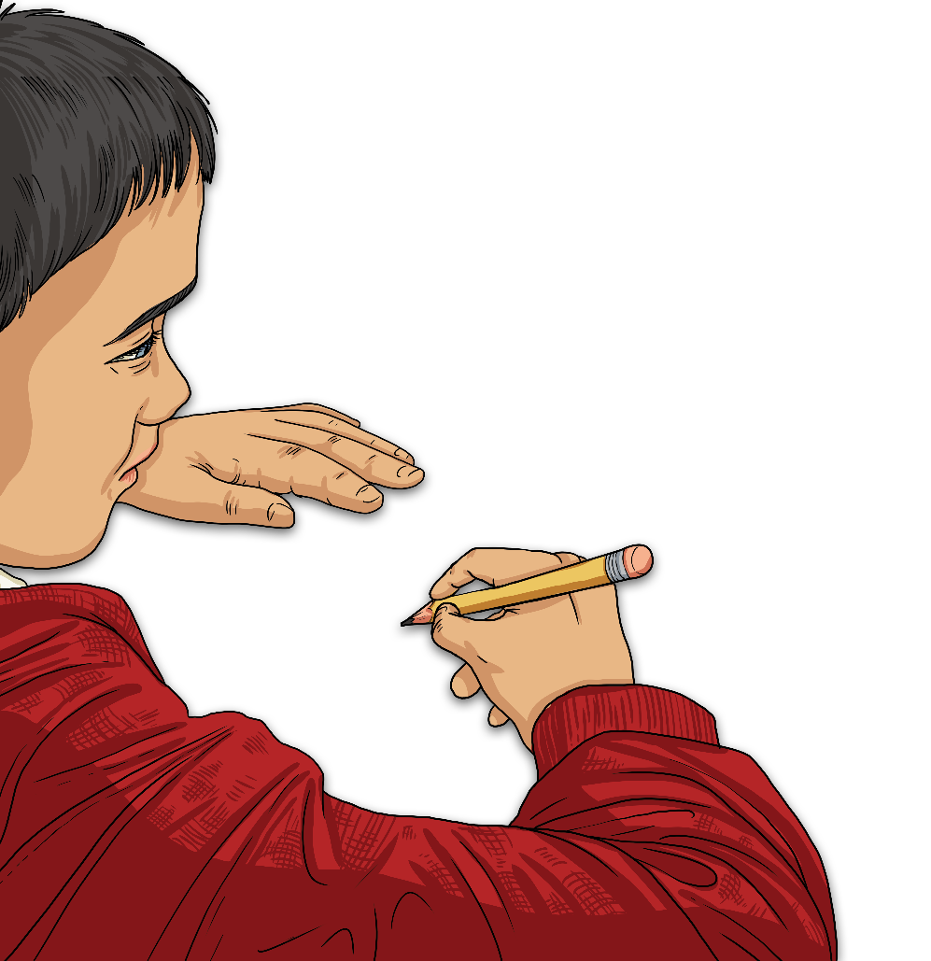
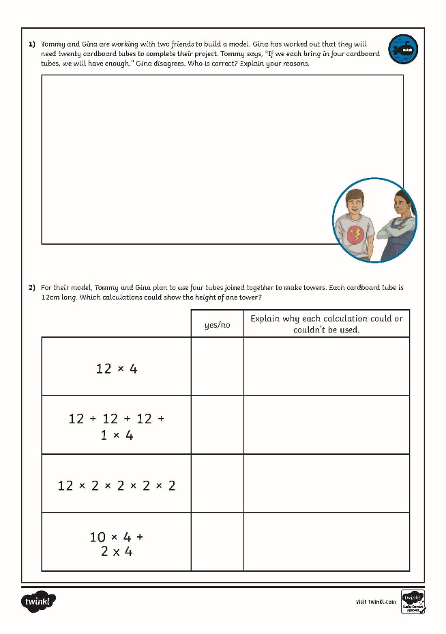
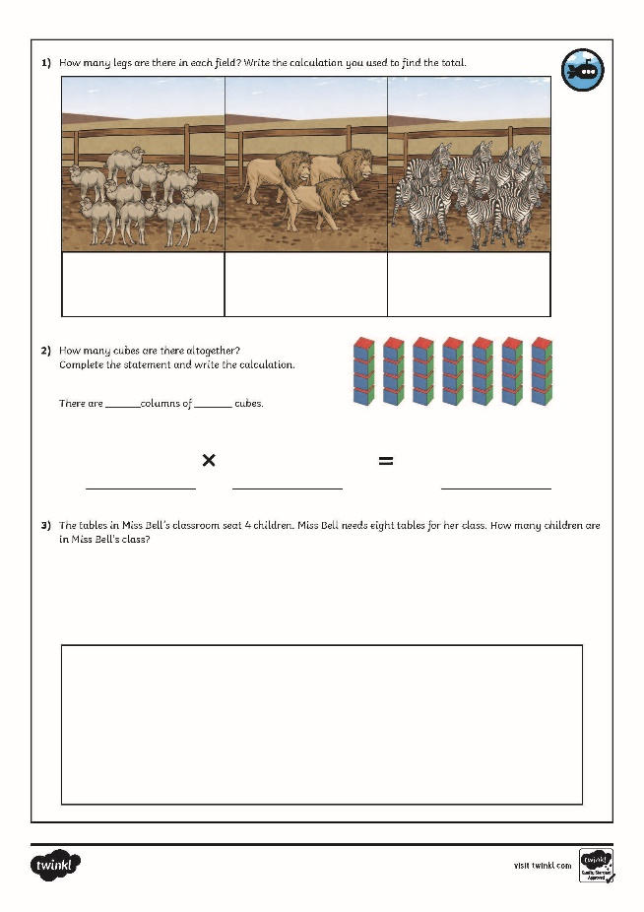
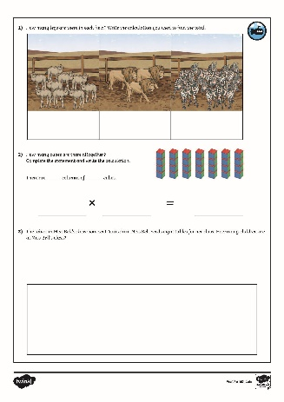
Multiply by 4
Dive in by completing your own activity!

Slide 10
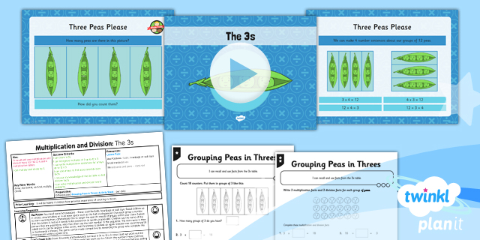
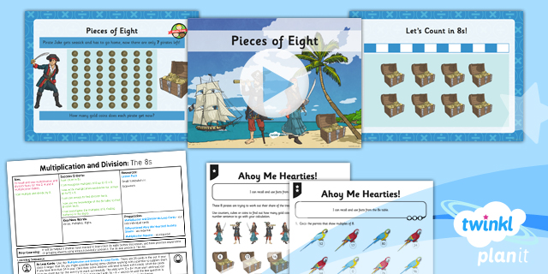
Need Planning to Complement this Resource?
National Curriculum Aim
Recall and use multiplication and division facts for the 3, 4 and 8 multiplication tables.
For more planning resources to support this aim, click here.
Twinkl PlanIt is our award-winning scheme of work with over 4000 resources.

