Slide 1
Geography
The UK
Year One
Geography | Year 3 | The UK | Countries and Cities | Lesson 1

Slide 3
Aim
I can name and locate the countries and cities of the UK.
I can use the eight compass points to describe the location of the countries and cities of the UK.
Success Criteria
I can locate the countries and cities of the UK.
I can name and label the capital cities of the countries of the UK.
I can label key cities in the UK on a map.
I can use the eight compass points to describe a location on the map.
I can use a compass direction to find a location on the map.
I can use the eight compass points to describe a location relative to another place.

Slide 4
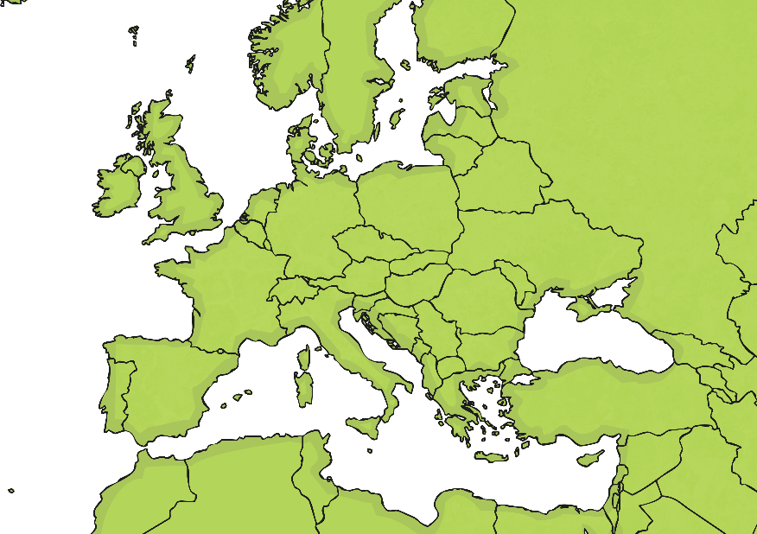
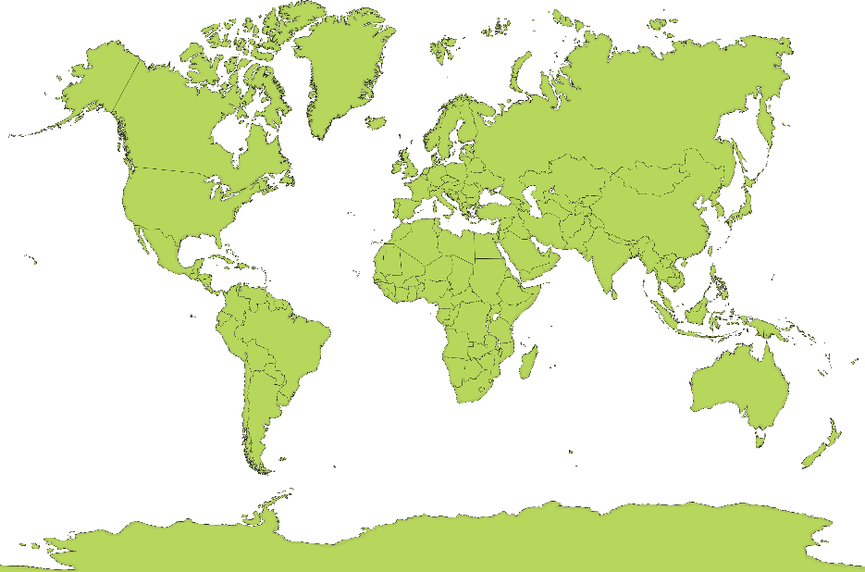
Where is the UK?
Can you spot the UK on each of these maps?

Slide 5
Where is the UK?
Can you spot the UK on each of these maps?

Slide 6
Where is the UK?
Can you spot the UK on each of these maps?

Slide 7
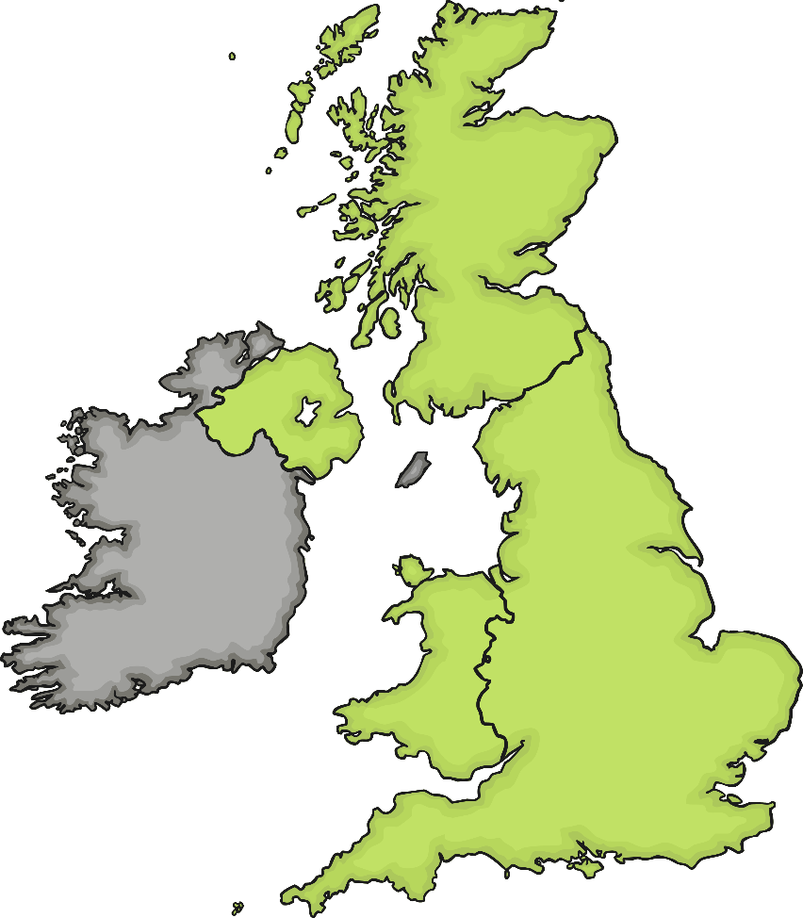
Which Countries Make
Up the UK?
Scotland
Northern Ireland
1
2
England
3
4
Wales

Slide 8
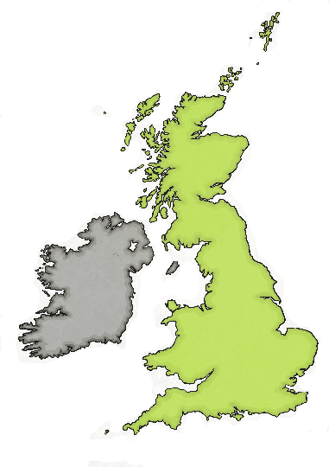
Which Countries Make
Up the UK?
The UK is short for:
The United Kingdom of Great Britain and Northern Ireland
Which countries do you think make up Great Britain?
The United Kingdom:
England
Scotland
Wales
Northern Ireland
Great Britain:
England
Scotland
Wales

Slide 9
Sorting the Facts
England
Northern Ireland
Scotland
Wales
I am home to Ben Nevis.
I am home to Snowdon.
I am home to the
Giant’s Causeway.
I am home to Stonehenge.
My capital city is Cardiff.
My capital city is Belfast.
My capital city is Edinburgh.
My capital city is London.

Slide 10
Sorting the Facts
Can you find the place each city is located on this map?
Look at a map on the UK in your atlas to help you.
London
Belfast
Edinburgh
Which city is being shown here?
S_________
Cardiff
Sheffield

Slide 11
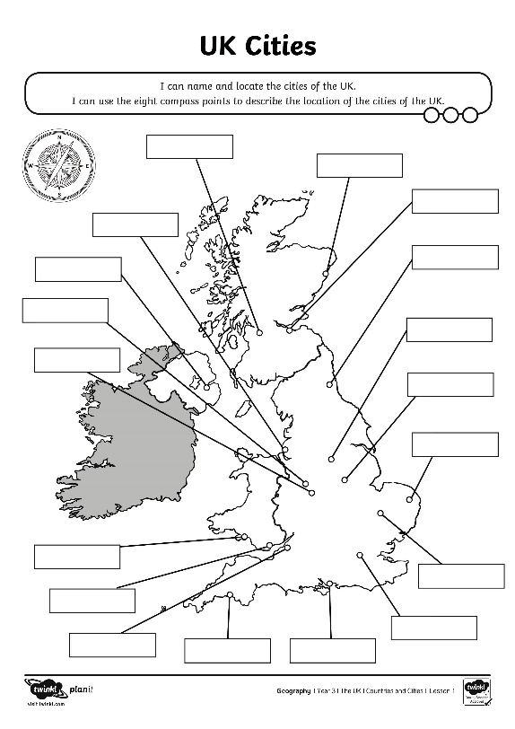
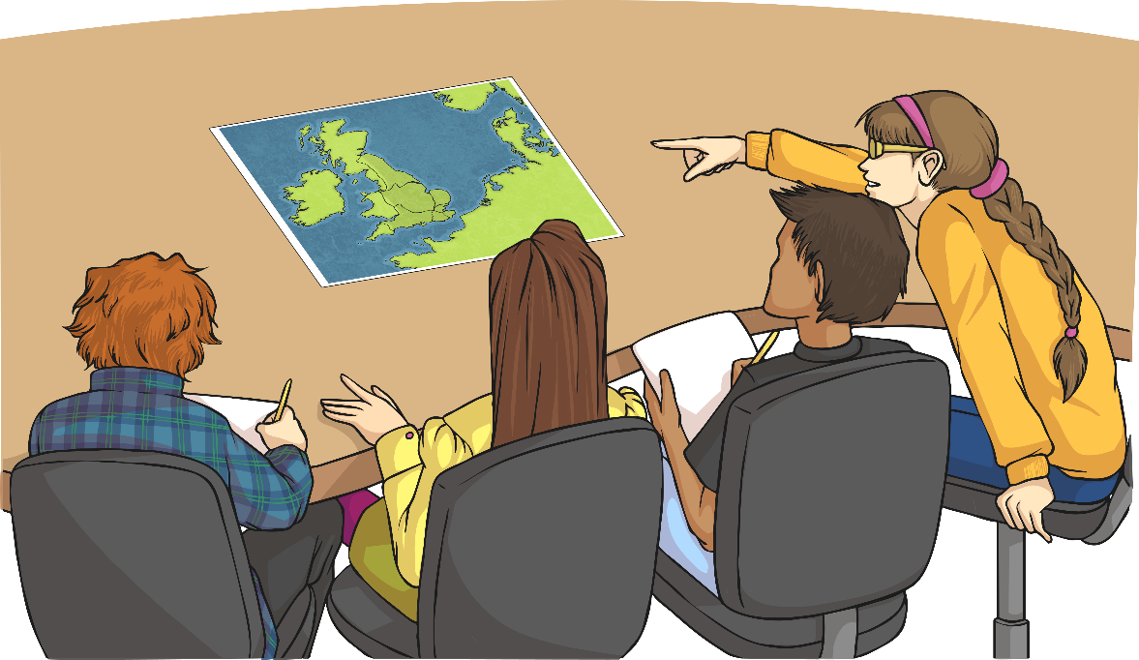
Cities in the UK
Use your atlases to find out the names of the cities shown on your map.
!
Extra Challenge: Can you find the town you live in and label it on the map?

Slide 12
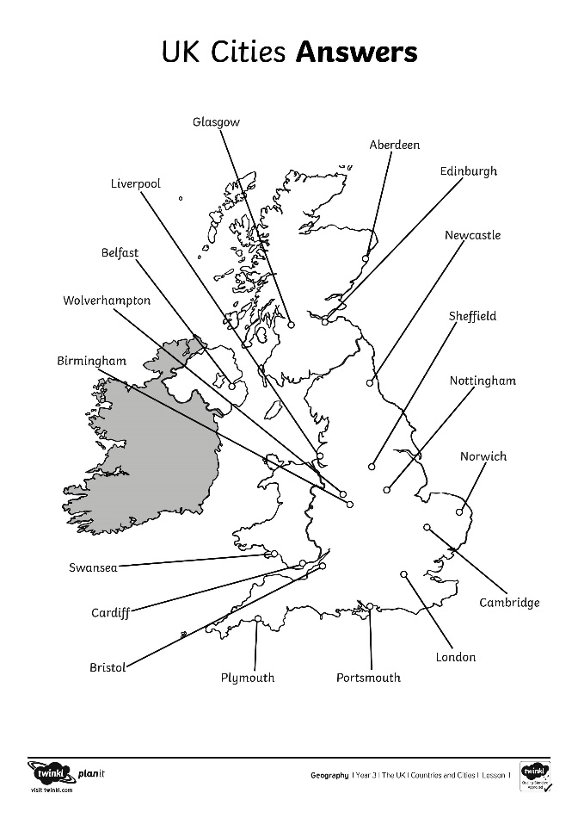
Where is That?
How could we describe the location of some of the cities?
?
I travel north from Bristol. Where do I arrive?
Aberdeen is in which direction from Edinburgh?
?

Slide 13
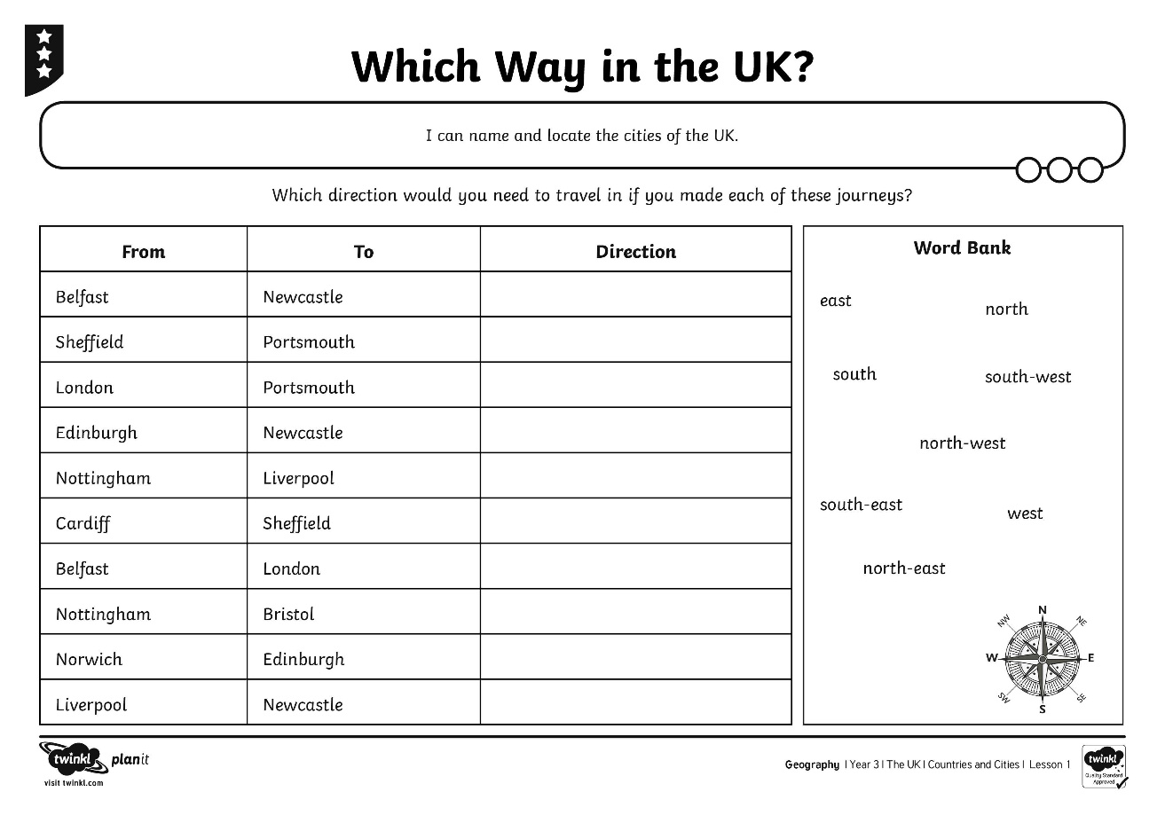
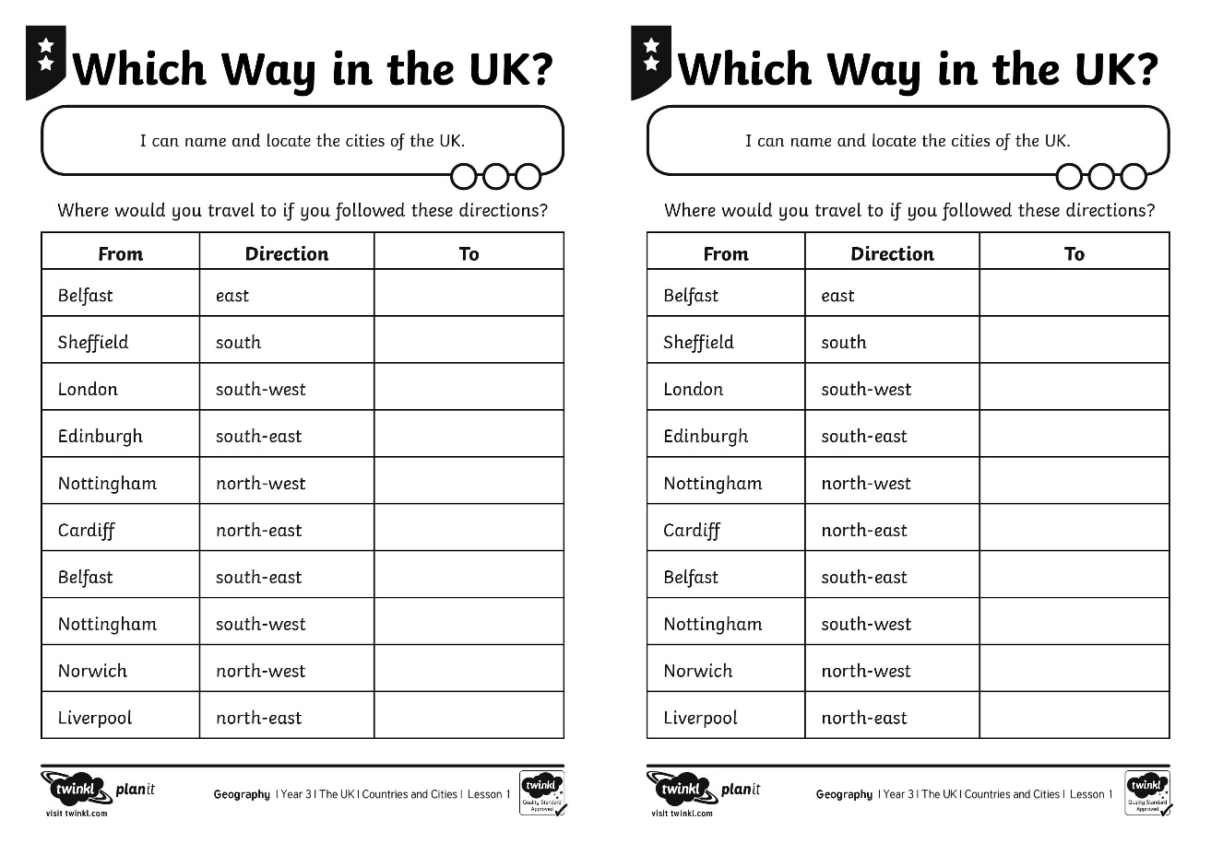
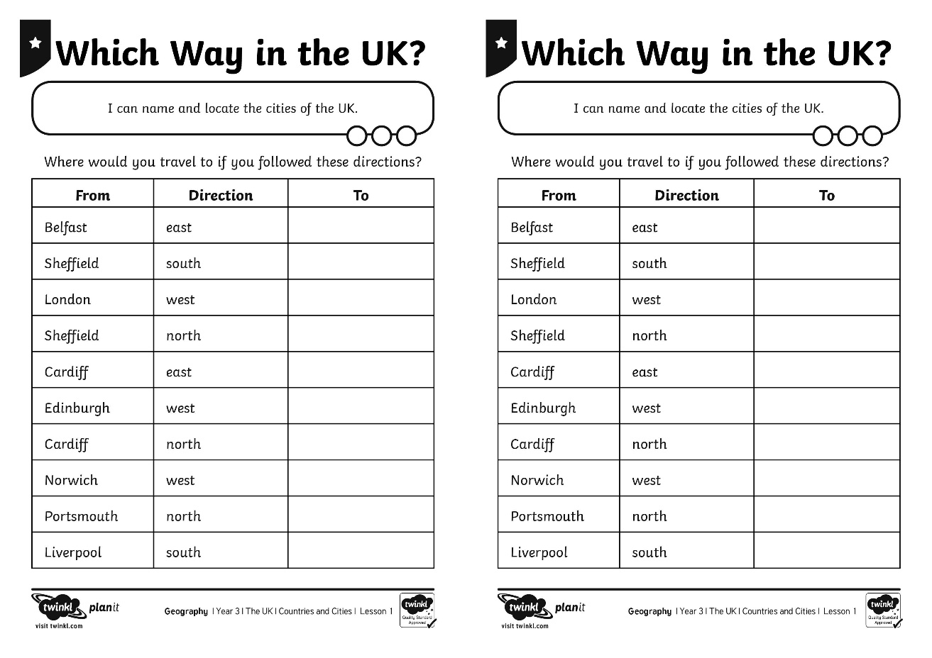
Which Way?
Use your UK Cities map to help you describe the position of different places.

Slide 14
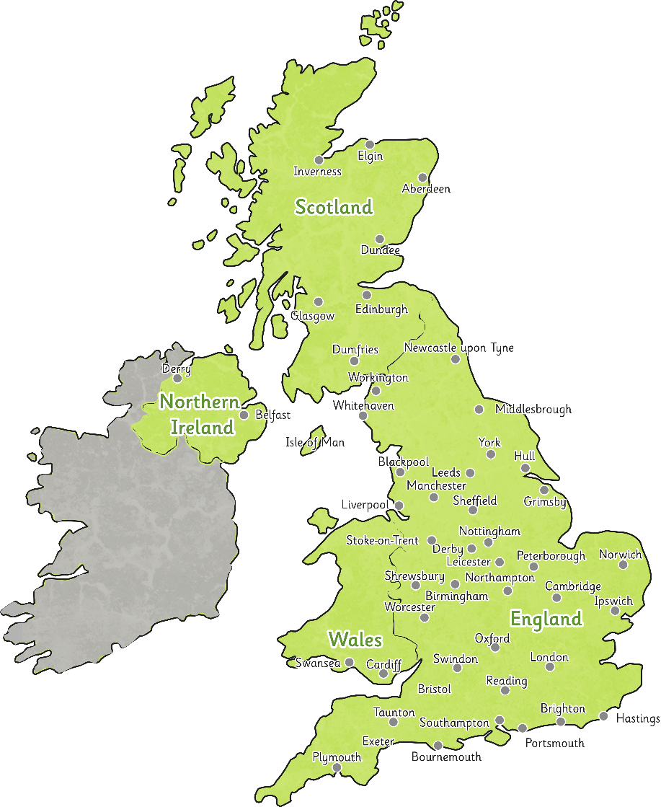
Guess Where I Am
Listen to the clues you are given. Can you guess where I am?

Slide 15
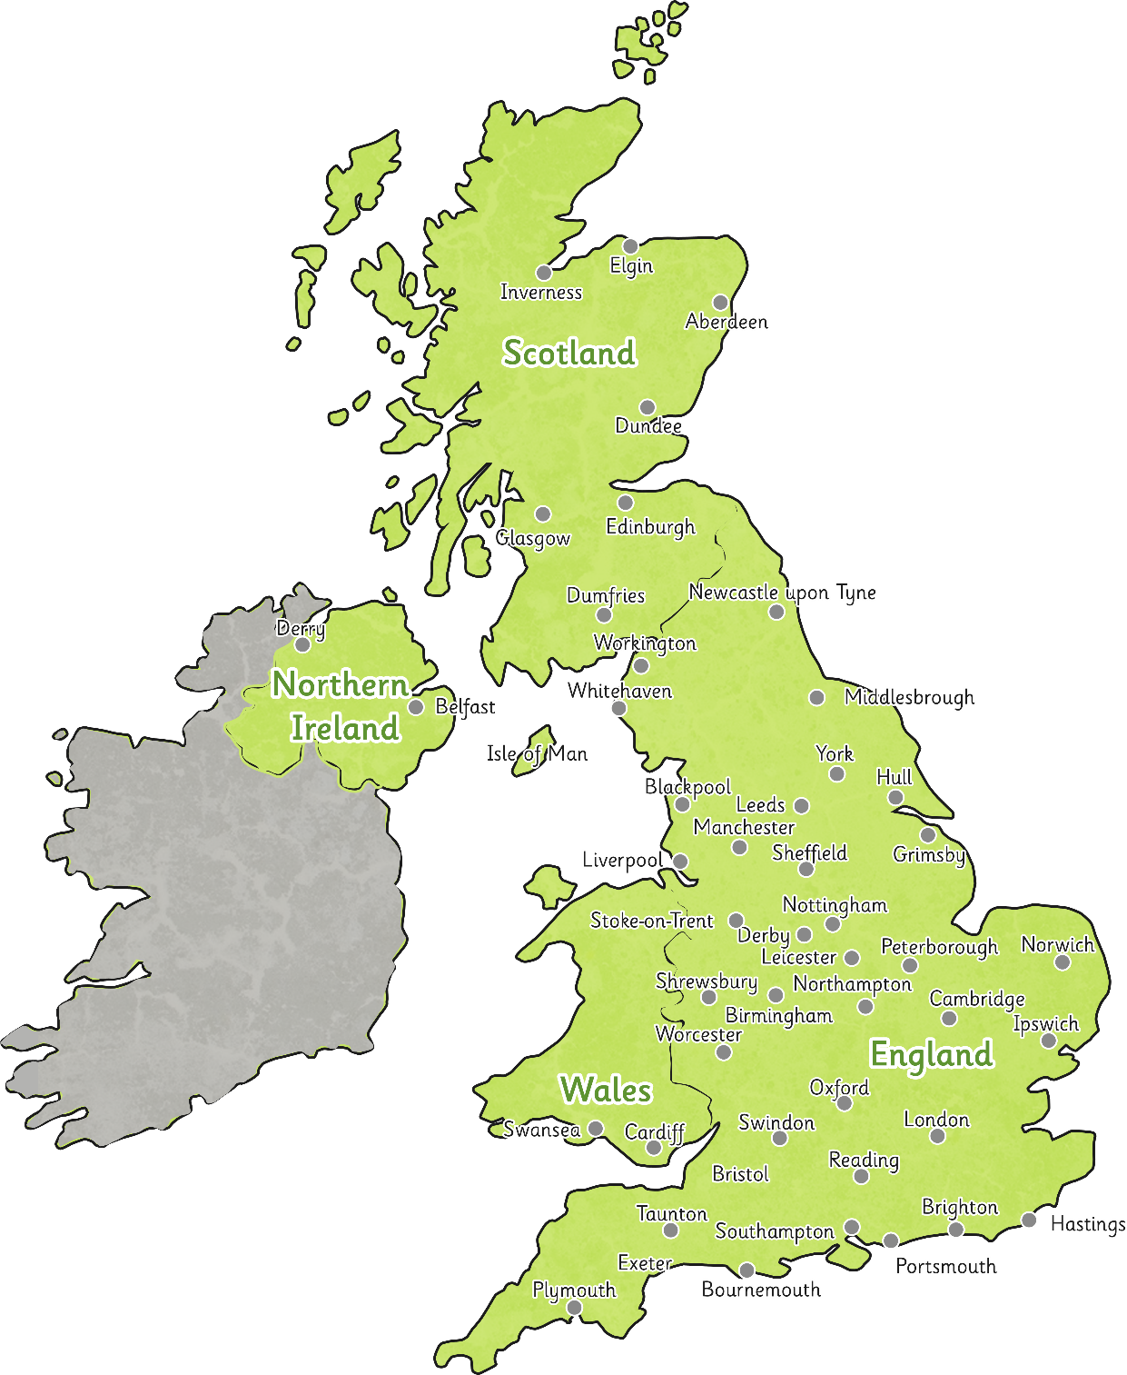
Back

Slide 16
Aim
I can name and locate the countries and cities of the UK.
I can use the eight compass points to describe the location of the countries and cities of the UK.
Success Criteria
I can locate the countries and cities of the UK.
I can name and label the capital cities of the countries of the UK.
I can label key cities in the UK on a map.
I can use the eight compass points to describe a location on the map.
I can use a compass direction to find a location on the map.
I can use the eight compass points to describe a location relative to another place.

